Slide 1

Immigrants in NTA: case of Slovakia
Mgr. Raman Herasimau
SAV EU / FSEV UK
raman.herasiamu@savba.sk
raman.herasimau@fses.uniba.sk

Slide 2
Content
Aims and Research questions;
Milestones of the results;
Motivation;
Methodological approach;
Results and future research

Slide 3
I. Aims and Research questions
Aim: Investigate the effects of aging and immigrants on aggregate life cycle deficit in the Slovak Republic.
Research questions:
1) What is a difference of immigrants and native population life cycle deficit in Slovakia?
2) What are the effects of immigration on the support ratio and the fiscal support ratio in Slovakia?

Slide 4
Content
Aims and Research questions;
Milestones of the results;
Motivation;
Methodological approach;
Results and future research

Slide 5
II. Milestones of the results
Immigrants have younger population pyramid;
Immigrants in Slovakia consume less than natives;
Larger share of immigrants occupy low-paid job;
Average immigrant of age group 25-65 works ~8.2 months;
Net flow of remittance is negative;
Immigrants decrease life-cycle deficit;
Immigrants increase net transfer flow;

Slide 6
Content
Aims and Research questions;
Milestones of the results;
Motivation;
Methodological approach;
Results and future research.

Slide 7
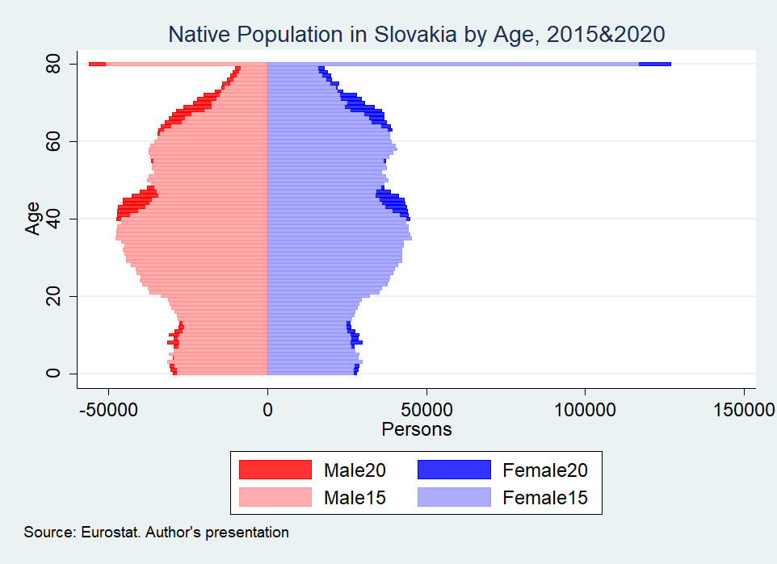
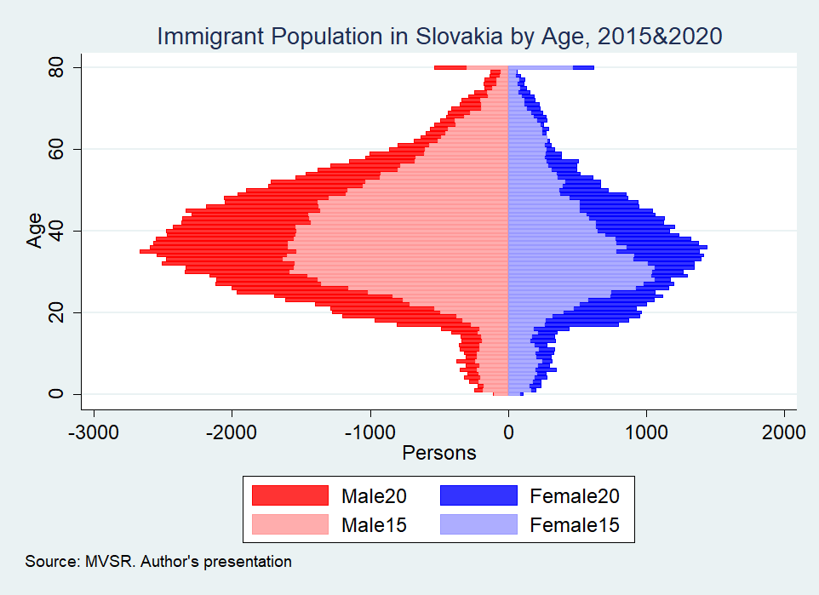
III. Motivation

Slide 8
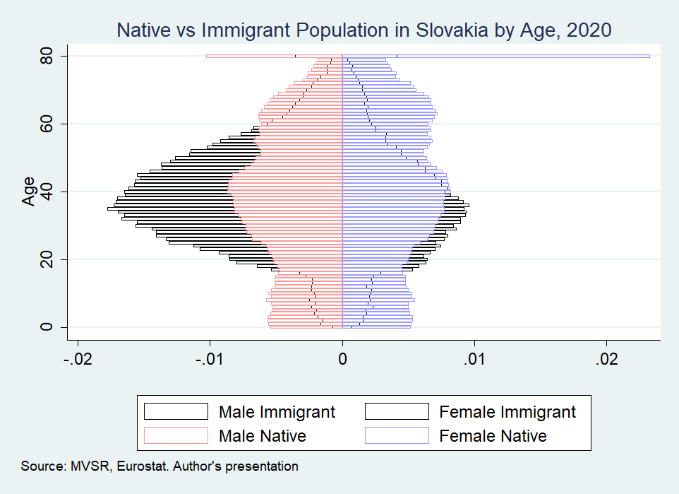
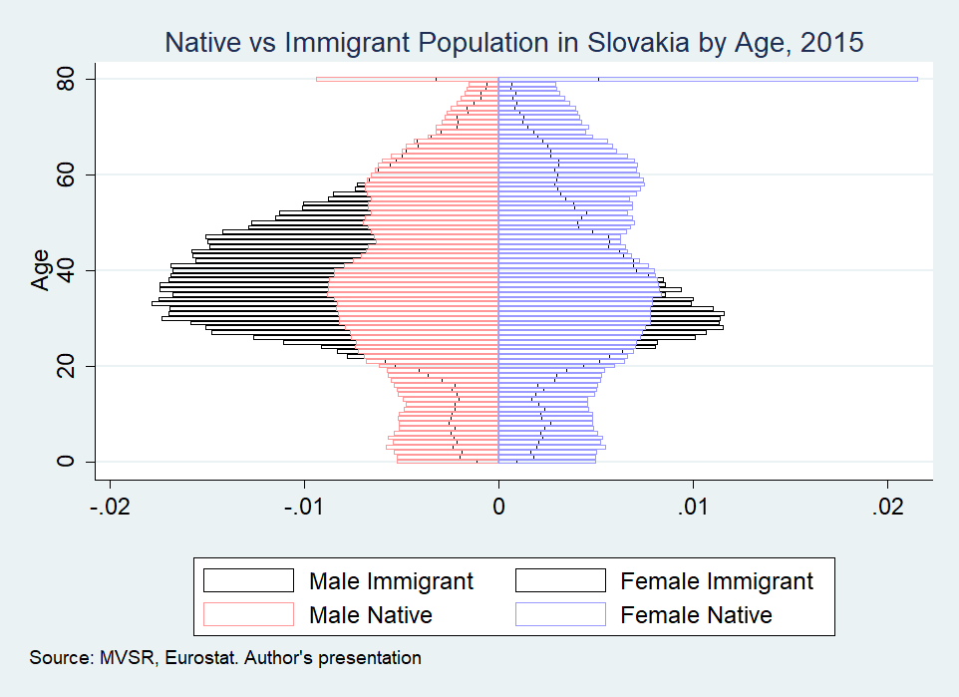
III. Motivation

Slide 9
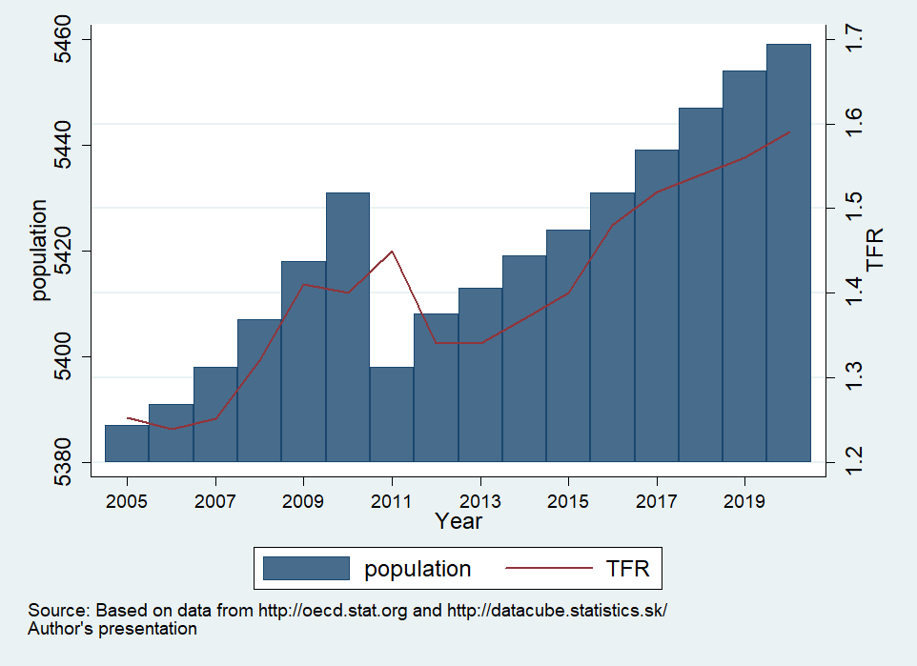
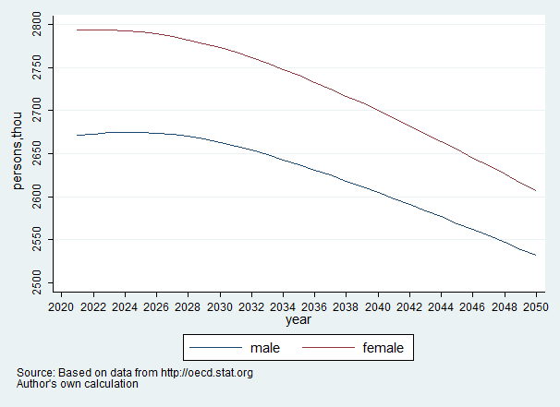
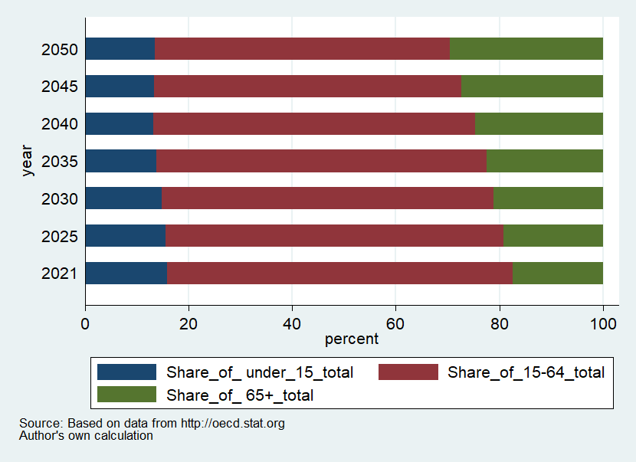
III. Motivation

Slide 10
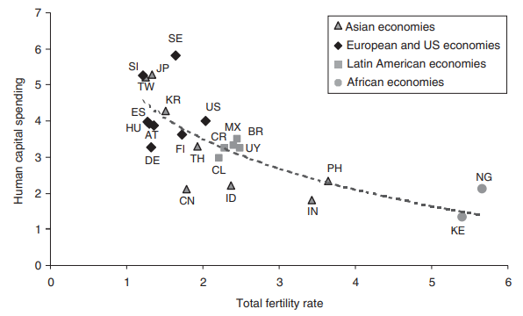
III. Motivation
Source: Lee R., Mason A., 2011, p. 19.

Slide 11
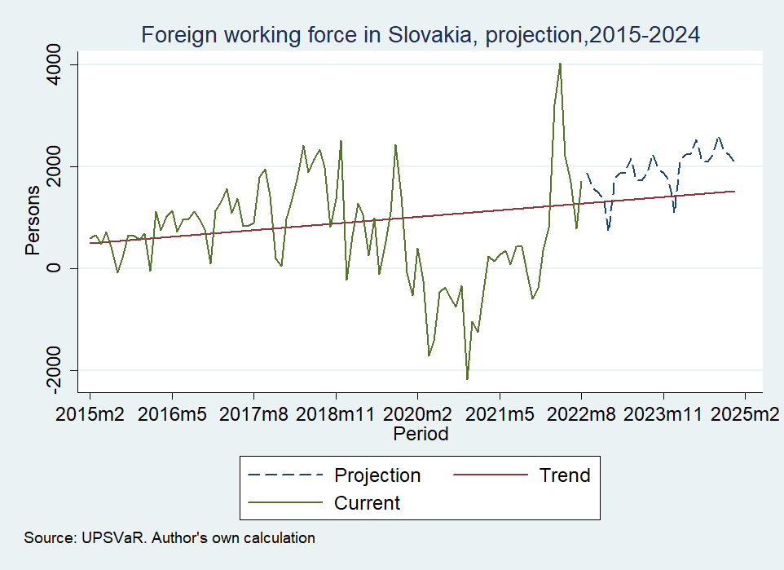
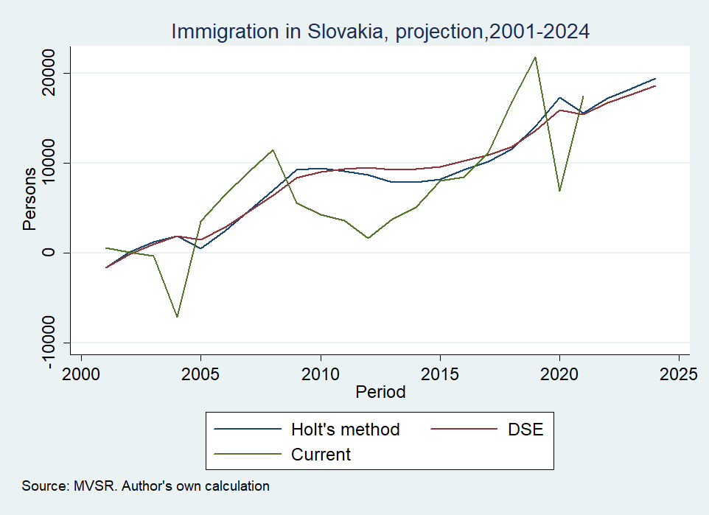
III. Motivation

Slide 12
Content
Aims and Research questions;
Milestones of the results;
Motivation;
Methodological approach;
Results and future research

Slide 13
IV. Methodological approach
National transfer accounts (NTA) specify the system of national accounts in terms of generational allocation of resources;
NTAs are called to improve understanding of how population age structure influence the economic growth, gender and generational equity, public finance, and give opportunity to calculate additional synthetic cohort estimates;

Slide 14
IV. Methodological approach
Macrocontrols (macro level);
Age-profiles (micro level);
  The Life Cycle Account (LCA)
    Consumption
    Income
  The Transfer Account (TA)
    Public transfers
    Private transfers
  The Asset base reallocation Account (ABR)
    Public ABR
    Private ABR
System of national accounts (SNA);
Demography;
Synthetic cohort estimates
  Support ratio (SR);
  Fiscal support ratio (FSR)

Slide 15
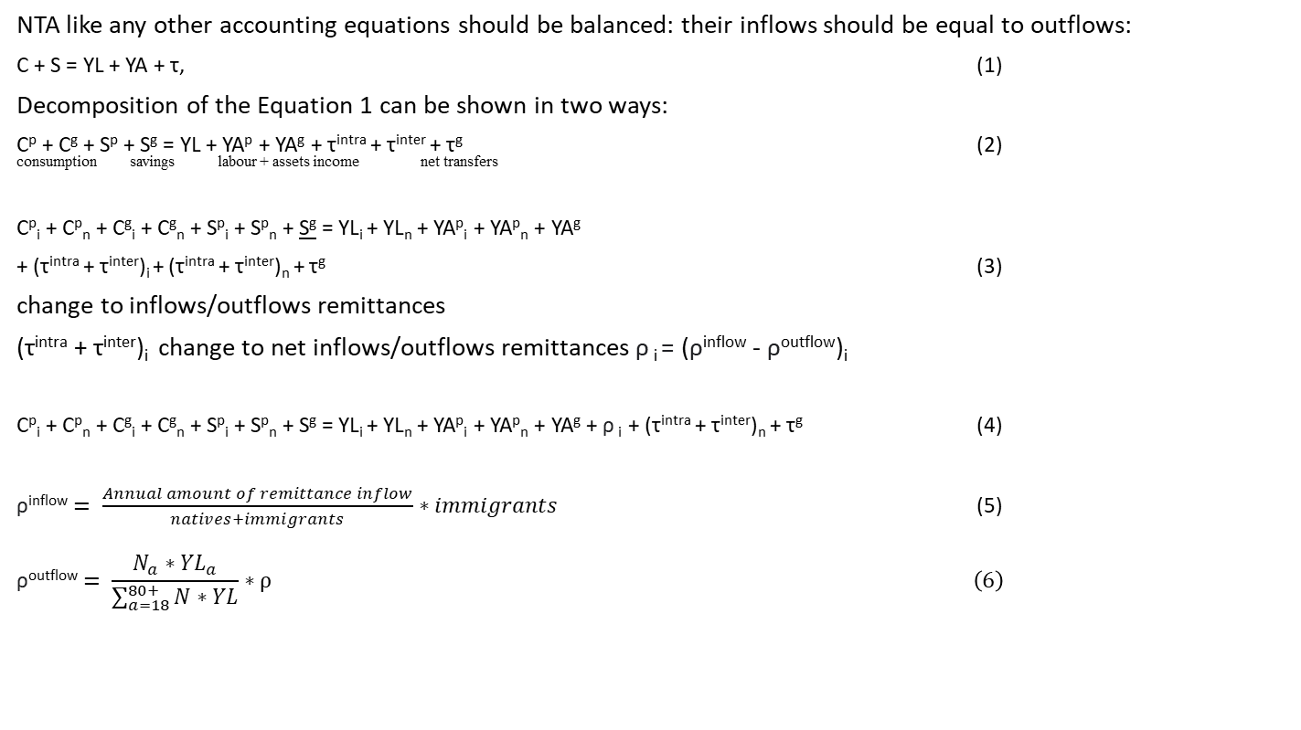
IV. Methodological approach
NTA like any other accounting equations should be balanced: their inflows should be equal to outflows:
C + S = YL + YA + τ, (1)
Decomposition of the Equation 1 can be shown in two ways:
C^{p} + C^{g} + S^{p} + S^{g} = YL + YA^{p} + YA^{g} + τ^{intra} + τ^{inter} + τ^{g} (2) consumption savings labour + assets income net transfers
C^{p}_{i} + C^{p}_{n} + C^{g}_{i} + C^{g}_{n} + S^{p}_{i} + S^{p}_{n} + S^{g} = YL_{i} + YL_{n} + YA^{p}_{i} + YA^{p}_{n} + YA^{g}
+ (τ^{intra} + τ^{inter})_{i} + (τ^{intra} + τ^{inter})_{n} + τ^{g} (3)
change to inflows/outflows remittances
(τ^{intra} + τ^{inter})_{i} change to net inflows/outflows remittances ρ _{i} = (ρ^{inflow} - ρ^{outflow})_{i}
C^{p}_{i} + C^{p}_{n} + C^{g}_{i} + C^{g}_{n} + S^{p}_{i} + S^{p}_{n} + S^{g} = YL_{i} + YL_{n} + YA^{p}_{i} + YA^{p}_{n} + YA^{g} + ρ _{i} + (τ^{intra} + τ^{inter})_{n} + τ^{g} (4)
$\text{ρ}\text{inflow}= \frac{Annual amount of remittance inflow}{natives+immigrants}∗immigrants$ (5)
$$\text{ρ}\text{outflow}= \frac{N_{a}∗{YL}_{a}}{\sum_{a=18}^{80+}{N∗YL}}∗ρ \left(6\right)$$

Slide 16
IV. Methodological approach
The first step is to derive macro controls for each economic activity from the SNA;
The second step is to calculate the age-specific averages of different economic categories;
  Calculate the age-specific averages for immigrants;
  Aggregation natives’ and immigrants’ the age-specific averages;
The third step is to eliminate random variations using smoothing procedure, due to random sampling of the survey;
The fourth step is a proportional age-profile adjustment to macro controls;
The fifth step is synthetic cohort estimates calculation (added value)

Slide 17
IV. Methodological approach
Account | 2015 | 2016 | 2017 | 2018 | 2019 | 2020
LCD | 12 312 | 12 258 | 12 009 | 12 100 | 5 620 | 15 694
Consumption | 49 988 | 51 879 | 54 538 | 57 812 | 61 221 | 63 749
Private | 35 125 | 36 549 | 38 555 | 41 114 | 42 754 | 43 987
Public | 14 863 | 15 330 | 15 983 | 16 698 | 18 467 | 19 762
Labor Income(-) | 37 676 | 39 621 | 42 529 | 45 712 | 48 374 | 48 055
Transfers | 49 | -816 | -703 | -594 | -894 | 869
Private | -962 | -1 164 | -1 100 | -926 | -893 | 301
Public | 1 011 | 348 | 397 | 332 | -1 | 568
ABR | 12 263 | 13 098 | 12 728 | 12 713 | -10 603 | 14 844
Private ABR | 12 700 | 12 536 | 13 088 | 13254 | -9 752 | 11 514
Private income on assets | 18 863 | 17 527 | 17 118 | 17 998 | 10 471 | 16 875
Private savings(-) | 6 163 | 4 991 | 4 030 | 4 744 | 20 223 | 5 361
Public ABR | -437 | 562 | -360 | -541 | -851 | 3 330
Public income on assets | -664 | -645 | -493 | -419 | 1 074 | -465
Public savings(-) | -227 | -1 207 | -133 | 122 | 1 925 | -3 795
Source: EUROSTAT, author’s own calculation

Slide 18
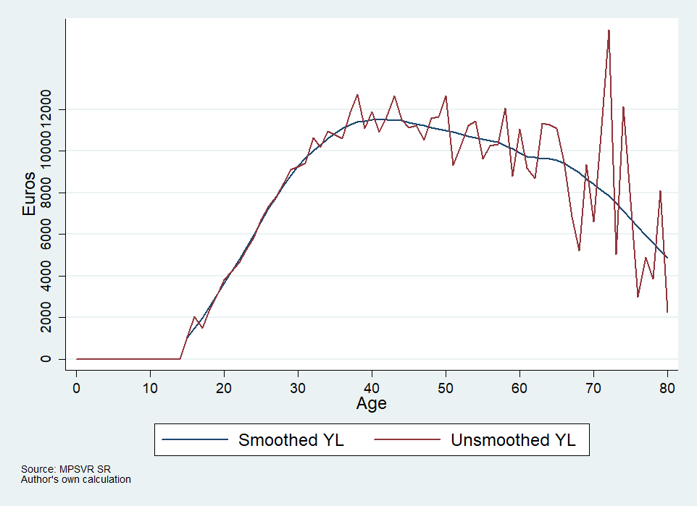
IV. Methodological approach
Age profiles of Labor income, earnings and self-employment income for natives, Slovakia, 2015
Labor income of immigrants, Slovakia, 2015
Age profiles of Labor income of natives and labor income distribution of immigrants, Slovakia, 2015

Slide 19
IV. Methodological approach
 | Early childhood education | Primary education | Lower secondary education | Upper secondary education | Post-secondary non-tertiary education | Short-cycle tertiary education | Bachelor’s or equivalent level | Master’s or equivalent level | Doctoral or equivalent leve
Expenditures, mln. € | 398,52 | 678,26 | 719,13 | 724,75 | 76,06 | 15,38 | 951,97 | 666,2 | 47,44
Number of students | 161 906 | 216 266 | 253 671 | 200 361 | 15 326 | 2 847 | 172 472 | 120 676 | 9 071
Cost per capita, € | 2 384 | 3 244 | 2 708 | 3 515 | 2 301 | 3 344 | 3 599 | 3 599 | 3 599
Age profiles of public education consumption, Slovakia, 2015

Slide 20
IV. Methodological approach
Age profiles of public consumption, Slovakia, 2015

Slide 21
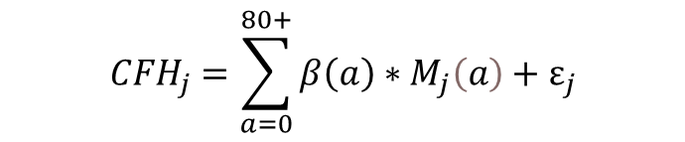
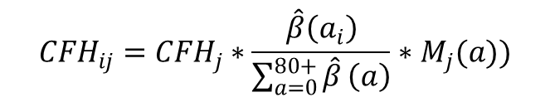
IV. Methodological approach
Age profiles of private education, Slovakia, 2015
$${CFH}_{j}=\sum_{a=0}^{80+}{β\left(a\right)}∗M_{j}\left(a\right)+ε_{j}$$
$${CFH}_{ij}={CFH}_{j}∗\frac{\hat{β}\left(a_{i}\right)}{\sum_{a=0}^{80+}{\hat{β}}\left(a\right)}∗M_{j}(a))$$

Slide 22
IV. Methodological approach
Age profile of private health consumption, Slovakia, 2015
Age profile of Other private consumption, Slovakia, 2015

Slide 23
IV. Methodological approach
Age profiles of old-age benefits, Slovakia, 2015
Age profiles of the family and children related allowances, Slovakia, 2015

Slide 24
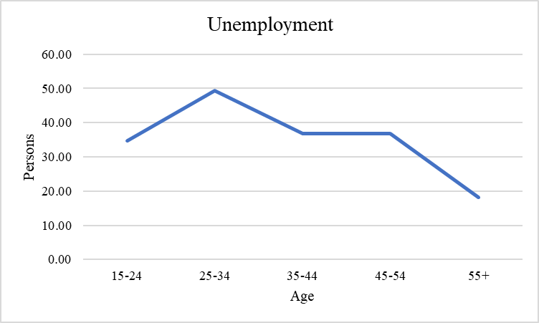
IV. Methodological approach
Age profiles of unemployment allowance, Slovakia, 2015

Slide 25
IV. Methodological approach
Remittance flows, Slovakia, 2015
Age profiles of remittances age profiles, Slovakia, 2015
Total remittance inflow, € | 2,435,293,773.00
Total remittance inflow for immigrants | 40,368,772.32
Total remittance outflow, € | 216,204,084.74
Net remittance, € | -175,835,312.42
Average per capita remittance outflow, € | 3,750.6
Average per capita remittance inflow, € | 441.41
Average share of income, % | 6%
Source: World bank, MPSVR SR; Authors’ own calculations.

Slide 26
IV. Methodological approach
Age profiles of Intra-household inflows and outflows, Slovakia, 2015
Age profiles of interhousehold transfers, Slovakia, 2015

Slide 27
Content
Aims and Research questions;
Milestones of the results;
Motivation;
Methodological approach;
Results and future research.

Slide 28
V. Results and future research
Reconciliation datasets of MV SR and MPSVR SR, Slovakia, 2015
Transfer flows of immigrants per capita, Slovakia, 2015
 | MV SR | MPSVR SR | Adjustments | Reconciled
Total population | 91456 | - | 0 | 91456
Foreign workers | 66765 | 52675 | -14090 | 52675
Students | 13612 | - | -11263 | 2349
Non-workers | 11079 | - | +25353 | 36432
Source: MV SR, MPSVR SR; Authors’ own calculations
Life cycle deficit of immigrants per capita, Slovakia, 2015

Slide 29
V. Results and future research
Life cycle deficit of natives per capita, Slovakia, 2015
Public and Private transfers, Asset-based reallocation per capita, Slovakia, 2015

Slide 30
V. Results and future research
Comparison of immigrant’s and native’s LCD per capita, Slovakia, 2015

Slide 31
V. Results and future research
Aggregated LCD with and without immigrants, Slovakia, 2015
Aggregate transfers with and without immigrants, Slovakia, 2015

Slide 32
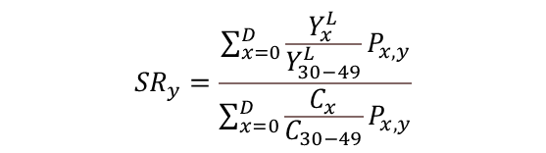
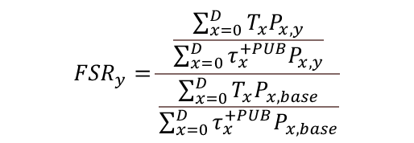
V. Results and future research
$${SR}_{y}=\frac{\sum_{x=0}^{D}{\frac{Y_{x}^{L}}{Y_{30−49}^{L}}P_{x,y}}}{\sum_{x=0}^{D}{\frac{C_{x}}{C_{30−49}}P_{x,y}}}$$
$${FSR}_{y}=\frac{\frac{\sum_{x=0}^{D}{T_{x}P_{x,y}}}{\sum_{x=0}^{D}{{τ_{x}^{+PUB}P}_{x,y}}}}{\frac{\sum_{x=0}^{D}{T_{x}P_{x,base}}}{\sum_{x=0}^{D}{{τ_{x}^{+PUB}P}_{x,base}}}}$$
Support ratio and Fiscal support ratio, Slovakia, 2015
 | SR_im | FSR_im | SR | FSR
2015 | 0.478561 | 1.000000 | 0.551963 | 1.000000
2016 | 0.478379 | 0.999970 | 0.551899 | 1.000141
2017 | 0.478748 | 0.997678 | 0.548809 | 0.989495
2018 | 0.479261 | 0.995023 | 0.545521 | 0.978895
2019 | 0.480114 | 0.991041 | 0.541984 | 0.968182
2020 | 0.48035 | 0.989427 | 0.538127 | 0.957178
Source: Authors’ own calculations

Slide 33
V. Results and future research
Labor income need to be detailed;
With current stage of EU SILC and HBS development ABR account for immigrant can’t be built properly;
Calculation of remittance inflow can be improved;
Transfer account can be improved via additional administrative data collection;
Almost 42% of immigrants are out of research;

Slide 34
Thank you for your attention

