Slide 1
Evaluating the welfare costs of the COVID-19 -pandemic in Finland with an AGE model of with Intergenerational Accounting
Juha Honkatukia
Research manager, Adjunct Professor
THL – National Institute for Welfare and Health
Risto Vaittinen
Senior economist, The Finnish Pension Alliance TELA.
Risto passed away in September, 2022

Slide 2
Background
Finland responded to the pandemic with extensive restrictions on the economy
Mortality in 2020 – 2021 was remarkably low
The aggregate effects of these measures on the economy were largely temporary
However, government debt as share of GDP rose by 10+ percentage points, leading to debate on cost cuts
Here, we focus on the effects on inter-generational income distribution
The effects of the pandemic are modelled with an AGE model (the FINAGE model)

Slide 3
Background
Finnish health, social care expenditures are almost entirely publicly funded.
Income transfers and national pensions also covered from public coffers (but work-related pensions covered from pension funds)
Assessing the welfare effects of publicly provided health and social care services and income transfers necessitates the use of register data
Data for care sector cost and employment forecast bases on registers kept by National Institute for Health and Welfare
Income transfers covered by National Transfer Accounts

Slide 4
What is driving increasing public health expenditure in Finland
High unit costs per person for older people
The ageing of the population

Slide 5
Old Age Dependency Ratio (65+/15-64)

Slide 6
Total public health expenditures in Finland
(based on NIHW HILMO register data)

Slide 7
Unit Costs of Health Care by Age

Slide 8
Ageing of the Finnish population

Slide 9
Decomposition of Growth in Health Expenditure Between 2015 and 2040

Slide 10
Earnings-related pensions
Statutory
  Benefit determination (broadly) uniform in different sectors and occupations
  Accrual of pension rights 1.5% of annual wage income
  Entitlements fully transferable
Defined Benefit, but
  Full-career based accrual (not final salary based)
  Gradually moving eligibilliy age for old age pensions
    2018- 2029 increases from 63 to 65 by 3 months in a year
    From 2030 on tied to life expectancy at age on 65
  Generation specific life-expectancy adjustment of benefit level
Included in general government in national accounts
  Expenditures 12% relative to GDP
  Contributions 9 % relative to GDP
Partly funded (providers run the PAYG part integrated)
  Private sector: insurance providers liable for the funded part, national risk-based solvency regulation
  Public sector: buffer funds

Slide 11
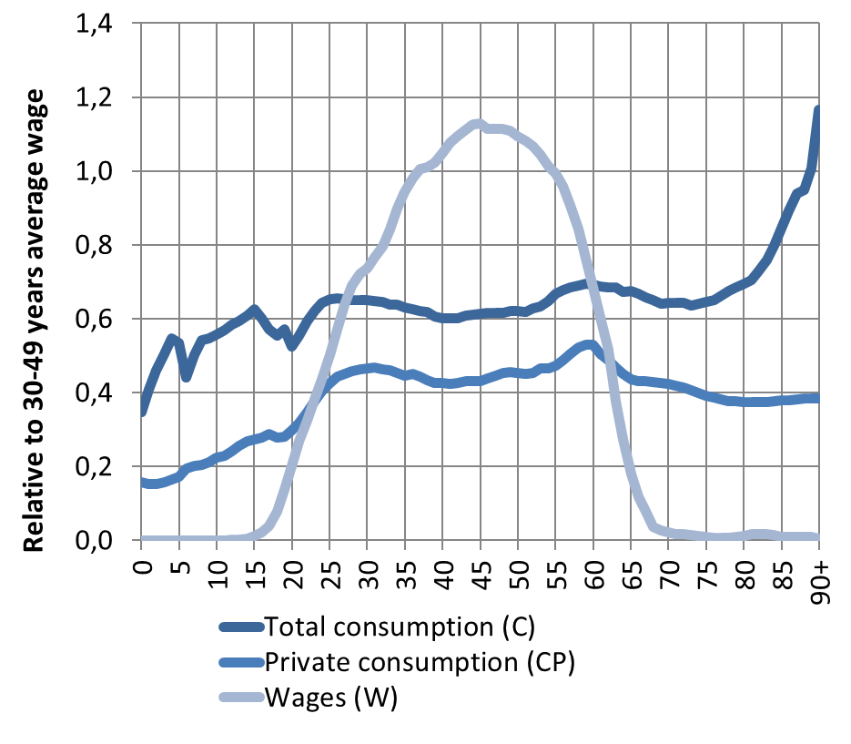
National Transfers Accounts (NTA): Finland 2017
Consumption and Wages by Age
NTA methodology
NTA goes beyond national accounts in two important new ways.
  breaks down national accounts by age.
  estimates transfers within families and households, between households, and through the public sector.
Based on existing surveys on private consumption, wages and administrative data on public consumption
National Transfer Accounts Manual: Measuring and Analysing the Generational Economy, UN Population Division, 2013

Slide 12
GDP-share of welfare services and transfers is projected to increase – is it sustainable?

Slide 13
Integrating expenditure projections for health in a computable general equilibrium model
FINAGE/REFINAGE – dynamic, AGE model for Finland
Aggregation for CPA 12 level of comodities and 11 Industries
Public demand and income transfers at existing tiers:
  Central govt, municipalities, counties
  Pension and social security funds
Population by age, each cohort a neoclassical utility maximizer
Current goal: calibration to AWG and NIHW projections
Outcomes: links to macroeconomy, fiscal sustainability, intergenerational economic welfare measures -> policy analyses

Slide 14
FINAGE-HEALTH extension
1) Reallocation of free public services from govt final consumption to households
2) households’ problem: in each region hhold chooses health & non-health consumption to maximize utility subject to budget constraint.

Slide 15
Modelling the pandemic and after
Domestic restrictions on the economy accounted for about half the effects on the economy, affecting especially service sectors and trade
The other half stemmed from a fall in exports, affecting mainly export industries
We modelled the impacts as temporary shocks that did not immediately affect capacity
The approach picks up the effect that recovery was rapid (until the war), but govt debt is becoming an issue
Private consumption was not much affected because of govt policies - but there were distributional effects due to impact on labour markets
If spending cuts after 2023, more distributional effects to be expected – how do they accrue (1 billion a year)?

Slide 16
Effects of the pandemic

Slide 18
Effects of the pandemic by gender

Slide 22
Effects of the pandemic on income distribution compared to baseline

Slide 23
Effects of the pandemic on income distribution compared to baseline

Slide 24
Conclusions
The pandemic had many effects that can only be analysed with the help of micro data and also NTA
Finland weathered the pandemic quite well economically
Effects on households were also rather small, because of govt intervention – but at the cost of increasing debt
There were diffirences btw effects on men and women, stemming from differences in labour force structure btw sectors
At the time of writing (2022), it was already clear that future governments would try to tackle the debt problem
We also addressed the distributional effects of spending cuts in health care: the youngest and oldest cohorts lose while working-age cohorts gain on impact

