Slide 1
Sustainable Consumption in an Aging World
Andrew Mason
Building Sustainable Generational Economies: The 14th Global Meeting of the NTA Network, University of Paris - Dauphine, February 14-17, 2023

Slide 2
Reform pensions?
“More than ever, we need to remind our Members of Congress that Americans 50+ voted them into the very seats they occupy today. The AARP community is nearly 38 million strong, our voices are powerful, and we don’t back down from a fight — especially when it comes to saving Social Security.” - AARP (American Association for Retired People)
Email message from AARP advocacy on Jan 21, 2023.

Slide 3
Work longer?
On January 19, 2023 over 1 million French protest against raising the retirement age from 62 to 64.
Place de la Republique, Paris (AP photo/Lewis Joly)

Slide 4
Introduction
Two issues
Are current levels of consumption sustainable in light of population aging around the world?
What policies might be pursued to increase sustainable consumption?
Method for addressing the issues
NTA data on consumption and labor income
Demographic data from UN World Population Prospects
Simulation model

Slide 5
Model Features
Steady state analysis that emphasizes the long-run and deemphasizes dynamics
Fertility and mortality are exogenous; no immigration
Reallocations systems are different for children and seniors
Interest rates respond to changes in population growth
Consumption profile shifts to achieve sustainability
Sustainability is assessed using the lifecycle profile of wealth

Slide 6
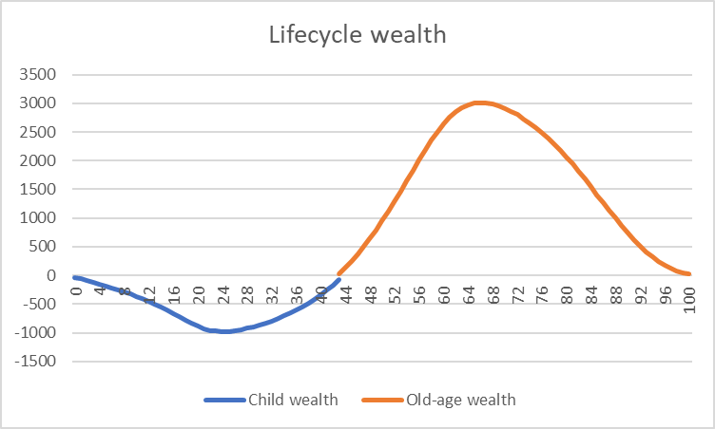
Sustainable wealth profile for Japan
Wealth consists of assets plus transfer wealth. Lee and Mason, Population Aging and the Generational Economy; UN NTA Manual.
Survival weighted per capita longitudinal values
Accumulating child debt
Paying off child debt
Based on work by Lee and by Willis.

Slide 7
Sustainable wealth profile for Japan
Survival weighted per capita longitudinal values
Drawing down wealth
Accumulating pension wealth

Slide 8
Solving for consumption level to achieve sustainable lifecycle wealth
Age of shift in lifecycle phases is endogenous
Initial wealth is zero
Final wealth is zero
Discount rate is biological rate
Discount rate is weighted average of biological rate and market rate
Biological rate is rate of population growth plus rate of productivity growth (Samuelson 1958.)

Slide 9
Illustration of Model: Application to Japan
Following questions are addressed:
Is current level of consumption sustainable?
How will sustainable consumption be affected by
Increase in life expectancy?
Increase in fertility?
Greater reliance on funded program rather than transfers to support old-age needs

Slide 10
Application to Japan Assumptions for baseline calculations
Exogenous factors | Japan Baseline value | Source
Constant TFR | 1.29 | WPP estimate for 2019
Constant population growth rate | -1.6% | Calculated from TFR with generation length of 30 years.
Constant mortality | e0 = 85.6; e60 = 27.6 | WPP Projections for 2025
Child transfer share | 100% | Used for all countries
Old-age transfer share | 49.8% | Japan estimates from Lee and Mason 2018
Consumption and labor income profiles | See figures | Japan NTA 2014 estimates from Ogawa and Matsukura
Productivity growth rates | 1.5% | Used for all countries

Slide 11
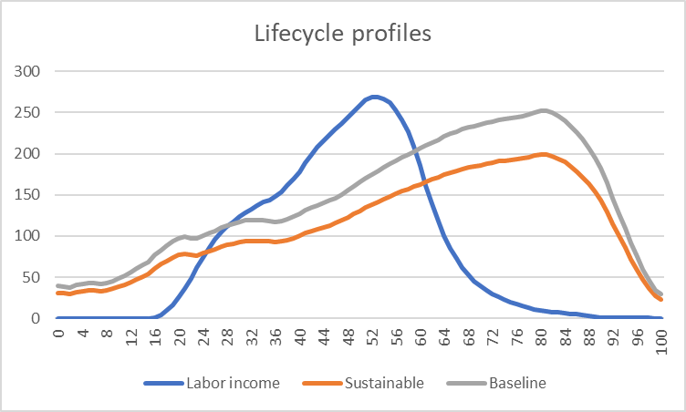
Observed vs sustainable consumption, Japan
Survival weighted, per capita consumption for a cohort (based on 2014 values)
Survival weighted, per capita labor income for the cohort (based on 2014 NTA)
Sustainble survival weighted, per capita consumption is 79% of observed values.

Slide 12
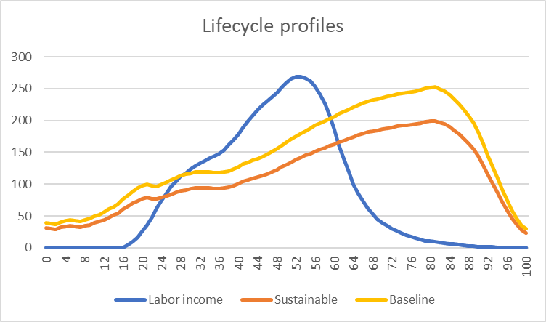
Baseline vs sustainable consumption, Japan
Survival weighted, per capita labor income for the cohort (based on 2014 NTA)

Slide 13
Baseline vs sustainable consumption, Japan
Survival weighted, per capita consumption for cohort (based on 2014 NTA)

Slide 14
Baseline vs sustainable consumption, Japan
Sustainble survival weighted, per capita consumption is 79% of baseline values.

Slide 15
Affect on Sustainable Consumption of
Longer life expectancy
Higher fertility
Greater reliance on funded old-age reallocations?

Slide 16
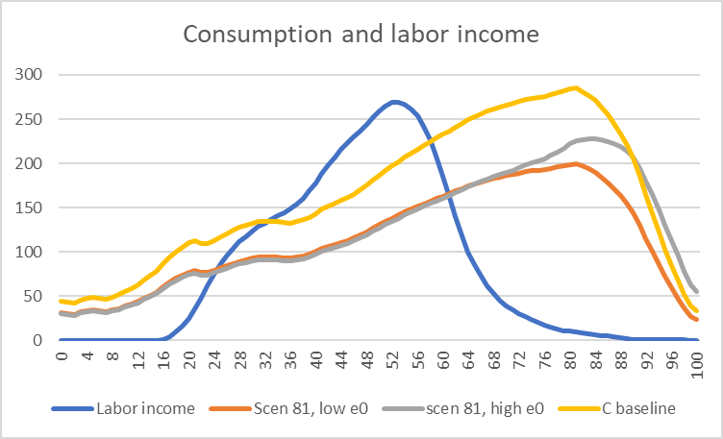
Effects of higher life expectancy 2025 (e0 = 85.6; e60 = 27.6) vs 2065 (e0 = 90.4; e60 = 31.5)
At most ages survival weighted consumption declines from 79% to 76% of baseline
At older ages survival weighted consumption rises

Slide 17
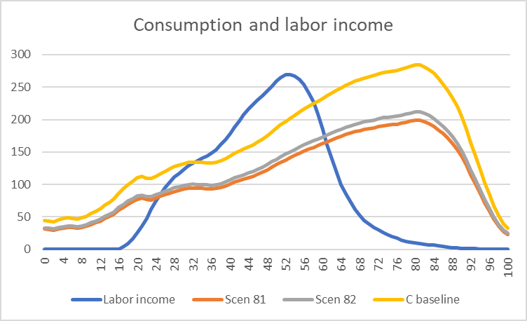
Baseline consumption and sustainable consumption given TFRs of 1.29 or 1.75
Higher fertility: consumption 84% of baseline.
Lower fertility: consumption 79% of baseline.

Slide 18
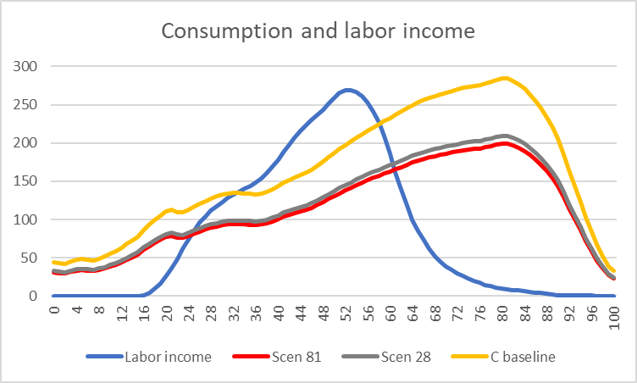
Baseline consumption and sustainable consumption given funded old-age reallocations: 49.8% or 66.7% share
Higher share funded
With increased emphasis on funded old-age reallocations, consumption would rise to 83% as compared with 79% of baseline.

Slide 19
Summary of application to Japan
Is current level of consumption sustainable? | No. Sustainable consumption is only 79% of current consumption.
How will sustainable consumption be affected by:
Increases in life expectancy? Projected increase over the next 40 years. | Small effect on those below age 70. Survival-weighted consumption will be much higher for the very old
Increase in fertility? Rise in TFR from 1.29 to 1.75 | Increase in sustainable consumption by 5 percentage points.
Greater reliance on funded program rather than transfers to support old-age needs? Increase in funded share from about ½ to 2/3. | Increase in sustainable consumption fy 4 percentage points.

Slide 20
Qualifications
Application is to Japan but the methods are general and can be readily applied to countries with NTA.
Demographic change that leads to aging has favorable effects not addressed in this presentation
Value of a longer life
Improved reproductive health
Second dividend effects (increases in human and physical capital)
Reform often meets considerable resistance

