Slide 1

The effect of educational expansion and family change on the sustainability of public and private transfers
A dynamic microsimulation study using microWELT
Martin Spielauer, Thomas Horvath, Marian Fink, Gemma Abio, Guadalupe Souto, Ció Patxot, and Tanja Istenic
martin.spielauer@wifo.ac.at
NTA 14th Global Meeting
Paris - Feb 2023

Slide 2
Focus
The dynamic microsimulation model microWELT integrating detailed socio-demographic projections with individual accounting of welfare transfers captured in disaggregated NTA data
The effect of education and family change on NTA indicators and on generational accounts

Slide 3
Key goals of microWELT
Providing a tool for comparative analysis of private and public welfare transfers over the life course and between generations
Portable model applicable in many countries
Modeling platform used / extended / adapted for a broad range of applications

Slide 4
Context: International Projects & Funding
Focus NTA/NTTA: 3 H2020 Projects
  Weltransim: NTA by education & family
  WellCare: Care need & supply, NTTA
  SustainWell: modeled NTA, wealth
Comparative labor force projections
  Bertelsmann Foundation: focus health and education
  NBER / US Social Security Administration: EU-US comparison focus health and education; ethnicity

Slide 5
Context: National & Related Projects
Detailed Austrian version
  Economic integration of immigrants & onward migration
  Public health costs by education
  Elderly in the labor force. Longitudinal employment careers accounting for education and health
Related projects
  Statistics Austria: population projections
  Slovenian Institute of Economic Research: DyPenSI Pensions

Slide 6
Key characteristics microWELT
Continuous time interacting population model
Can reproduce existing/official population projections
Implemented in Modgen/openM++
H2020 versions are open source
Fully documented, incl. statistical scripts for parameter generation

Slide 7
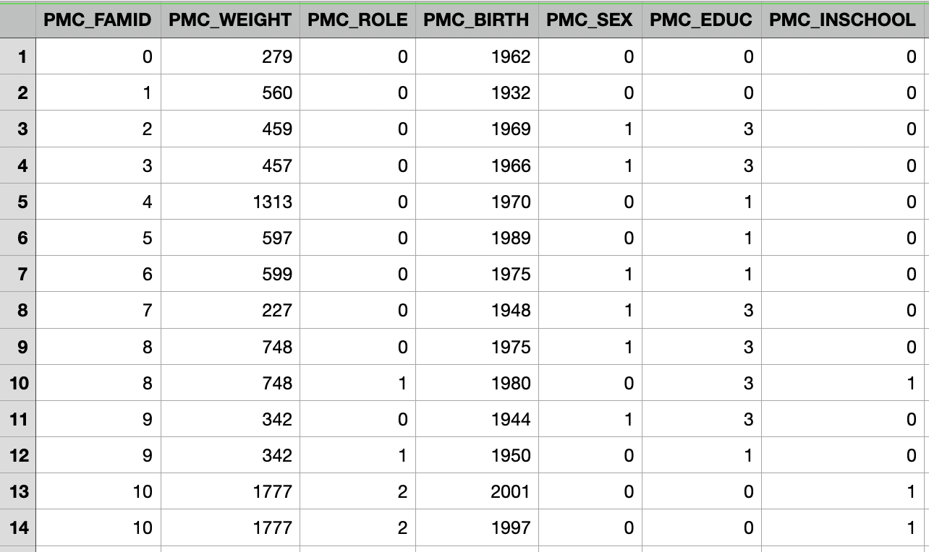
Starting Population
Cross-sectional starting population file generated from EU-SILC/Euromod
Most simple version: Family ID (nuclear family), Sample Weight, Role in Family, YOB, Sex, Education Level, Current School Attendance

Slide 8
Mortality
General goal: reproduce existing (e.g., Eurostat) projections but include mortality differentials by education
  Period life tables
  Published data on remaining life expectancy at 30 and 65 by education
Relative mortality risks calculated and applied in simulation

Slide 9
Fertility
Goal is to simultaneously reproduce given age-specific fertility rates (as Eurostat) while accounting for educational differences in fertility.
﻿﻿Focus on childlessness as key component of concentration of reproduction by education.
Parameters:
﻿﻿Age-specific period fertility rates
﻿﻿Cohort first birth rates by age and education.

Slide 10
Migration
Most simple version: Reproduce age- and sex-specific net migration targets (Eurostat net migration projections).
Emigrants are removed from population, immigrants are cloned from existing population members of same age and sex.
Refinements
Immigration and emigration; by country/region of origin
Characteristics like place of origin, duration of residence, 2nd generation immigrant status used in models for education, labor force behaviors, emigration

Slide 11
Partnerships
Goal: capture typical patterns influenced by welfare state regimes - partnership status by age, education, children, age of youngest child
﻿﻿Female driven. (some rules for males)
﻿﻿Partner matches reproducing observed age and education differences/distributions
Longitudinal consistency for cohorts by education and parenthood

Slide 12
Education
Goals: We try to capture
(1) intergenerational transmission patterns typical for welfare state regime while
(2) being able to reproduce aggregate education projections.
Typical Scenario: future educational change entirely driven by transmission

Slide 13
Disaggregated NTAs
﻿﻿Children (0-16) and students (17-25) by parents education
﻿﻿﻿﻿Non-students (17-25) and adults (up to 59): sex, education, family type by partnership and small/other dependent children in family
﻿﻿Adults 60+: sex, education, family type by partnership and childlessness

Slide 14
NTA Profiles (1)

Slide 15
NTA Profiles (2)

Slide 16
NTA in Simulation
﻿﻿Both aggregated and standard NTA enter as parameters
﻿﻿﻿﻿microWELT calculates and projects a variety of indicators
Individual life-time accounting of income and net transfers
Generational accounts by education and parenthood
Mechanisms to balance budgets (e.g., symmetric reduction of transfers / increases in contributions)

Slide 17
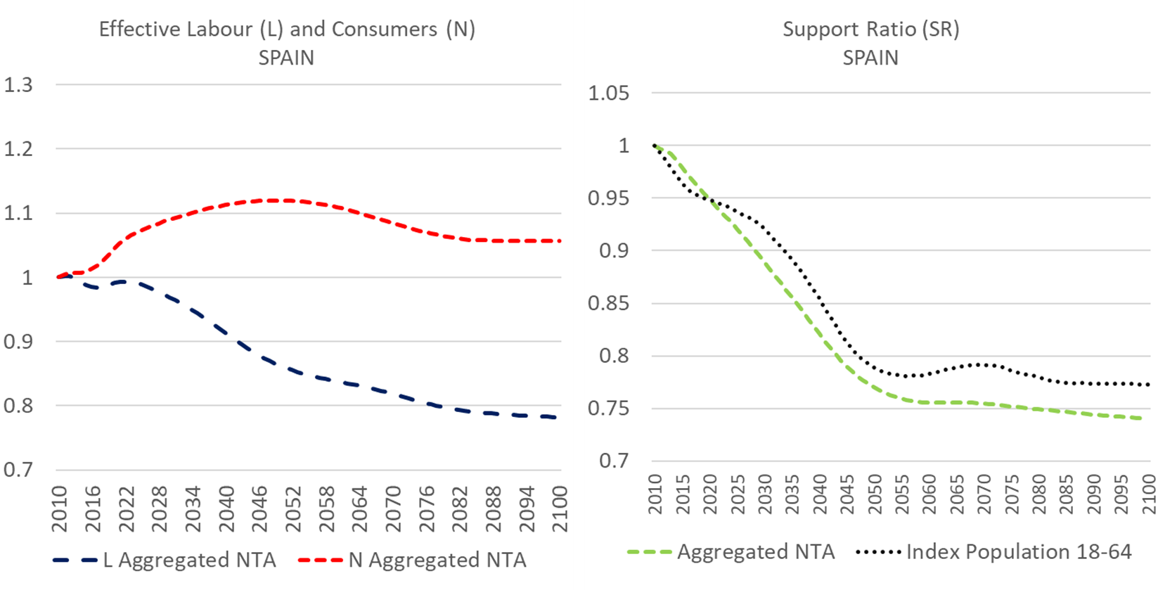
Support Ratios

Slide 18
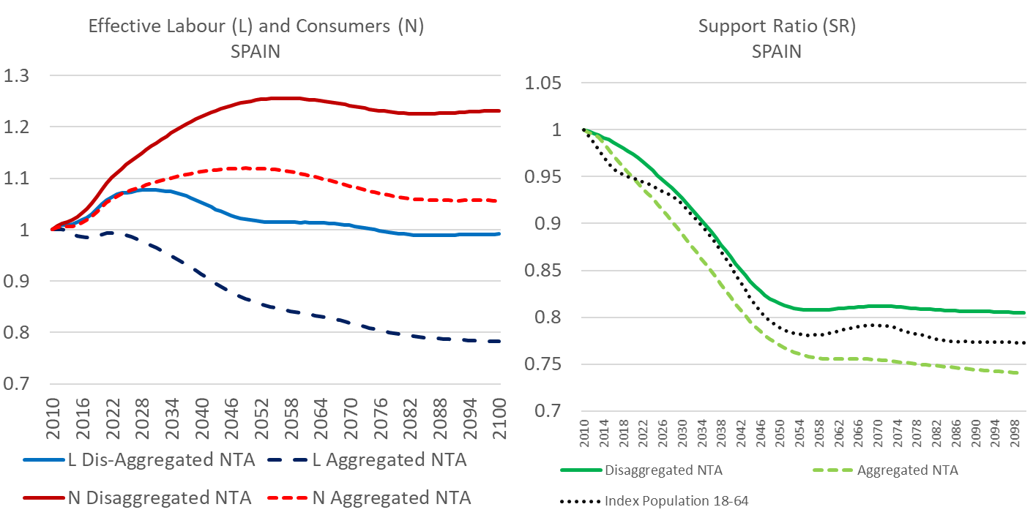
Support Ratios

Slide 19
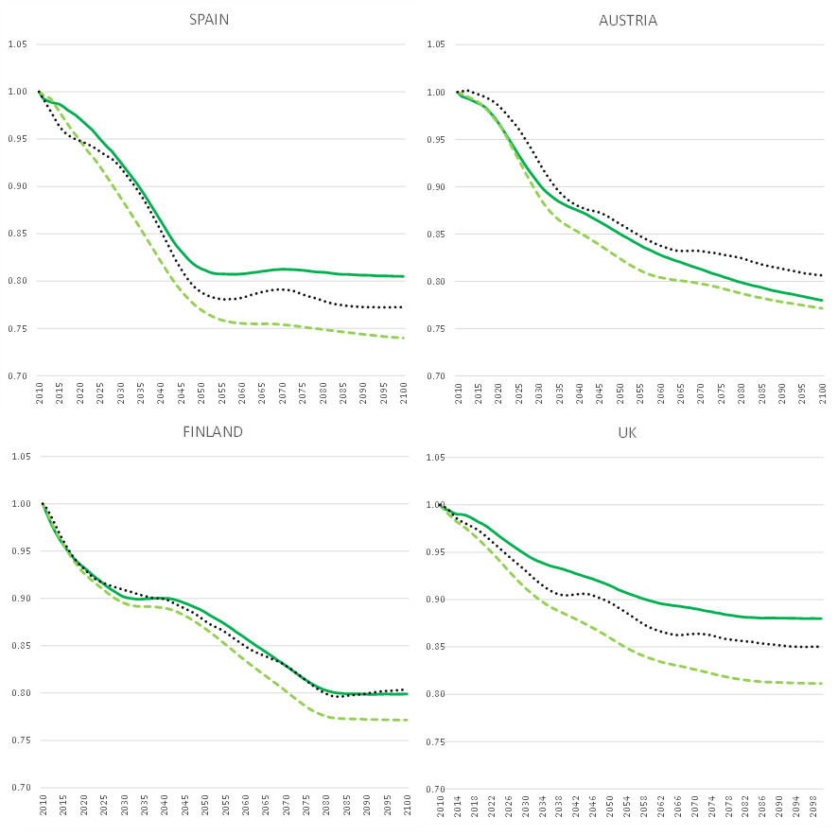
Support Ratios

Slide 20
Generational accounting
Net present value of private and public transfers in relation to the present value of employment income
Scenario: 1.5% Growth, Discount factor 3%, balanced budgets

Slide 21
Generational accounting

Slide 22



Martin Spielauer
martin.spielauer@wifo.ac.at
+43 1 798 26 01 - 246
https://www.wifo.ac.at/martin_spielauer

