Slide 1
Reflections on NTA and Policy
Ronald Lee, University of California at Berkeley
The 15th Global Meeting of the NTA Network
Policy and the Generational Economy
Bangkok, March 10 2025
Thanks to Michael Abrigo, Gretchen Donehower, and all NTA teams.

Slide 2
1. NTA background and history

Slide 3
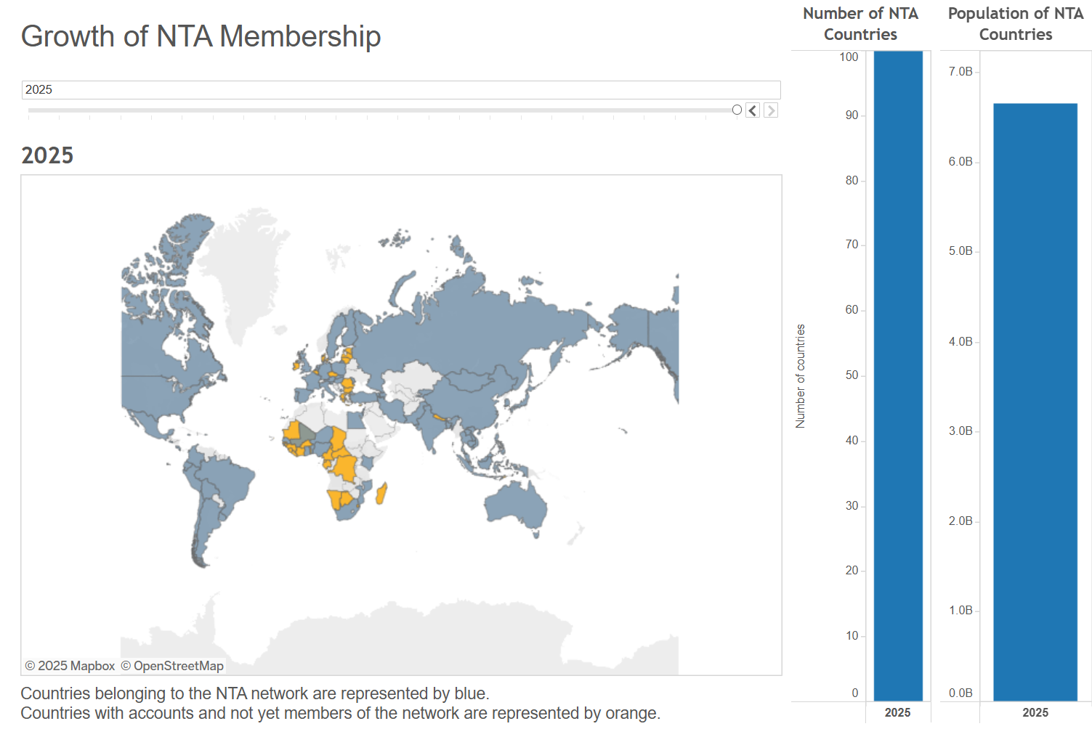
NTA countries
Grey=members
Orange=addit with NTA done.
Beginning
Growth

Slide 4
Now some recent policy applications of NTA and some new ideas for policy uses.

Slide 5
2. Demographic Observatories and Demographic Dividend Sensitive Budgeting
Work by Latif Dramani for African countries
Response to initiative of African Union
Creating Demographic Observatories in many countries
  facilitating evidence-based development planning processes related to demographic dividends
  integrate demographic dividend priorities into sectoral, local and national development plans and actions based on analytical evidence.

Slide 6
3. Gender and time use: Gretchen Donehower will discuss today, Counting Women’s Work and NTTA.

Slide 7
4. Using NTA data to analyze economic impacts of migration on sending and receiving countries (Workshop here).
Great interest for sending (brain drain, remittances, sending labor markets) and receiving countries (labor markets, fiscal impacts).
Early version of NTA methods was used for study of fiscal impacts of US immigration by Lee, Miller, and Donehower.
Jorge Bravo for how to use existing NTA data for this. He and Gretchen Donehower will lead Workshop on this.
Ivan Mejia-Guevara and Alma Vega will present pioneering work on Mexico this afternoon.

Slide 8
5. National Inclusion Accounts: New UN Manual and Workshop here
NTA by socioeconomic status, e.g. education or income
  Pioneered by Latin American teams
Many uses
  Measure inequality
  Do public transfers help?
  How do life cycles differ for high and low SES?
And…

Slide 9
4. Combine NTAxEducation with Wittgenstein Centre data on educational attainment
NTA shows how education affects labor inc, asset inc, taxes, etc.
Education rises because of rising public and private investment.
One big reason is declining fertility

Slide 10
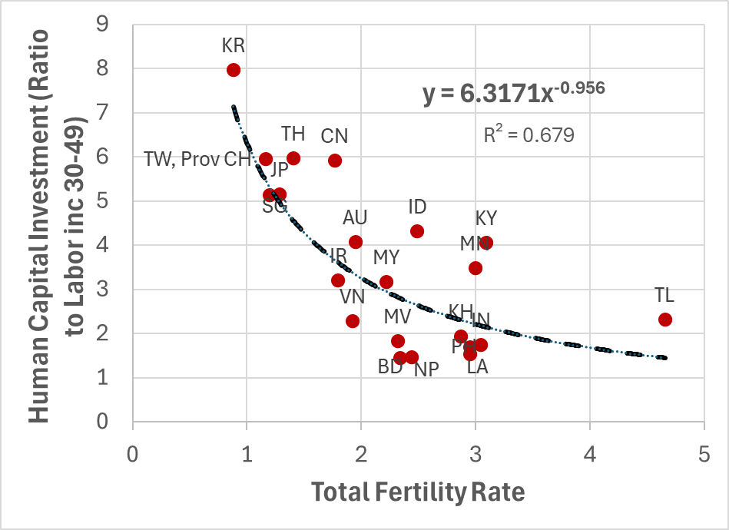
Total Fertility Rate and Human Capital investment in Asia and Pacific countries
Approximately HK = (6 years of labor income)/TFR

Slide 11
Total Fertility Rate and Human Capital investment in Asia and Pacific countries
Approximately HK = (6 years of labor income)/TFR
  TFR = 1 corresponds to 6 years of prime age labor invested per child

Slide 12
Total Fertility Rate and Human Capital investment in Asia and Pacific countries
Approximately HK = (6 years of labor income)/TFR
  TFR = 1 corresponds to 6 years of prime age labor invested per child
  TFR=3 corresponds to 2 years of yl30-49 invested per child

Slide 13
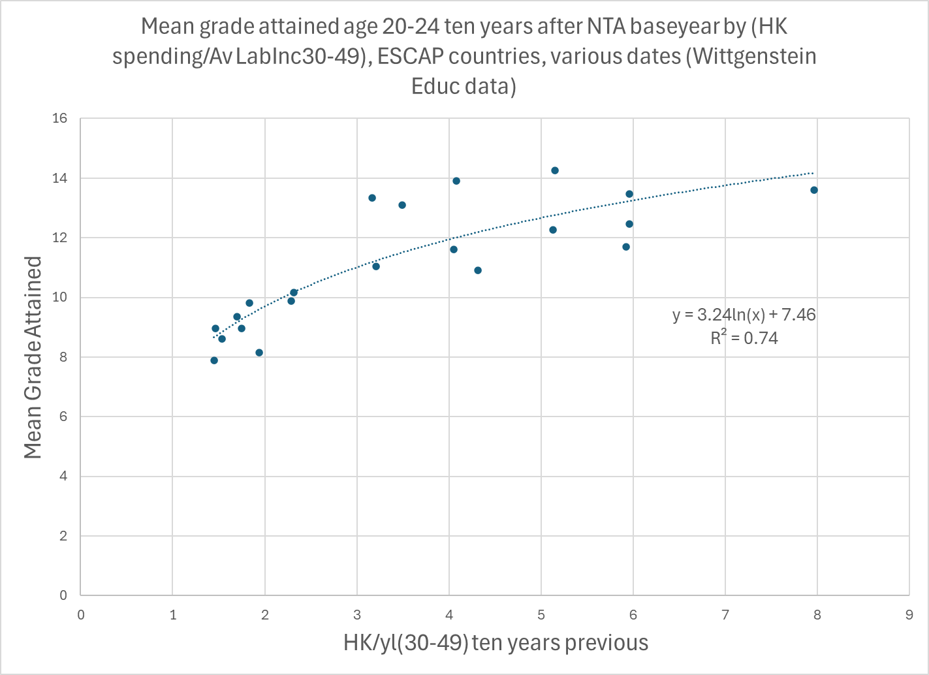
Human capital investment drives educ in Asian&Pacific countries
Wittgenstein mean grade age 20-24
Curved line reflects higher costs of secondary and tertiary education.
NTA: Human capital investment 10 years earlier

Slide 14
Linking educ and NTA finds that…
Rising educational attainment strengthens the demographic dividend (Rentería, Souto, Mejia-Guevara, and Patxot, 2016, and others in JEOA 2024 special NTA issue)
Rising education powerfully raises productivity growth and labor income in past and future, typically by 2 or 3% per year (Choo and Gee 2024, Mejia-Guevara, Renteria et al 2024).
Including educ reduces cost of population aging (Prskawetz and Hammer 2018).
Rising education also raises asset income, further boosting productivity growth.

Slide 15
7. Some preliminary new ideas: Potential Support Ratios and using NTA to evaluate policy options .

Slide 16
Potential support ratio
Standard support ratios
  Valuable workhorse measure
  Great for looking at change over time, but not good for evaluating baseline support ratio.
  If women earn more, older work longer, youth are productive – none of these will affect baseline support ratio.
  Anything raising income will also raise consumption.
  SR = Effective Labor Income/Effective Consumption
  What does influence SR at baseline?
    High national saving rate reduces consumption raises SR (e.g. China).
    High income from extractive industries like oil, timber, uranium raises consumption reducing SR (Azerbaijian – their team will discuss later).
    High foreign aid or high remittances from abroad (Kyrgyzstan).

Slide 17
Those are good, but other policy variables include:
  Labor income of older people. Early retirement?
  Labor income of younger people. Underemployment?
  Labor income of females relative to males. Could it be raised?
  Could educational attainment be increased?
These variables differ a great deal across countries.

Slide 18
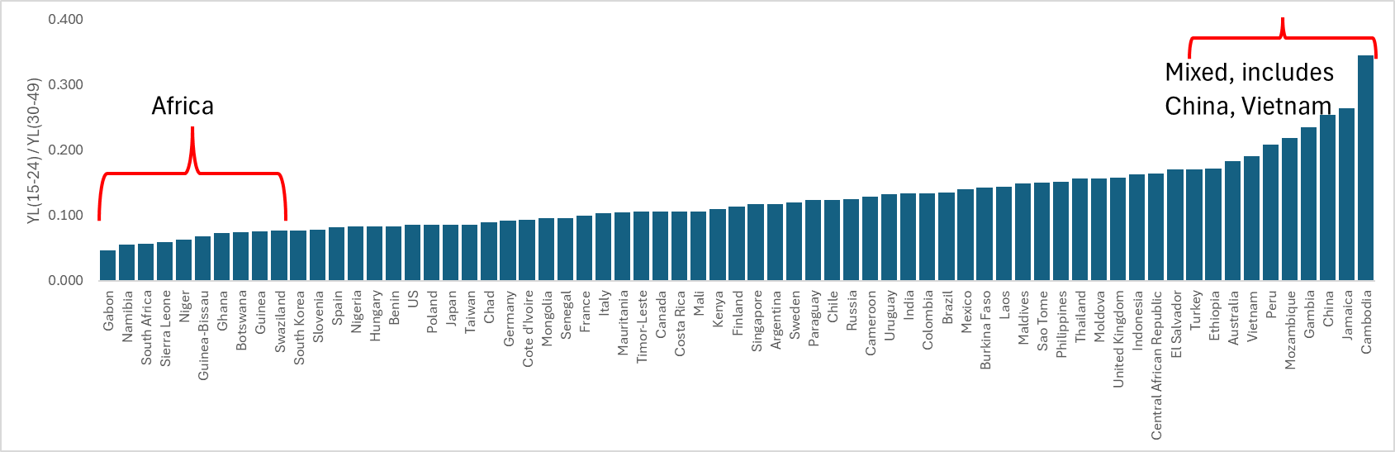
Labor income ages 15-24/Labor income 30-49 in NTA countries
Factor of 8 from lowest to highest.
Some due to youth unemployment and underemployment.
Other due to differences in educational enrollment.
Can divide yl at each age by share of youth not enrolled, to get labor inc for those not in school.

Slide 19
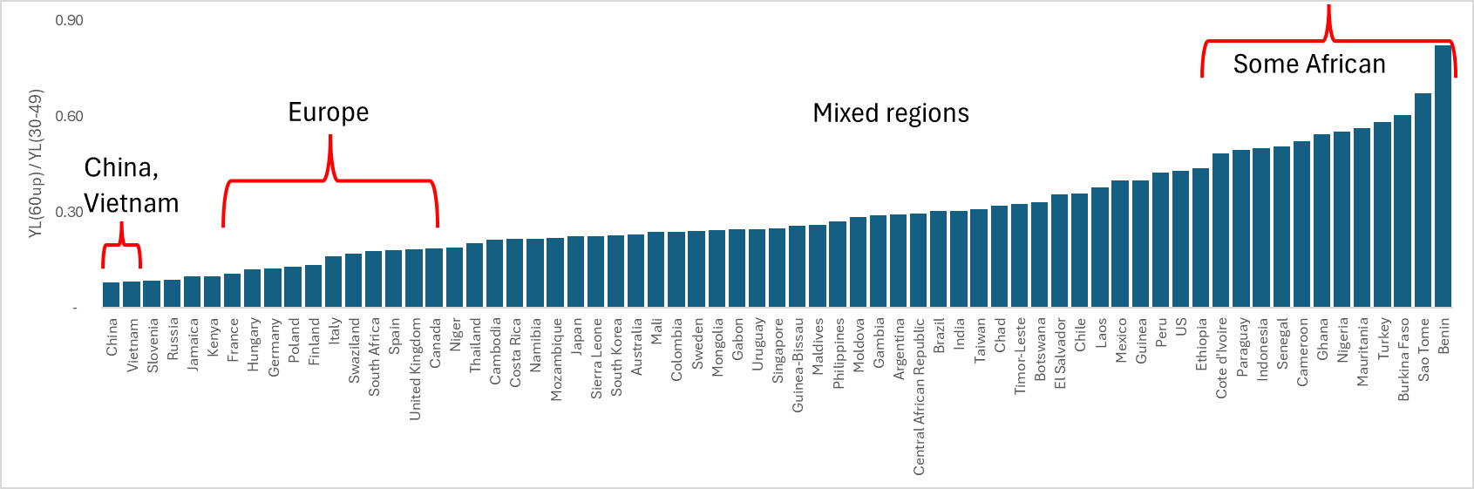
Labor income ages 60+/Labor income 30-49 in NTA countries
*Factor of 10 from lowest to highest.
*China and Vietnam are lowest.
Elderly may work hard but have very low productivity relative to young, due to lower education, work in rural agriculture.
Divide by the Labor Force Participation rate of elderly.
Among lowest are France, Germany, Russia. Retirement is early.

Slide 20
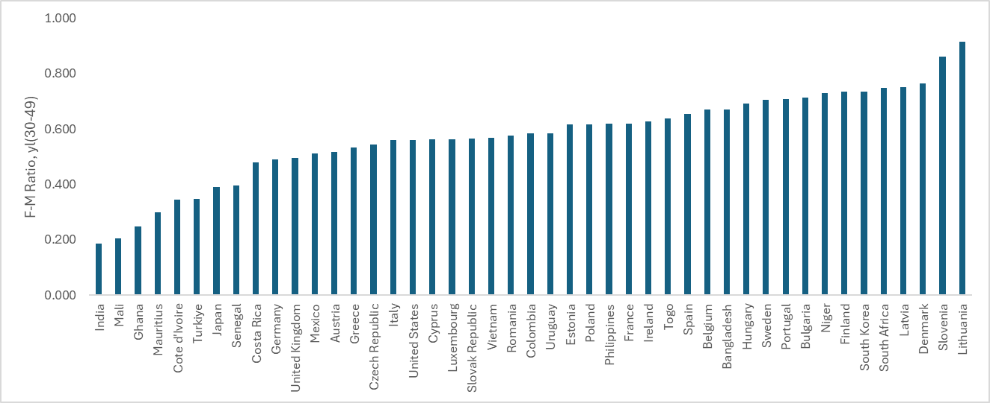
Ratio of female to male labor income at ages 30-49.
Vary by factor of five
Source: Gretchen Donehower, Counting Women’s Work, AGENTA, and Michael Abrigo for Philippines.

Slide 21
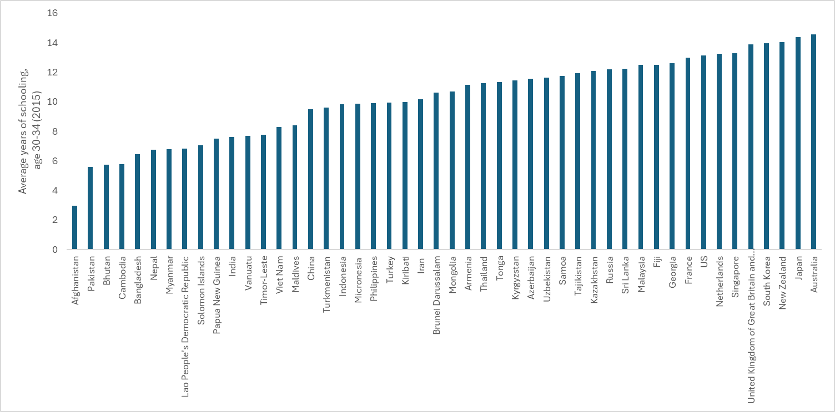
Av yrs schooling at age 30-34
Varies by factor of 4.5

Slide 22
How big a bang if these aspects of labor are increased?
Estimate effect of change in each on Total Labor Income, Yl (or other outcome, e.g. net taxes).
Measure here is “elasticity”, percent change in Total Labor Income divided by policy-driven percent change in labor income.

Slide 23
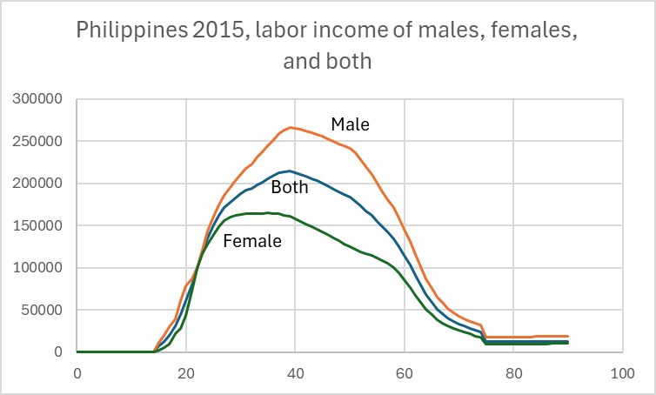
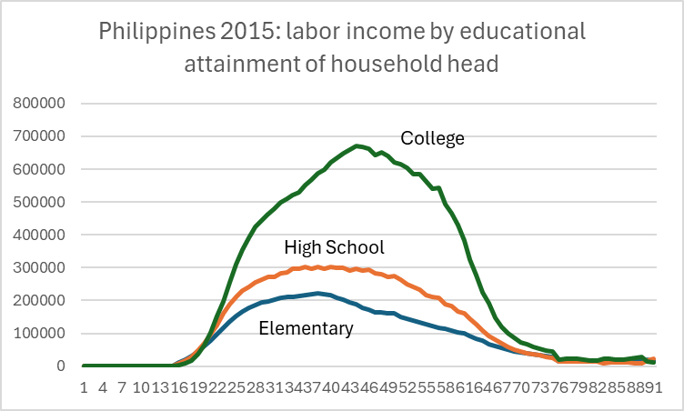
Case study: Philippines, 2015. Labor income by age, gender, educ

Slide 24
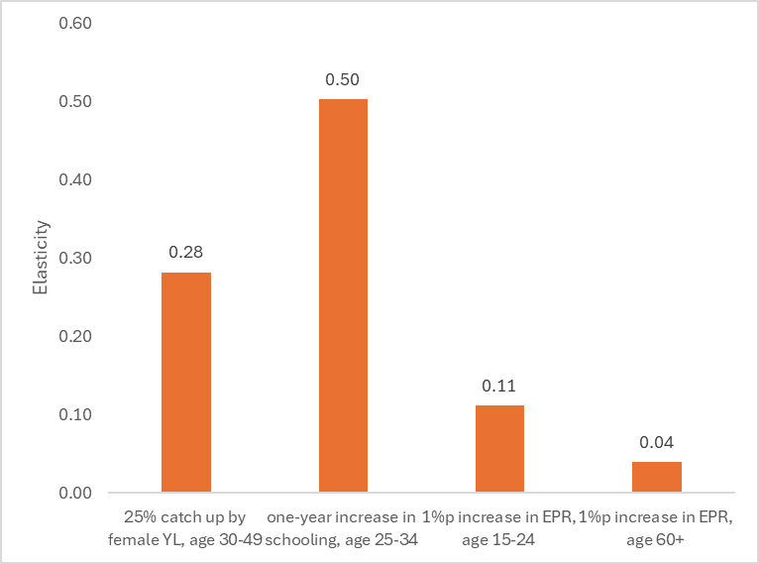
Policy Elasticities for Philippines – (thanks to Michael Abrigo)
Ratio of Percent change in Aggregate Yl to percent change in policy targets
Reduce male female gap
Increase educ 25-34
Raise 15-24 emplmt
Raise emplmt 60+

Slide 25
Interpreting these results
Raising youth employment has a big payoff for total labor income, but it competes with educational attainment.
Raising employment of older people has smaller payoff, due to small population share and low productivity.
  Will be much more important in future! Do projections.
Raising educational attainment is powerful but expensive and slow to have full effect.
Closing gender gap has high payoff, but important cost is lost care work in home.
All will affect employment and wages in labor market, not considered.

Slide 26
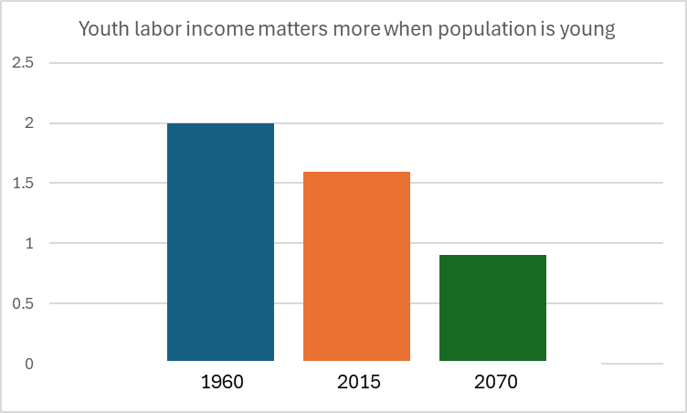
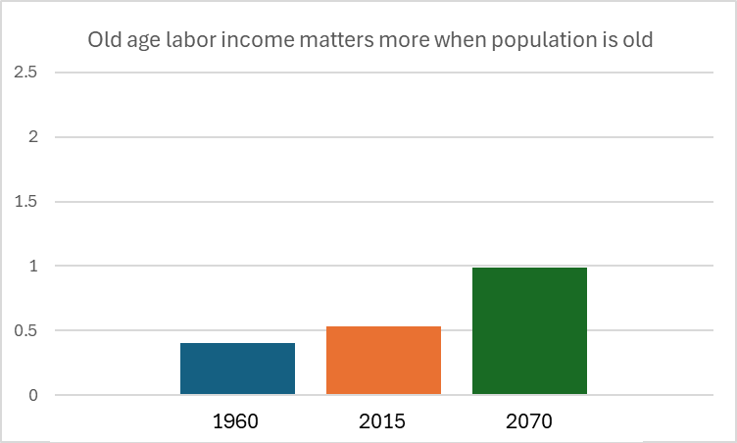
Effects depend on pop age distribution. Compare with pop age of 1960, 2015, and 2070 in Philippines
Youth labor income matters more when population is young (1960)
Old age labor income matters more when population is old (2070)

Slide 27
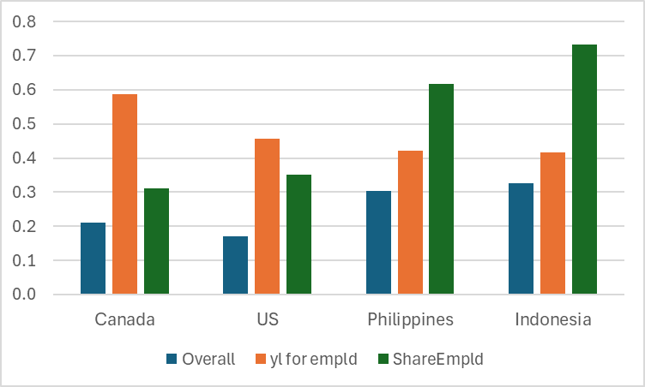
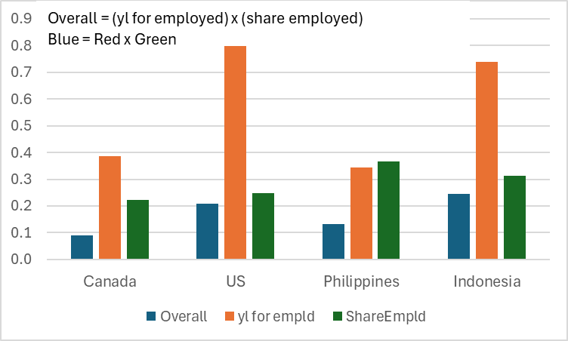
Decomposing differences in labor income of youth and elderly for four countries due employment ratios income per employed per person
Youth labor inc high in Philippines and Indonesia due to high employment rates (green).
Elder labor income high in US and Indonesia due to high income for those employed (red)
Inc/Emp
Tot
Empl

Slide 28
NTA is still growing and developing new methods, measures and applications
After 20 plus years, NTA remains a dynamic network and project.
I look forward to learning more about it this morning, this afternoon, and over the next few days!

