Slide 1
Reflections on NTA: Achievements, Challenges, and Opportunities
Sang-Hyop Lee
University of Hawaii at Manoa
March 10, 2025
Policy and the Generational Economy:
The 15th Global Meeting of the NTA Network
Bangkok, Thailand

Slide 3
N |  |  |  |  | N
 |  |  | N
 |  |  |  |  | N
 |  |  | N

Slide 4
N |  | T |  |  | N
T |  |  | N
 |  |  |  |  | N | T
 |  |  | N

Slide 5
N | A | T |  |  | N | A
T |  | A | N
A |  |  |  |  |  | T
 |  | A | N

Slide 6
N | A | T |  | O | N | A
T |  | A | N
A |  |  | O |  |  | T
15 |  | A | N |  |  | O

Slide 7
N | A | T | I | O | N | A | L
T | R | A | N | S | F | E | R
A | C | C | O | U | N | T | S
15 | B | A | N | G | K | O | K

Slide 8
N | A | T | I | O | N | A | L
T | R | A | N | S | F | E | R
A | C | C | O | U | N | T | S
T | H | A | I | L | A | N | D

Slide 9




Reflections
Liked
4L
Learned
Lacked
Long(ed) for

Slide 10
What did you like about NTA?
Liked

Slide 11
We liked building our NTA network, which made for dreamwork
Teams were recruited from countries
Methodology was formalized
Website was established
Research program was initiated

Slide 12
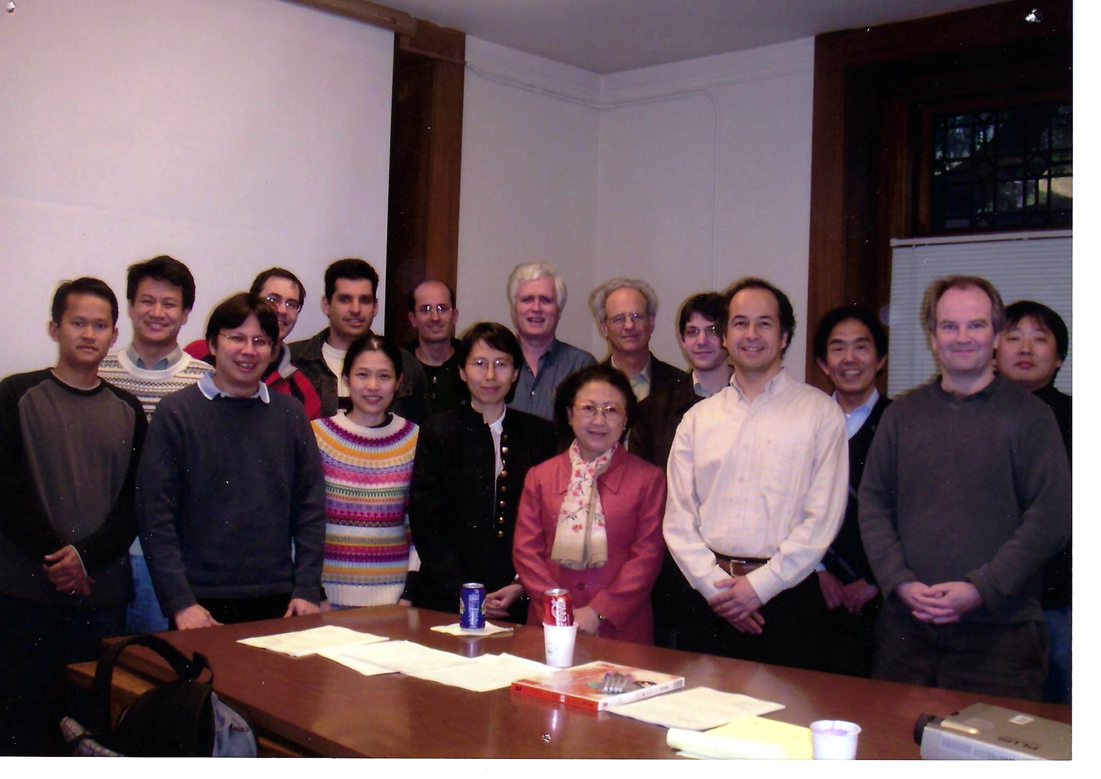
The 2nd Global NTA Meeting, Berkeley, 2005

Slide 13
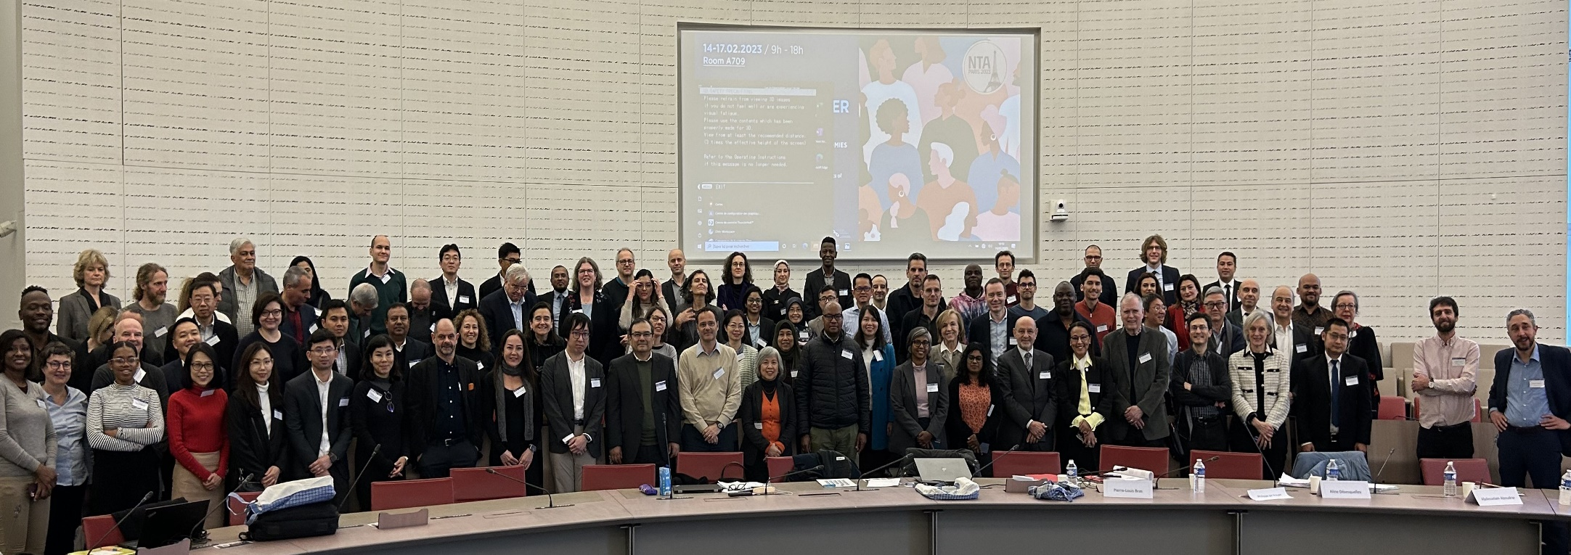
The 14th Global NTA Meeting,
Paris, 2023

Slide 14
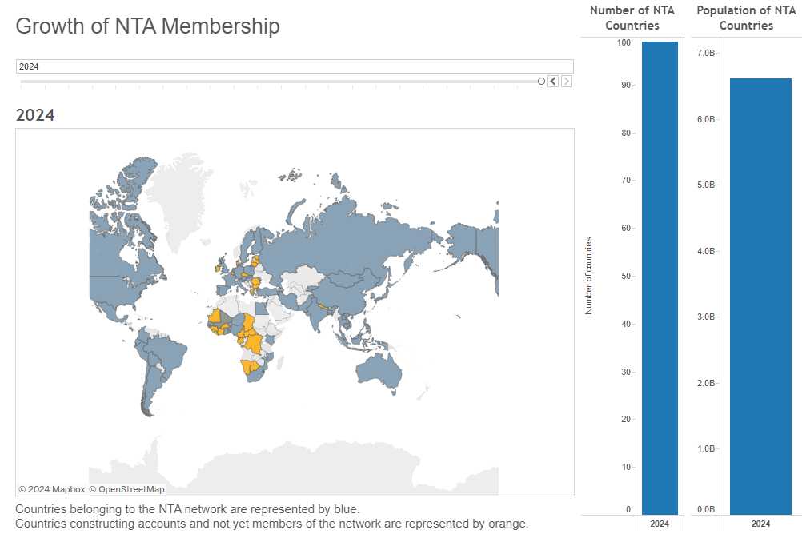
NTA network has rapidly expanded
(7 countries in 2003 → 100 in 2024)

Slide 15
Why is NTA so successful?
Timing: Rapid demographic change
Dedicated leaders (Ron Lee, Andrew Mason)
Power of networking
  Decentralized (regional) organization
  Global meetings, regional, and national meetings
Collaboration with UN and other organizations
  Manuals, organized meetings, funding support (regional, international, or national)

Slide 16
We loved the methodological strength of NTA (What is NTA?)
Integrating population into economy (Constructed using population estimates, surveys, administrative records, macroeconomic data).
Quantifies how each age groups acquires and uses economic resources (comprehensive output including private sector)
Consistent with UN System of National Accounts (implication on macro-economy; comparable across countries; comparable over time)
→ Not only a great research tool, but also provides evidences/advocate for policy questions (evidence-based policy and evidence-based policy advocates)

Slide 17

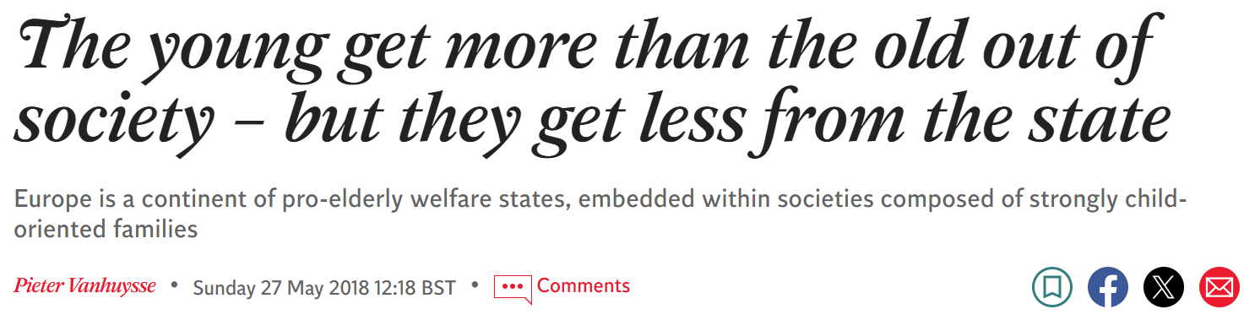
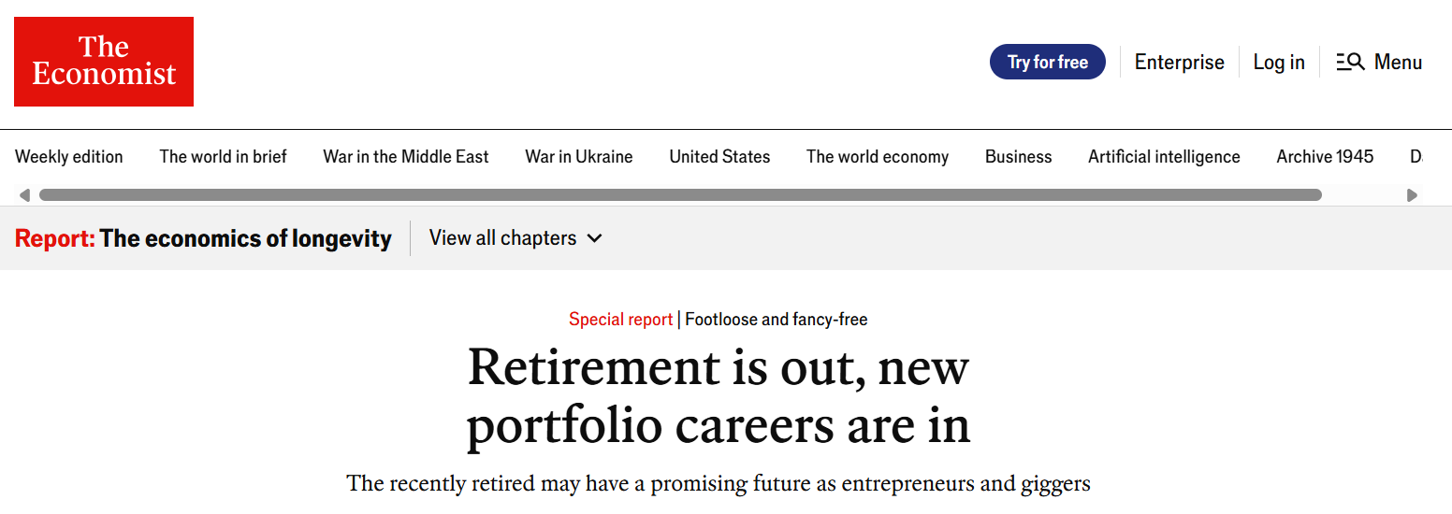

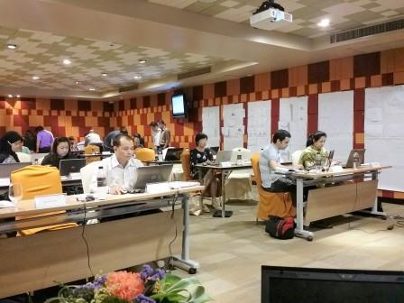

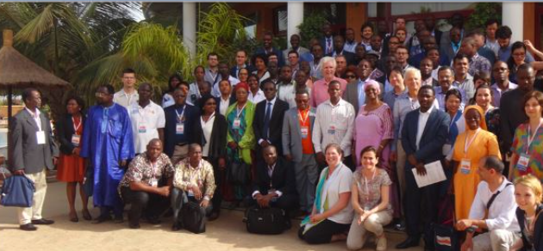
We liked our research, capacity building, media exposure, policy dialogue, south-south collaboration, etc.

Slide 18
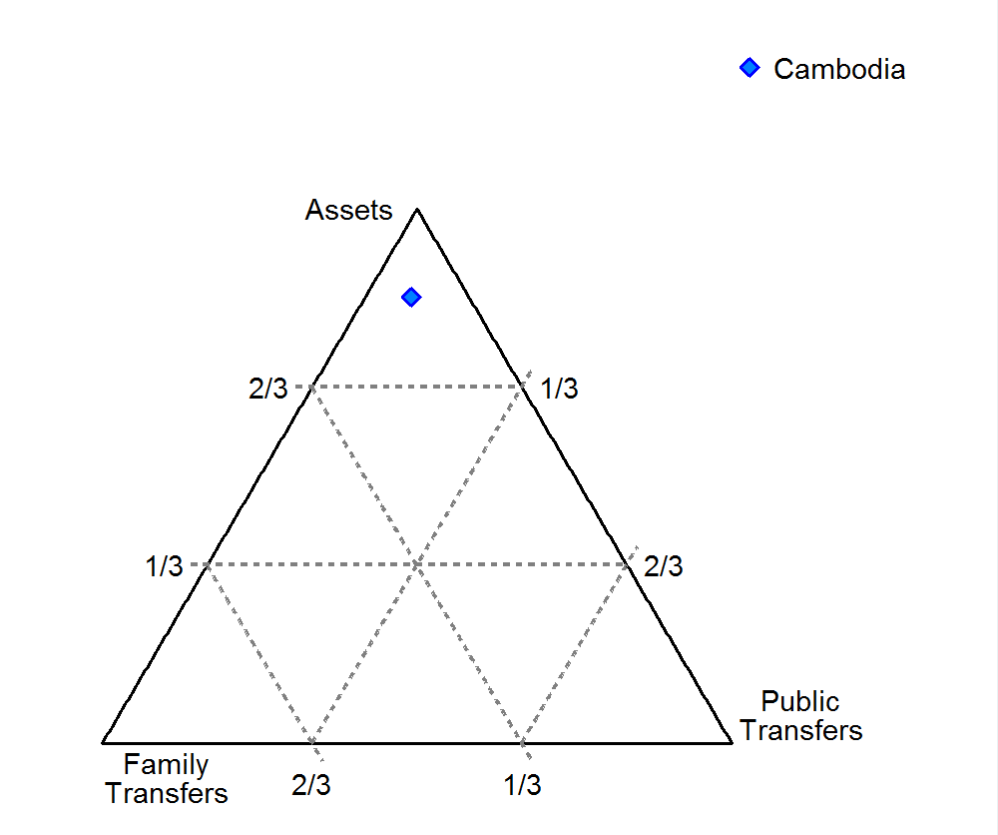
I loved our visualization projects too.
(This shows family transfers play an important role as the elderly get older from 65 to 85)

Slide 19
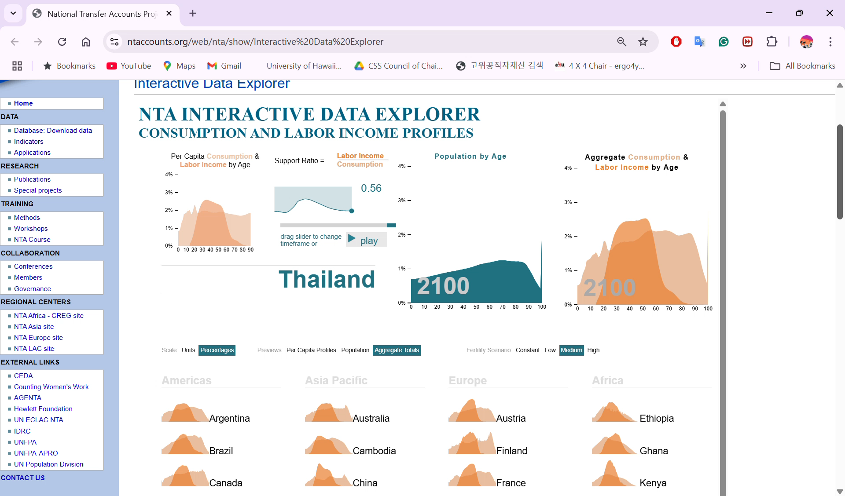

Slide 20
What did we learn?
Learned

Slide 21
NTA research is addressing many important issues
How large are the demographic dividends? When does the window of opportunity open and close? (1st and 2nd)
How are older people supported? (private vs. public)
Are current government programs fiscally sustainable?
How much are countries investing on human capital? What is the impact of the investment?
How has the intergenerational economy changed over time?
What are the full contributions of men and women in the economy? (NTTA)
What are the potential source of inequality? (NIA)
What are the impacts of the economic crisis/pandemic on generational economy?
→ NTA has provided evidences for these questions

Slide 22
Shifts in population change affect a nation’s economic growth (Demographic Dividend:DD)
; NTA is an amazing tool addressing the population change and development
Increase in the share of working age population (1st DD)
Increase in capital (2nd DD)
  Physical capital: savings
  Human capital (education and health)
Women’s entry into labor (Gender Dividend)
Healthy elderly labor force (Silver Dividend)

Slide 23
Demographic Dividend = % change of SR
2015-2050 average
Source: NTA database www.ntaccounts.org
http://www.ntaccounts.org/web/nta/show/Interactive%20Data%20Explorer

Slide 24
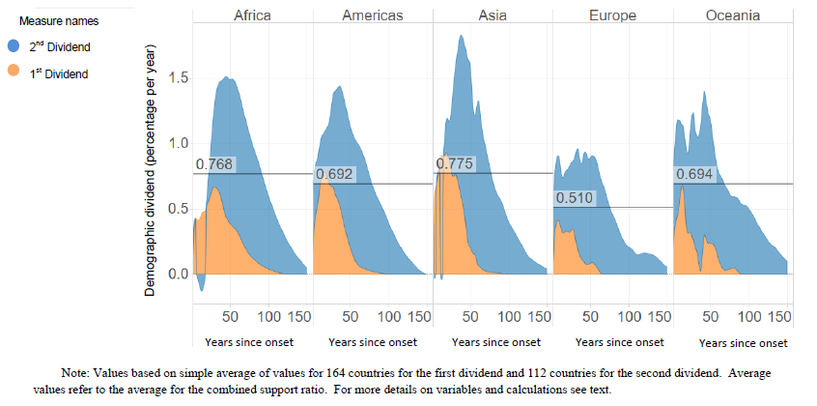
1st vs. 2nd Demographic Dividend by Region

Slide 25
We learned a lot on fiscal sustainability issue
Benefit (Inflows: TGI) and tax revenue (Outflows: TGO)
Per Capita
Aggregate
Note: Ratio of average labor income of 30-49.
Source: NESDC, Thailand. 2017 profiles.

Slide 26
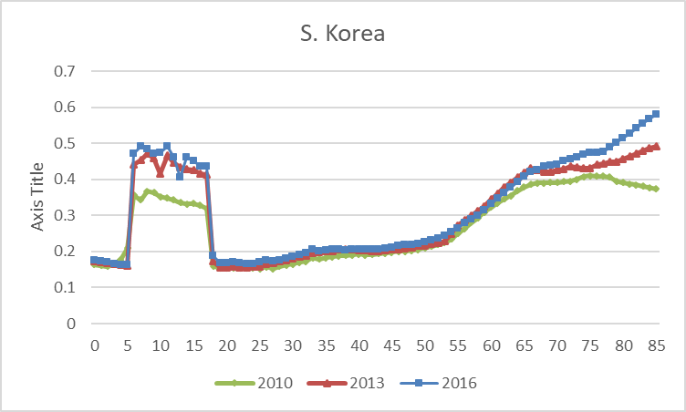
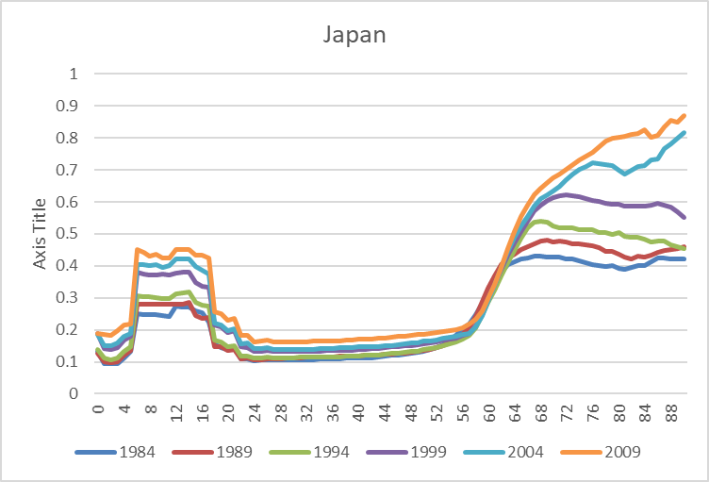

In addition, per capita transfers are increasing rapidly
(ratio of labor income 30-49)

Slide 27
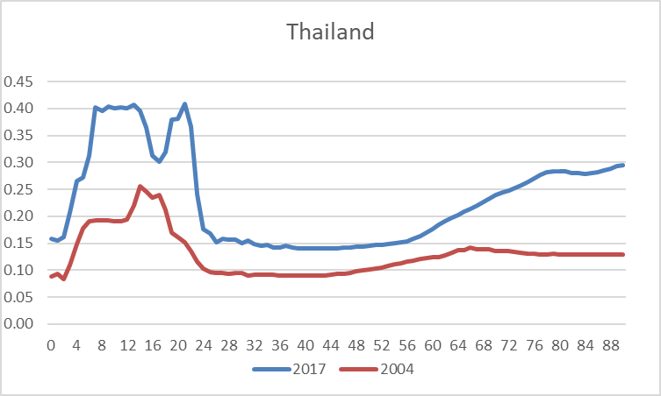
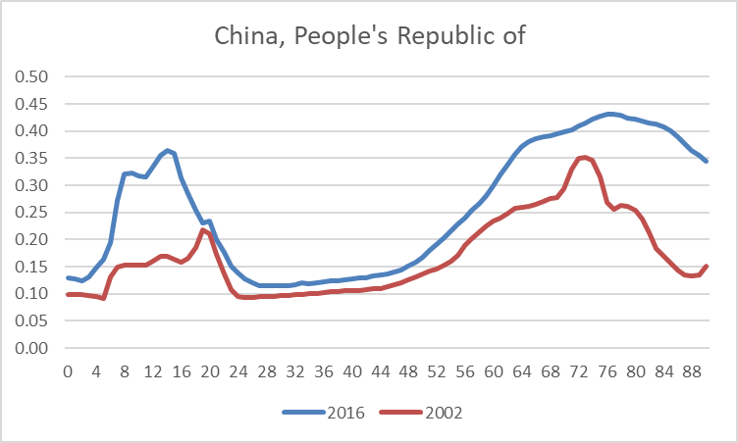
Could be more serious in developing economies

Slide 28
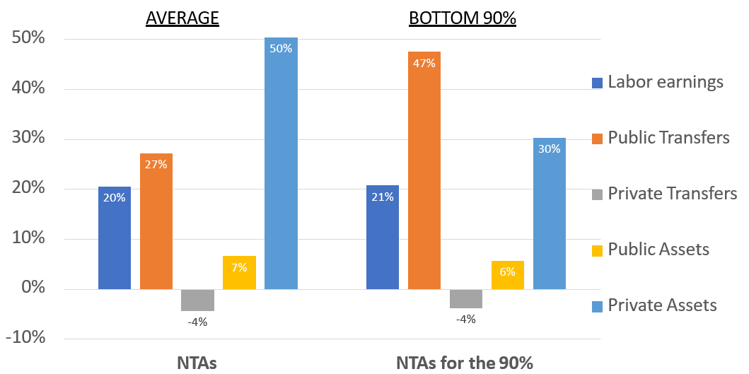
National Inclusion Accounts: Older persons fund consumption differently by their income level
(Age + Socio-economy) e.g.) USA
AVERAGE BOTTOM 90%
50%
50%
47%
40%
Labor earnings
30%
Public Transfers
30%
27%
20%
21%
Private Transfers
20%
10%
Public Assets
7%
6%
0%
Private Assets
-4%
-4%
Source: Nicole Mun Sim Lai and Tim Miller, Honolulu, 3-7, August 2020.

Slide 29
What do you think is lacking?
Lacked

Slide 30
NTA requires a lot of good quality data, methodology somewhat complex
(needs to produce excellent researchers as well as communicators)
National Transfer Accounts
National Accounts
(NA)
Household Surveys
Census, Population Projections
Administrative Data
Other Surveys and Indicators

Slide 31
People pointed out difficulties
Need continued and consistent production of data
  Insufficient original data to construct
  Difficult to estimate
  Users vs. producers issue
  Need for institutionalization?

Slide 32
Growing demand for NTA evidences for policy formulation
Need more evidences (research)
  National Inclusion Accounts? Inequality?
  Impact evaluation? Longitudinal?
Need more NTA evidence-based policies
  Assessed and used by policymakers and stake holders? (effectiveness of data as a policy tool)
Need more training and trainers, and support

Slide 33

In fact, NTA have been widely used by many governments
Demographic Dividend National Observatories. Academic and government partnerships to estimate and analyze NTAs and to monitor and evaluate national efforts. (West Africa)
National Policy Declaration to Harness the Demographic Dividend. Policy declaration: design and implement multisectoral national policy to harness the demographic dividend (Senegal, Kenya).
Intergenerational Report. 40-50 year forecast of future population and its implications for economic growth and transfer systems. (Thailand, Indonesia).
Source: Nicole Mun Sim Lai and Tim Miller, Honolulu, 3-7, August 2020.

Slide 34
How governments are using NTA (examples)
Official National Statistics. NTAs estimated by national statistics offices as part of their official statistics. (Rep. of Korea, Colombia).
Statistics Korea NTA
Providing situational analysis for government policy reports. Analysis based on NTA used in background briefs, overview chapters in government reports (Austria, Bangladesh, Brazil, Costa Rica, India, Kenya, Maldives, Mexico, Paraguay, Senegal, Sri Lanka, Thailand, Viet Nam, etc.)
Source: Updated Nicole Mun Sim Lai and Tim Miller, Honolulu, 3-7, August 2020.

Slide 35
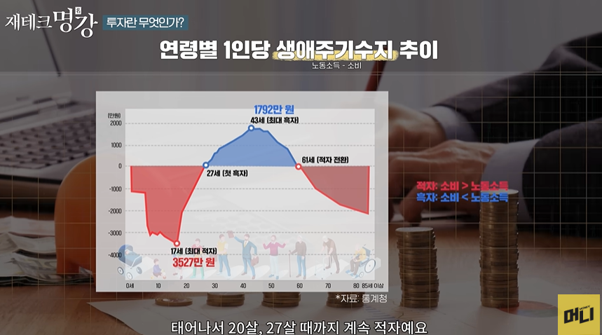
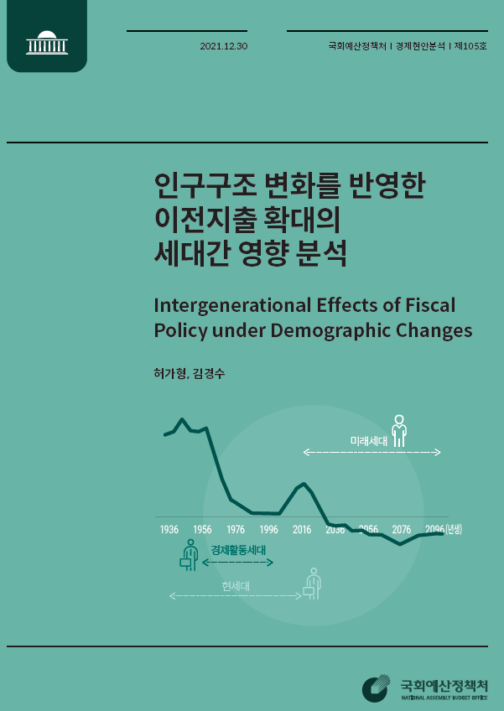
We just don’t know who are using
(unaware of, or no citation)

Slide 36
What did (do) you long for?
Long for

Slide 37
Do we have to explain this in the future?
Evolution of old-age support system
Assets / Saving
Capital-based transformation
Social welfare transformation
Traditional society?
Family
Transfers
Public Transfers

Slide 38
Evolution of old-age support system
Asset/Saving
Developing Asia, Africa, Singapore
US
Thailand
Korea, PRC
Japan
Europe, LAC
Family
Public

Slide 39
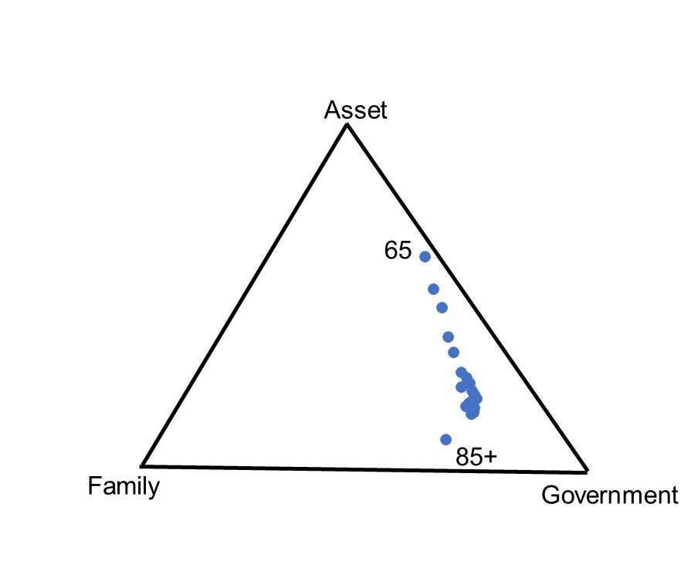
Looks like assets accounts for 2/3 and TG accounts for 1/3 of source of funding for people ages 65 in S. Korea (2022). However, it is much smaller (26% and 14%) if you consider YL.
Where is labor income?

Slide 40
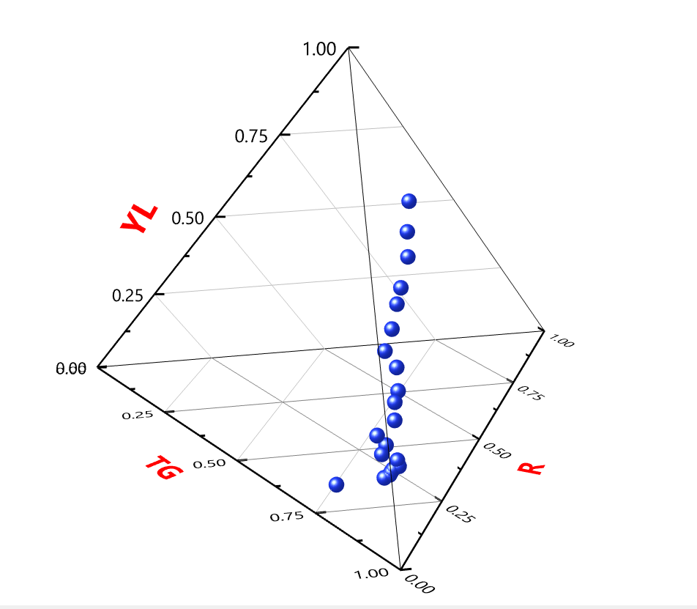
How about a tetrahedral graph?
(Old-age support system by single age)
Labor Income
S. Korea, 2022
65
Asset/Saving
Family
Transfers
85+
Public

Slide 41
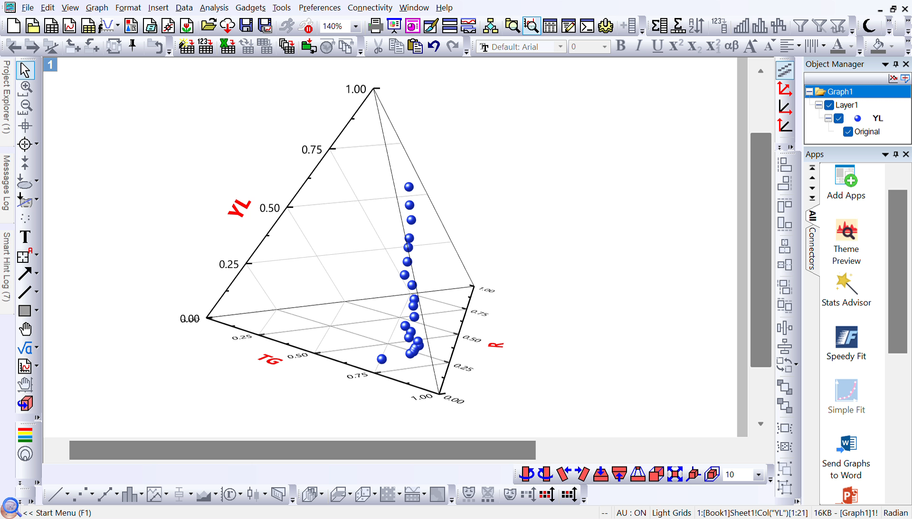

Slide 42
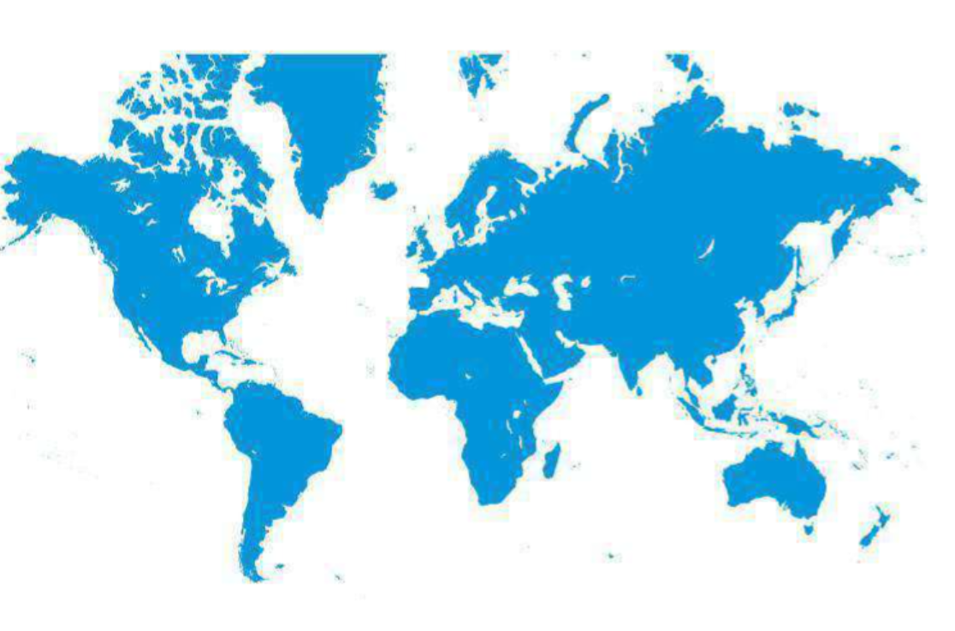
NTA network has expanded from 7 countries in 2003 to a global presence by 2045!

