Slide 1


Training Workshop:
Asset-based Reallocations and NTTA
Gretchen Donehower, UC Berkeley
March 12, 2025

Slide 2
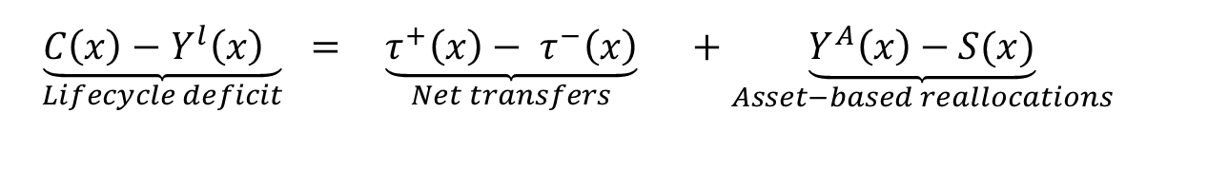
BASICS ABOUT ASSET-BASED REALLOCATIONS (ABR)
ABR consist of two different flows: asset income (capital and property) and savings
ASSET INCOME
a) Capital income
yield from owning capital (e.g. equipment, inventories, commercial structures, homes)
b) Property income
yield from owning financial assets (e.g. shares, bonds, deposits)
yield from owning physical assets (e.g. royalties, land, natural resources)
for the economy as whole (private, public, and ROW) property income always sums to zero (e.g. creditor and debtor relationship)
SAVING
asset income is a result of past (dis)saving
disposing/acquiring of an asset or debt
$\underset{Lifecycle deficit}{\underbrace{C\left(x\right)−Y^{l}\left(x\right) }} =$ $\underset{Net transfers}{\underbrace{τ^{+}\left(x\right)− τ^{−}\left(x\right)}}$ $+$ $\underset{Asset−based reallocations}{\underbrace{Y^{A}\left(x\right)−S(x)}}$

Slide 3
EXAMPLES OF ABR INFLOWS AND OUTFLOWS
EXAMPLES OF INFLOWS
owned capital yields an asset income (return on capital)
owned financial assets yield an asset income (interest, dividends, rents received)
dis-saving (disposing of an asset or acquiring debt)
EXAMPLES OF OUTFLOWS
acquired debt in the past yields property income outflow (interest paid)
dividends and rents paid yield property income outflow
losses
saving (acquiring an asset or disposing a debt)

Slide 4
WHY ARE ABR IMPORTANT?
assets allow individuals to use resources available at one age to fund uses at the other age (for consumption, transfers, or savings)
physical assets (capital, land) can be used only in upward direction
financial assets can be used to reallocate resources in upward (classical lifecycle motive for saving) or downward (parents credit the education of their children)

Slide 5
PUBLIC ASSET-BASED REALLOCATIONS
Public asset-based reallocations = public asset income – public saving =
= public transfer deficit/surplus
Public transfer deficit:
public transfer outflows (taxes and grants) are not enough to finance public transfer inflows (plus net public transfers to the ROW)
the difference is covered through positive public ABR
disposing of an asset or acquiring debt by general government
Public transfer surplus:
public transfer outflows (taxes and grants) exceed public transfer inflows (plus net public transfers to the ROW)
the difference is covered through negative public ABR
surplus is accumulated as an asset

Slide 6
PUBLIC ASSET-BASED REALLOCATIONS II
ASSET INCOME
a) Capital income
– based on SNA it generally equals to zero; public sector does not accumulate profits (be careful: public enterprises are part of private sector)
b) Property income
interest paid/received on public borrowing/lending (important as majority of countries run fiscal deficit)
sovereign wealth funds (with significant age reallocation rationale; e.g. oil revenues in Norway and United Arab Emirates)
(be careful: general government can receive property income from public enterprises)
SAVING
- equals to the sum of public asset income and public transfer deficit/surplus

Slide 7
AGGREGATE CONTROLS (PUBLIC ABR)
ASSET INCOME
a) Capital income
- in NTA defined as net operating surplus
- for general government the following holds: gross operating surplus = consumption of fixed capital → net operating surplus is close to 0
b) Property income
interests
dividends
reinvested earnings on foreign direct investment
rent
SAVING
equals to the net saving from SNA (= net fixed capital formation + net capital transfers + net non-produced non-financial assets + net lending)

Slide 8
EXAMPLE – AGGREGATE CONTROLS FOR PUBLIC REALLOCATIONS, SLOVENIA
Public transfers (net from the ROW) | -185
Public transfer inflows | 13657
less: Public transfer outflows | 13842
Taxes and grants | 13345
Transfer surplus (-)/deficit (+) | 497
Public asset-based reallocations | 497
Asset income, net | -406
less: Saving, net | -903
Notes:
S čigave strani tu gledaš za pozitivno in negativno (če sploh je negativno?)

Slide 9
AGE PROFILES (PUBLIC ABR)
Age profiles of both public asset income and savings follow general tax profile.
Why?
NTA assumption that taxpayers own government assets and are responsible for all government debts.

Slide 10
Public asset-based reallocations, Slovenia, 2012

Slide 11
PRIVATE ASSET-BASED REALLOCATIONS
private sector includes households, corporations, and non-profit institutions serving households (NPISH)
but we should keep in mind that NTA attributes all the flows to individuals, while corporations and NPISH serve as intermediaries
ASSET INCOME
-private asset income is attributed to the household head (difficult to assign the owner)
a) Capital income
is assigned to owners of corporations (shareholders) and households (imputed rents go to household head of owned home, capital share of mixed income go to household heads in households with income from owned farms or enterprises)
b) Property income
is assigned to the owners of assets (mainly interest, dividends, rents)
in the absence of the ROW flow, public and private inflows and outflows must balance

Slide 12
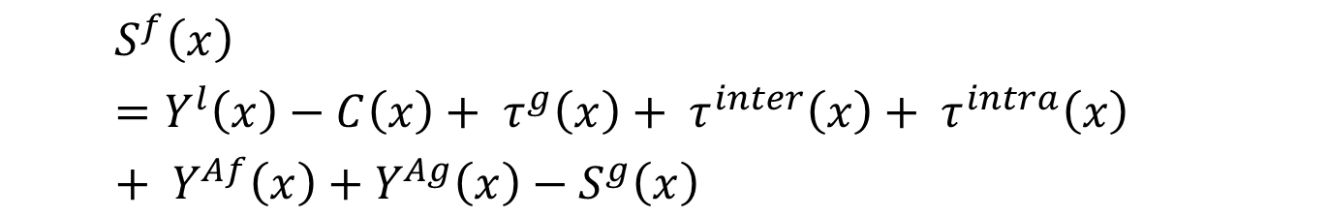
PRIVATE ASSET-BASED REALLOCATIONS II
PRIVATE SAVING
final balancing item
$$S^{f}\left(x\right)=Y^{l}\left(x\right)−C\left(x\right)+ τ^{g}\left(x\right)+ τ^{inter}\left(x\right)+ τ^{intra}\left(x\right)+ Y^{Af}\left(x\right)+Y^{Ag}\left(x\right)−S^{g}\left(x\right)$$
Private saving at age a is the difference between disposable income (in the form of labour income, asset income and transfers) and consumption (less government savings)

Slide 13
AGGREGATE CONTROLS – PRIVATE ABR
ASSET INCOME
a) Capital income =
= net operating surplus + 1/3 of mixed income + capital share of indirect taxes less subsidies (share of asset income in total income) =
= corporate income + income from owner-occupied housing + income of unincorporated enterprise
b) Property income =
= private property income inflow - private property income outflow
SAVING
net private saving from SNA (corporations, households, NPISH)
no adjustment needed because it is created from macro adjusted age profiles
Notes:
INDIRECT TAXES LESS SUBSIDIES (TAXES ON PRODUCT AND PRODUCTION LESS SUBSIDIES)

Slide 14
EXAMPLE – AGGREGATE CONTROLS FOR PRIVATE ABR, SLOVENIA
Private asset-based reallocations | 1,307
Asset income, net | 3,585
Capital income, net | 4,091
Corporate income | 1,470
Income from owner-occupied housing | 1,503
Unincorporated income | 1,118
Property income, net | -506
Private property income inflow | 2,298
less: Interest outflows, households | 385
less: Other property income outflow | 2,419
Saving, net | 2,278
Notes:
A property income net ni enako 0?
Capital income, net: ker si odštel depreciacijo
Property income, net: net, ker je od ROW
Saving, net: net, ker je odšteta depreciacija

Slide 15
AGE PROFILES – PRIVATE ABR
ASSET INCOME
a) Capital income
corporate income (survey: property income – interest, dividends, rents)
income from owner-occupied housing (survey: imputed rent)
income of unincorporated enterprise (survey: self-employment labor income)
b) Property income
property income inflow (survey: property income)
household Interest outflow (survey: interest expense)
property income outflow, excluding interest paid by household (survey: property income)
SAVING
residual from accounting identity
Notes:
survey: self-employment labor income): mxed income
property income outflow, excluding interest paid by household: koliko posamezniki posamezniki plačujejo (so pa hkrati lastniki podjetij).

Slide 16
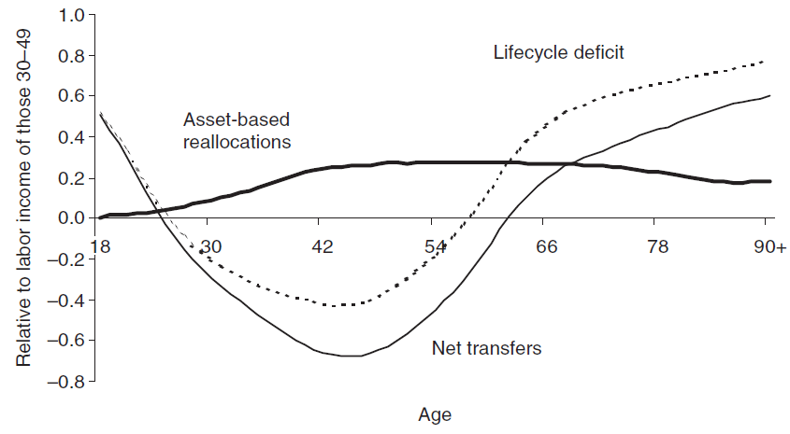
Figure 3: Life-cycle deficit and reallocations, example of 17 NTA countries
Source: Lee, R., & Mason, A. (2011). Population Ageing and Generational Economy, p. 217

Slide 17
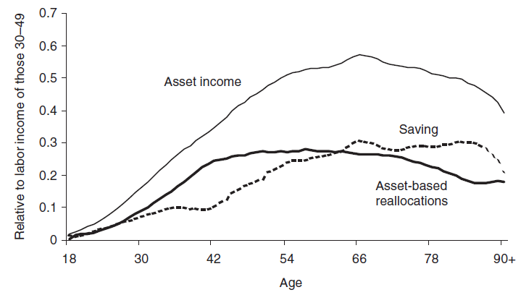
Figure 3: Asset-based reallocations, example of 17 NTA countries
Source: Lee, R., & Mason, A. (2011). Population Ageing and Generational Economy, p. 217

Slide 18
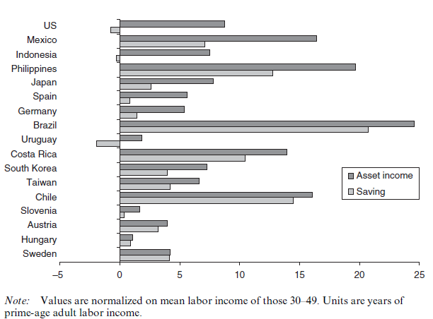
Figure 4: Asset income and saving for 65+ age group
Source: Lee, R., & Mason, A. (2011). Population Ageing and Generational Economy

Slide 19
Financing the LCD in 2010 in Slovenia
Source: AGENTA Data Explorer. (2021). http://www.agenta-project.eu/en/dataexplorer.htm

Slide 20
Financing the LCD in 2010 the UK
Source: AGENTA Data Explorer. (2021). http://www.agenta-project.eu/en/dataexplorer.htm

Slide 21
NOW, on to NATIONAL TIME TRANSFER ACCOUNTS
Objectives
To review the motivation behind the development of the Counting Women’s Work project and National Time Transfer Accounts
To give a brief summary of the methods
  NTA by sex
  NTTA by sex
To share resources for more information

Slide 22
NTA example
United States, per capita National Transfer Accounts age profiles
Production & Consumption
Lifecycle Deficit
(Consumption – Production)

Slide 23
NTA by sex
United States, per capita National Transfer Accounts age profiles
Production & Consumption
Lifecycle Deficit
(Consumption – Production)

Slide 24
What explains this pattern?
What is missing?
Why?

Slide 25
“The volume of services rendered by housewives and other members of the household toward the satisfaction of wants must be imposing indeed, when totaled for the 30 million families comprising the population of this country; and the item is thus large enough to affect materially any estimate of national income.
…
But the organization of these services render them an integral part of family life at large, rather than of the specifically business life of the nation. Such services are, therefore, quite removed from those which gainfully occupied groups undertake to perform in return for wages, salaries, or profits.
…
It was considered best to omit this large group of services from national income, especially since no reliable basis is available for estimating their value.”
- Simon Kuznets, quoted in “National Income, 1929-1932 : Letter from the Acting Secretary of Commerce Transmitting in Response to Senate Resolution No. 220 (72nd Cong.) a Report on National Income,” 1934.

Slide 26
Gendered economic measurement
 | Goods | Services
Sold in the marketplace | Included | Included
Produced and consumed in the household | Included | Not included
“Not included” is work most often done by women.

Slide 27

CWW: Measuring the gendered economy
Household production satellite accounting
+
NTA age-disaggregation and framework
=
Counting Women’s Work

Slide 28

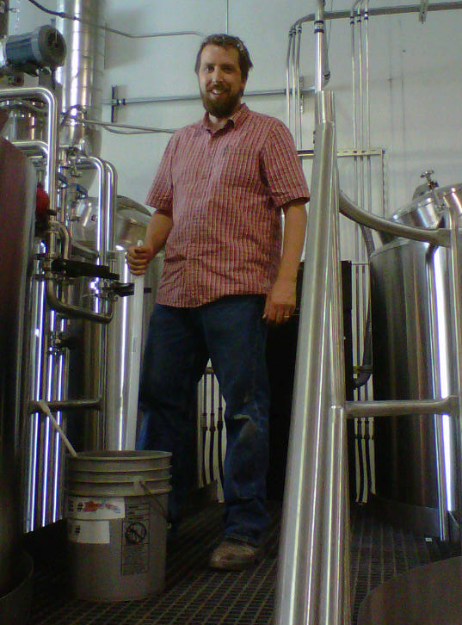
CWW’s Goal:
Value everyone’s work, measure everyone’s care
Producing market goods:
Producing non-market services:

Slide 29
The rest of the workshop
NTA by sex
NTTA by sex
  Production in Time Units
  NTTA: Consumption and Transfers in Time Units
  NTTA: Monetary Units

Slide 30
NTA by Sex

Slide 31
NTA by Sex Estimation Steps
Estimate single-sex NTA
Estimate separate M/F age profiles
  Follow basic NTA methodology again, with additional category
  For regression-based imputation, add sex to independent variables in regression equations
Adjust M/F profiles to macro controls by making them consistent with single-sex NTA
Sensitivity tests based on different methodology
  Change EAC weight allocations to regression
  Adjust assumption about headship

Slide 32
Review single-sex estimation strategy
In single sex NTA, we use different estimation strategies depending on data source, level of availability, and type of age profile:
  Data source: household surveys
    For individual-level data, compute age means directly
    For household-level data, allocate to household members
      Use “equivalent adult consumer” (EAC) weights for non-health, non-education private consumption
      Use regression method or iterative method for education and health care if utilization measures are available
      Allocate total amount to household head if assets are involved or for interhousehold transfers
  Data source: administrative data (government reports)
    Take age-means from government sources
  Profiles based on imputation/assumption

Slide 33
How to add sex as another category?
Data source: household surveys
  For individual-level data, compute age and sex means directly
  For household-level data, allocate to household members
    Use “equivalent adult consumer” (EAC) weights for non-health, non-education private consumption, using the same weights for males and females of the same age
    Use regression method or iterative method for education and health care if utilization measures are available, adding sex to the independent variables in the regression equations
    Allocate total amount to household head if assets are involved or for interhousehold transfers, treating male and female heads the same
Data source: administrative data (government reports)
  Take age- and sex-means from government sources
  Profiles based on imputation/assumption (use same imputation/assumption for both sexes)

Slide 34
Adjustment for consistency with single-sex NTA
Single-sex NTA is our best estimate
  Keeping sexes together means larger sample size
  Single-sex NTA profiles are adjusted to macro controls
Want gender-specific profiles to be consistent with single-sex
Adjust each age of gender-specific profiles for consistency
  Adjustment is different at each age, but the same for both sexes within an age group
  Adjust smoothed profiles to be consistent with smoothed profiles; unsmoothed with unsmoothed

Slide 35
Calculating adjustment factors
N(a): Population age a
N(a,g): Population, age a, sex g
: Single-sex profile, adjusted to control
x(a,g): Sex-specific profile
Age-Specific Adjustment Factors:
Adjusted Profiles :

Slide 36
Final notes on adjustment
Adjusting this way makes the gender profiles consistent with single sex profiles and macro controls in one step
Save the schedule of adjustment factors and plot them for review
  Adjustment factors should be similar size to the control adjustment factor for single-sex NTA
  If gender adjustment factors are very different, there may be a mistake in the calculations
  If factors have an age pattern, there may be a problem with the data not measuring the concept well

Slide 37
NTTA
PRODUCTION
(time units)

Slide 38
Production Estimation Strategy
Learn your time use survey, data cleaning
Identify activity groups included in NTTA
Turn time use data into time spent in each activity group per time use respondent
Take age/sex means
Smooth and adjust at the aggregate level so that total consumption equals total production
  This can be a big adjustment if time use survey does not include all potential unpaid care work producers in a household

Slide 39
Know your time use survey
How is the data structured?
How are activities coded?
Whose time use data do you have in the household?
Do you need to merge different types of files (like activity files linked to demographic information files by a person ID number)
Are there sample weights? What are they adjusting for?
When were the surveys done? (Want to know what time of year because of seasonality)

Slide 40
Time use survey data cleaning
The usual data cleaning activities
  Variables are as described in the codebook?
  Duplicate observations?
  Unrealistic outliers?
  Invalid codes?
  Codes for missing data changed to missing or zeros as appropriate?

Slide 41
Time use survey data cleaning
Time-based diagnostics and checks on your use of the data
  Does total time sum to 24 hrs/day or all persons? (Or if you don’t have all activities accounted for, is sum of accounted activities reasonable?)
  If not, is error correlated with age and/or sex?
  Do you observe time patterns as expected
    more market work done on typical workdays
    childcare marked as an activity in households with very young children
    sleep is a reasonable amount on average by age

Slide 42
What to do if there are problems?
Total time not equal to 24 hours?
  Proportional adjustment for each individual if errors are not too large and your survey accounts for all possible activities
    Can delete some observations with far more than 24 hours accounted for, and adjust the rest
  OR look for specific outliers by individual or by type and see if problem can be isolated (eg observations from one province have large errors but others are fine)

Slide 43
Which activities are in NTTA?
Find time use survey’s coding scheme for activities, or list of activities with time variables in your survey
Identify NTTA productive activities in coding scheme
  Not already included in national accounts
    So market production is NOT included
    Unpaid family labor that generates market income is not included, even if the person who did the work did not get paid
    Collecting water/wood/fuel is often included even though it is conceptually already in national accounts
  Satisfies third party criterion
    You could pay someone else to do it for you
    Leisure, education, and many self-care activities do NOT satisfy this criterion
Group NTTA productive activities into categories, data permitting
  11 categories (plus gathering water/wood) in “manual” but you may have more or less depending on your time use data

Slide 44
Which activities are NOT in NTTA?
Ones whose value is already in national accounts and NTA
  Consumption of goods produced by household for own use are imputed in national accounts consumption measures
    (gathering wood/water is an exception in countries where in practice it is not included in national accounts)
  Returns to labor to produce these household-consumed and produced goods are imputed in mixed income

Slide 45
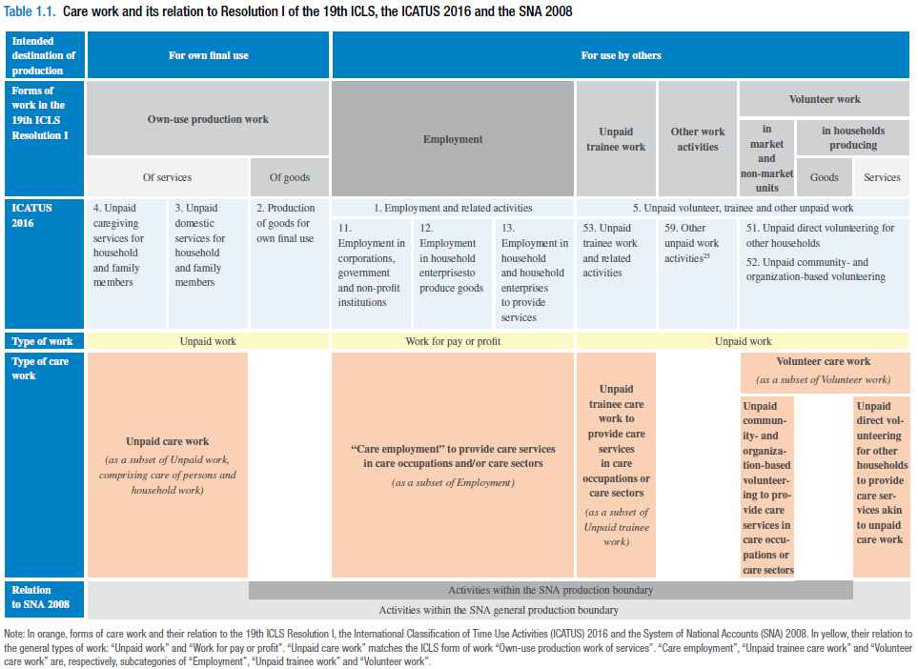
Care work and care jobs for the future of decent work / International Labour Office – Geneva: ILO, 2018.

Slide 46
Groups of NTTA Activities
Cleaning
Laundry (includes sewing and clothing repair)
Cooking (food and drink preparation)
Household maintenance and repair
Lawn and garden care
Household management (incl. finances, scheduling, coordinating, and related telephone calls)
Pet care (not veterinary care)
Purchasing goods and services
Childcare **
Eldercare and care outside the home (includes volunteering) **
Travel (related to care activities and purchasing goods and services)
(Fetching wood or water: included in NTTA if it is NOT imputed into national accounts in your country, even though conceptually it is goods produced for own use)
** Needs to be divided into variables for care in household versus outside household

Slide 47
Time use survey file preparation
Need to create a file with one observation per household member and variables for time average daily time spent in each household production activity
  Includes all household members, with unique household id for each household
  Time respondents will have time values in those variables, non-respondents will have missing data code (“.” in Stata)
  Non-time respondents are not necessary for production but are for consumption

Slide 48
File prep for diary surveys
Given time diary file and household roster file:

Slide 50
File prep for activity questions

Slide 51
Unsmoothed Age Means
Collapse file by age/sex, using survey weights, keeping number of observations:
gen obs=1
collapse (mean) cook clean chcare… (rawsum)
obs [w=wgt], by(age sex)
(need “obs” for smoothing routine)
Keep care categories separated by location (in household vs. outside household) if possible, for use in consumption calculation
Use survey weights

Slide 52
Smoothing
Strategy
  Examine smoothed profiles by looking at each one
  Adjust spans so as not to “smooth over” a real pattern
    care variables will often need smaller spans than other household activities or need to be smoothed in sections
Method
  Current prefered method: Friedman’s super smoother
    Available in R as “supsmu”, available in Stata as “supsmooth”

Slide 53
Sensitivity Tests
Change methodology to evaluate how different results would be if you made different assumptions
Most important one for production account in time units is including secondary activities
  Preserve 24 hours in a day (i.e. no multitasking miracle)
  Divide the time unit in half between the two activities

Slide 54
Understanding the results
Can further cross-cutting reveal how overall patterns emerge?
  Regional variation
  SES
  Different household structures
  If you have more than one time use survey, are patterns stable over repeated cross-sections?
Examine time use and gender differences across different countries

Slide 55
NTTA
CONSUMPION
(time units)

Slide 56
Consumption Estimation Strategy
Impute consumption to individuals in households
Take age/sex means as you did for producers
Smooth and adjust at the aggregate level so that total consumption equals total production
  Why? Surveys are designed to get representative producer, not consumer
  This can be a big adjustment if time use survey does not include all potential unpaid care work producers in a household

Slide 57
Consumption Imputation Assumptions
For care activities
  If care is for household members, implement regression method using household members in target age range
    Example: for care of household children aged 0-18, estimate regression equation using number by age and sex for household members age 0-18
  If care is for non-household members:
    If age-targeted (children, elders), distribute proportionally to household members in that age group.
    If not age targeted (general volunteering) divide time equally across total population
  (Can experiment with alternatives, like one child method)

Slide 58
Consumption Imputation Assumptions
For general household activities
  Divide equally among all household members
  Easy!

Slide 59
Finalizing profiles
Smooth and adjust smoothed and unsmoothed means so that consumption equals production
Why do we need to adjust?
  Smoothing throws off the balance slightly
  Differential sampling can throw off the balance A LOT

Slide 60
Simplified Spreadsheet Examples
Available on the wiki
  www.ntacounts.org
    Projects > Working Groups > Gender, time use
  Versions for simplified and complex methods

Slide 61
NTTA
TRANSFERS
(time units)

Slide 62
NTTA Transfers Defined
Transfer outflows are the time produced but not consumed by the producer
  All care time produced is a transfer outflow
  General household activity time produced MINUS that portion consumed by the producer is a transfer outflow
Transfer inflows are the time consumed but not produced by the consumer
  All care time consumed is a transfer inflow
  General household activity time consumed MINUS that portion produced by the consumer is a transfer outflow
Code examples to do this are available on the NTA wiki
  http://www.ntaccounts.org/web/nta/show/Gender%2c%20Time%20use

Slide 63
NTTA
(monetary units)

Slide 64
Understanding your wage data
What type of wage data is available?
What is the coding scheme for different jobs or occupations?
Is the data pre-tax or post-tax?
Do the wages include fringe benefits or employer-paid taxes?

Slide 65
Methods for Imputing Wages
Different methods for different types of research questions
  Replacement method: what would you have to pay to buy the service in the market?
    Can replace with generalist or specialist wages
  Opportunity cost method: what could you earn with your time in the market if you worked for pay instead of doing the household activity?
  Cost of output method: values time by the cost of the service produced in that time, not just the cost of the labor
NTTA uses specialist replacement
  Although in some countries, generalist may be more appropriate

Slide 66
Why use specialist replacement?
NTA is mostly concerned with accounting type questions, not behavioral models or individual incentives
Opportunity cost analyses sometimes come up with values of household production that are so large that no one pays attention
  Reveals the limitations of the behavioral model and measurement issues with opportunity cost method
Output method is very challenging to implement consistently across our many NTA countries

Slide 67
Which wages to use?
Country teams must decide what is appropriate in their context
Wage data may need to be transformed to reflect a flow per consistent unit time
Can use single occupation or average of different occupations
  Use employment-weighted averages to reflect the distribution of occupation types in the market

Slide 68
Other aspects of wages
Want pre-tax wages, so gross wages paid to employee, plus employer-paid taxes
Potential change down the road: Add an age-productivity adjustment, but have not settled on one method yet
Adjustments we used to make that we have dropped:
  Quality adjustment factors for some activities
  Inclusion of imputed fringe benefits in wages

Slide 69
Sensitivity Tests
Change methodology to evaluate how different results would be if you made different assumptions
Changing wage imputation
  Specialist to generalist
  Mean to median?

Slide 70
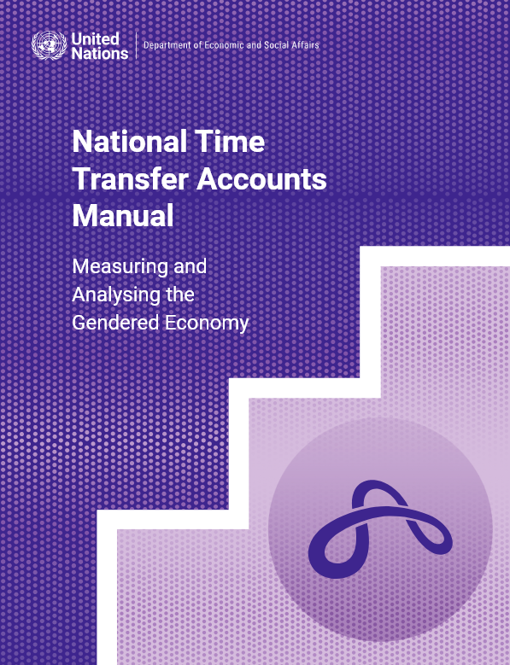
Resources
Just published! NTTA Manual:
https://www.un.org/development/desa/pd/sites/www.un.org.development.desa.pd/files/files/documents/2025/Jan/undesa_pd_2025_ntta_manual.pdf
NTA Website Time Use and Gender Working Group page
https://www.ntaccounts.org/web/nta/show/Gender%2c%20Time%20use
Countingwomenswork.org

