Slide 1
DELIVERING CAPACITY BUILDING WORKSHOP TO DEMOGRAPHIC DIVIDEND STAKEHOLDERS
Olanrewaju Olaniyan
University of Ibadan
Ibadan, Nigeria
lanreolaniyan@yahoo.co.uk, o.olaniyan@ui.edu.ng
Presented at the 14th Global Meeting of the NTA Network with the theme “Building Sustainable Generational Economies, 17 February 2023

Slide 2
“In the next 50 years Africa’s biggest single asset but also its potential Achilles heel will be its youthful population.
  The upside risk of the youth population is their contribution to economic growth resulting in increased incomes and employment.
  The downside risk is the inability to provide gainful employment for them thus creating a potential source of instability.”
(Agenda 2063, First Ten-Year Implementation Plan 2014–2023, p. 127)

Slide 3
How the concept of demographic dividend is shaping policy and practice?
“…demographic dividend lens offers a strategic basis for focusing and prioritizing investments in people in general and the youth in particular, in order to achieve sustainable development, inclusive economic growth, and to build "an integrated, prosperous and peaceful Africa, which is driven by its own citizens and representing a dynamic force in the international arena” (African Union, 2016)

Slide 4
How the concept of demographic dividend is shaping policy and practice?
Nigerian Demographic Dividend Roadmap (2017) strives to put Nigeria on the path to reaping demographic dividend within the shortest possible time, through key deliverables, milestones and concrete activities.
And the Nigerian roadmap further notes that
  The next 15 years offer a unique opportunity for a demographic dividend that will accelerate sustainable economic growth and development in Nigeria if we empower, support, educate and create employment for young people today.

Slide 5
Steps in the production of DD
Creating the DD
Sustaining the DD
Harnessing the DD
Cultivating the DD

Slide 6
Steps in the production of a demographic dividend
Fertility decline
Age dependency
Economic dependency
Savings and Investment
Economic Growth
Support ratio is computed as the inverse of the dependency ratio, which reflects how the non-workers have been supported by workers, that is, the ratio of the effective number of producers to the effective number of consumers.
Source: National Demographic Dividend Report for Nigeria

Slide 7
However, Nigeria is not homogenous…

Slide 9
Main Outputs of the different stages of the DD programming
Roadmap for Harnessing the Demographic Dividend
Demographic Dividend Estimation and Profile Report
Demographic Dividend Monitoring Index and Observatory Report

Slide 10
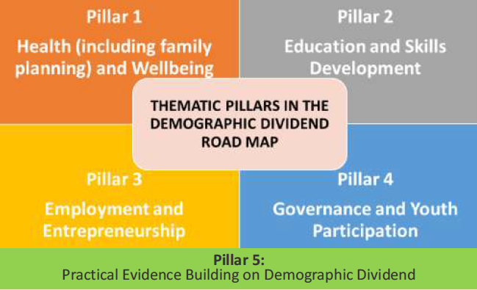
Thematic Pillars in the Nigerian Demographic Dividend Roadmap

Slide 11
Steps to preparing the demographic dividend reports
Sensitisation on importance of population dynamics for sustainable economic
A stakeholder analysis of the country’s current demographic considerations
Country modelling of the country’s potential to benefit from a DD
Policy analysis of Strategic Options
Drafting a document/report for national harnessing of a DD
Official pronouncement and validation of report

Slide 12
Key DD Stakeholders
Demograhic Dividend
Stakeholders
Government (Federal, State and Local)
Private Organisations
Traditonal and Community Leaders (Baales...)
Development Partners
Religious Leaders (Churches and Mosque Heads...)
Media (Print, Electronic and Social)
The Legislature, Executive and Judiciary
Ministries, Departments and Agencies
NGOs, CBOs and CSOs
Academia

Slide 13
Some Key Resources
Roadmap for harnessing the demographic Dividend - Training Manual (Available at: https://www.researchgate.net/publication/361422202_Roadmap_for_harnessing_the_demographic_Dividend_-_Training_Manual)
Using National Transfer Accounts Approach for estimating the Demographic Dividend and Preparing the Demographic Dividend Report - Training Manual (Available at : https://www.researchgate.net/publication/361422452_Using_National_Transfer_Accounts_Approach_for_estimating_the_Demographic_Dividend_and_Preparing_the_Demographic_Dividend_Report_-_Training_Manual
Demographic Dividend Monitoring Index for Nigeria (DDMI) (Available at : https://www.researchgate.net/publication/364182176_Demographic_Dividend_Monitoring_Index_for_Nigeria_DDMI)

Slide 14
Reading Materials
African Union Commission. AU Roadmap on Harnessing the Demographic Dividend through Investments in the Youth . Addis Ababa : African Union Commission , 2017. - Available at: https://library.au.int/au-roadmap-harnessing-demographic-dividend-through-investments-youth
Federal Government of Nigeria (2017) Roadmap on Harnessing Demographic Dividend through Investments in Youth in Nigeria. Abuja: National Population Commission
Harnessing Demographic Dividend for Sustainable Development of Nigeria (https://www.researchgate.net/publication/332523296_Harnessing_Demographic_Dividend_for_Sustainable_Development_of_Nigeria)
United Nations (2013). National Transfer Accounts Manual: Measuring and Analysing the Generational Economy. Population Division, Department of Economic and Social Affairs, United Nations, New York, USA.
UNFPA (2019) Programming the Demographic Dividend: From Theory to Experience; Regional Office for West and Central Africa, United Nations Population Fund, Dakar (unfpa-dividende-en-.pdf)

Slide 16
Stages for delivering the workshops
Pre-workshop and planning stage
Workshop and training delivery stage
Post-workshop and report writing stage

Slide 17
Roadmap for harnessing the demographic Dividend - Training Manual

Slide 18
Section A: Introduction and Background
This section provides the introductory note to the manual that seeks in Nigeria to guide the development of the Roadmap for Harnessing Demographic Dividend. It contains the background, purpose of the manual, target audience, training approach, required knowledge resources as well as the timeframe for preparing the roadmap.
Background
Purpose of the DD Roadmap Training Manual
Target Audience
Approach to Training
Knowledge Resources Required for the Training Workshop
  Reading Materials
  Video Materials
  Other Necessary Materials
Timeframe for preparing the Roadmap

Slide 19
Section B: Pre-Workshop Stage
Step 1: Engagement with Ministry of Planning and Budget (or lead MDA)
Step 2: Awareness/Enlightenment campaign across the necessary Ministries, Departments and Agencies)
Step 3: Requirements, Manpower/Personnel, Documentation
Step 4: Consultative Meeting and Roles Dissemination
Step 5: Preparing and Budgeting for the Roadmap
Step 6: Selection of the physical and virtual personnel of the DD Roadmap Training
  Criteria for Inclusion as DD team member
  Setting up the DD Roadmap Team
Step 7: Data Requirement and Overcoming Data Limitation

Slide 20
Section C: Workshop Stage
Module 1: Overview and Methodology for Measuring Demographic Dividend
  Video Presentation on the Concept of Demographic Dividend
  Concept and Importance of the Demographic Dividend
  Methodological Approaches for Estimating the DD including NTA, DemDiv etc.
Module 2: The African Union Agenda, SDGs and Overview of the AU Roadmap for Harnessing the Demographic Dividend
  The African Union Agenda 2063 and the SDGs
  Overview of AU Roadmap on Harnessing the Demographic Dividends for African Countries

Slide 21
Module 3: National and State Development Plans and Overview of the Nigerian Roadmap for Harnessing the Demographic Dividend
  The National / State Economic Development Plan
  Video Documentary on Demographic Dividend in Nigeria
  Overview of Nigeria Roadmap
Module 4: Demographic Profiles and Analysis of Status of Socio-economic Planning for State Development
  Demographic Features of the Country/State
  Identification of Key Demographic Indicators and Dynamics
  Status of Current Policies and Programmes Linking Demography to Development in the State

Slide 22
Module 5: Overview of Pillars Matrix
  Identification of the Pillars
  Guiding Steps for the Matrix Development
Module 6: Pillars Matrix Development
  Objectives and Investments Options for each Pillar
  Key Activities for each Pillar
  Performance and Monitoring Indicators
  Responsibilities and Timelines

Slide 23
Module 7: Implementation, Monitoring and Evaluation of the Roadmap
  Implementation Framework
  Monitoring and Evaluation Framework
Module 8: Finalization of the Roadmap
  Harmonization of Pillars Matrix
  Presentation of the Zero Draft
  Presentation of the Action Plan, Way Forward and Closing

Slide 24
Section D: Post Workshop Stage
Finalisation of the Report Submitted at the DD Roadmap Workshop
Validation of the Report
Editing and Publication of the Report

Slide 25
Thematic Pillars in the Nigerian Demographic Dividend Roadmap

Slide 26
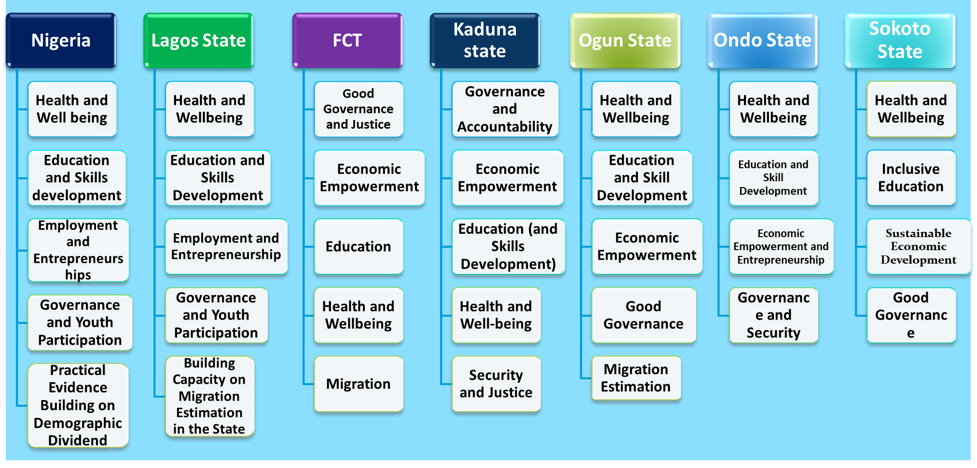
Pillars in various Roadmaps for Harnessing the Demographic Dividend

Slide 27
Using National Transfer Accounts Approach for estimating the Demographic Dividend and Preparing the Demographic Dividend Report - Training Manual

Slide 28
Stages of the Training Procedure
Pre-workshop Stage
Objective | Outcome
To thoroughly engage the appropriate Ministry responsible for Budgeting and Planning for the country, region or state. This engagement is important to consolidate on the roadmap through estimation of DD. Consultations are made with relevant stakeholders, including sensitization campaign and awareness creation for the Senior Staff and top government officials responsible for creating, executing and monitoring government programmes and activities. The modalities for the workshop and post workshop are also discussed, including location, funds, duration etc. | A successful pre-workshop engagement entails effective workshop logistics, support from government through the relevant ministries and agencies and effective mobilization of quality human, financial and material resources. Adequate provision of required computer software.

Slide 29
Stage 2 of the Training Procedure
Workshop Stage
Objective | Outcome
To have quality and engaging interaction between the facilitators (those knowledgeable about the DD estimation) and the Trainees (those knowledgeable about the situation of the nation, region or state) to harness their expertise in estimating DD. | A successful workshop activity ensure that the participants are able to estimate DD, write reports, write policy briefs and adequately info policy designs.

Slide 30
Stages of the Training Procedure
Post-workshop Stage
Objective | Outcome
To conduct a thorough review of the DD estimation report. To edit, print and disseminate the report to all key stakeholders. | A successful post-workshop activity will produce a final printed copy of the validated DD report, with duly assigned responsibilities and timelines with an appropriate monitoring and evaluation framework.

Slide 31
PRE-WORKSHOP STAGE
Stakeholders Engagement and Meeting
Human Resources and Data Requirement
Preparation of Logistics
Arrival
Hall Arrangement/Preparation
Preview Meeting of Facilitators

Slide 32
Module 1: Concepts and Overview of the Demographic Dividend and Estimation Fundamentals
Session 1: Introduction to Demographic Dividend (DD)
Concept and Importance of the Demographic Dividend
Video Presentation on the Concept of Demographic Dividend
The African Union and Nigerian Roadmap for Harnessing the Demographic Dividend for Youth Development
Session II: Methodological Approaches for estimating Demographic Dividend
Methodological Approaches for Estimating the Demographic Dividend Estimates
Comparative Analysis of the Demographic Dividend Estimates
Video Documentary on Demographic Dividend in Nigeria

Slide 33
Module 2: Concept and Overview of the National Transfer Accounts
The concept and theory of demography and generational Economy
The NTA Flow Identity, Economic lifecycle and Intergenerational transfers
Examples using the Nigerian NTA Estimates
Extensions to the NTA methodology
  Demographic dividend projections
  Wealth and Bequests
  National Time Transfer Accounts

Slide 34
Module 3: Introduction to Excel, Stata and R Statistical Software
Basic Fundamentals of Excel Worksheet for calculations and constructing figures
Basic Statistical Operations using Stata
Basic Statistical Operations using R software
Hands-on: Basic Fundamentals of using the Excel, STATA and R Software

Slide 35
Module 4: Getting Started with the Estimation
Materials
Building a micro‐level database
Basic methods for Estimation
Steps to follow in completing the accounts
  Hands-on: Familiarisation with demographic indicators as well as drawing graphs of population dynamics

Slide 36
Module 5: Situation Analysis of the Demographic, Socio-economic and Governance Context of the State
Population and Demography of the State (Population size, distribution and growth Including fertility, mortality and migration) in the state
Economic Structure, employment profiles and development of the State
Structure of Access, Quality and Financing of Health and Education in the State
Governance, rights and youth empowerment in the State
Hands-on: Using the Batch file mode (do-file) in STATA software

Slide 37
Module 6: Analysing the Household: Part 1. Public and Private Consumption
  Session I: Education
    Obtaining the profiles
    Adjusting and Smoothing
  Session II: Health
    Obtaining the profiles
    Adjusting and Smoothing
  Session III: Others Consumption Expenditures
    Obtaining the profiles
    Adjusting and Smoothing
  Hands on: Constructing the Per Capita Consumption Expenditure
  Adjusting and smoothing the estimates using the R software

Slide 38
Module 7: Analysing the Household: Part 2. Labour Income
  Session I: Wage and Earnings
  Session II: Self-employed Income
    Obtaining the profiles
    Adjusting and Smoothing
  Hands on: Constructing the Per capita Consumption Expenditure
  Adjusting and smoothing the estimates using the R software
Module 8: The Macroeconomy and Aggregate Control for the variables
  Relationship between NTA and SNA
  Calculating Macro-control for each of the Variables

Slide 39
Module 9: Economic Lifecycle Account
  Estimating the Age Profiles
  Finalising the Age Profiles
  Comparing, Summarising and applying both the aggregate and Per capita account profiles
Module 10: Economic Support Ratio and the Demographic Dividends
  Demographic Transition
  Dependency Ratio
  Support Ratio
  First and Second Demographic Dividend

Slide 40
Module 11: Preparation of the Demographic Dividend Report
  Group delineation for the purpose of report writing
  Brainstorming on the Outline of the report
  Sharing of roles on the report preparation
Module 12: Presentation and Harmonization of Group Report
  Group preparation of the State Transfer Accounts and Demographic Dividend reports according to agreed Chapters
  Presentation of the Revised Groups’ Reports
  Harmonisation of the Groups’ Reports

Slide 41
Module 13: Preparation of the Demographic Dividend Policy Brief
  Presentation: How to write a Policy Brief
  Harmonising the outlines of the Policy Briefs and the Reports
  Policy Briefs Writing
  Presentation of the Policy Briefs
SECTION C: POST-WORKSHOP STAGE
  Report Writing by Technical Team
  Submission of Draft Report
  Report Validation
  Submission and Publication of the Revised Report

Slide 42
The Demographic Dividend Observatory?
Institutional setup for...
  monitoring the thematic pillars of the national roadmap.
  provision of a performance matrix to identify areas of strengths and areas for rigorous policy attention.
  tracks the progress made towards creating and harnessing the Demographic Dividend.
  housing the Demographic Dividend dashboard

Slide 43
National Policy and Evaluation Systems
National Development Plans
National Monitoring and Evaluation Framework
Implementation Systems for DD
Population Monitoring and Evaluation Framework
DD Pillars and Dimensions
Sectoral, thematic and programme monitoring and evaluations

Slide 44
Proposition from the African Union Roadmap (P 28)
Establishing multisectoral observatories of the demographic dividend
37. Strengthen the capacity to coordinate, monitor and report on progress in implementing DD priorities (including strengthening national data systems to ensure timely and quality data for planning and decision-making).
This may include the establishment of a multisectoral DD observatory under the leadership of the National Statistics, Planning and/or Population Agencies, as appropriate.

Slide 45
Proposition from the Nigerian DD Roadmap (p19)
The National Demographic Dividend Observatory (NDDO) to be domiciled in the Office of the Vice President of the Federal Republic of Nigeria but supervised by relevant MDAs.
To achieve this, meeting of all stakeholders involved in producing activities that will lead to demographic dividend generation.
The stakeholders will brainstorm and develop both qualitative and quantitative signature indicators including targets and benchmarks to be monitored from the National Observatory.
A task force comprising the Office of the Senior Special Assistant to the President on Sustainable Development Goals (OSSAP-SDG), Ministry of Budget and National Planning, the Nigerian Population Commission with support from Development Partners will be established to manage the Observatory and advise the Office of the Vice President at regular intervals.
Feedback to implementing partners will be channelled through the office of the Vice President.

Slide 46
Concluding Thoughts
The two manuals are intended as a Train the Trainer manual for developing countries that are still within the first dividend window.
It explains how to compute the age profiles of the National Transfer Accounts flows and to estimate the demographic dividends for different countries.
It simplifies the training guidelines that will help academics and bureaucrats to construct NTA age profiles and to prepare a comprehensive report on their country’s Demographic Dividend.
It discusses ways through which the National Transfer Accounts can be mainstreamed into the national accounting and government systems.
It is our belief that other countries within the NTA network will find the manual useful for their training purposes. It should be especially valuable for training government officials

