Slide 1
National Time Transfer Accounts
Workshop
Part 1: Overview and orientation
Gretchen Donehower
University of California, Berkley
Tim Miller
United Nations DESA
14th Global Meeting of the NTA Network
University of Paris - Dauphine, February 16, 2023
Notes:
Good morning, thanks for invitation and attention
Introduce self
Introduce NTA, explain that counting women’s work came out of NTA, familiar to EWC persons because of Andy Mason and Sang Hyop Lee, two senior fellows at EWC
NTA is about economic lives by age,
Sex is another characteristic that shapes economic lives so the methodology was expanded to show age profiles by sex.

Slide 2
Objectives
To explain the motivation behind the development of the Counting Women’s Work project and National Time Transfer Accounts
To give a brief summary of the methods
To share what we have learned so far

Slide 3
NTA example
United States, per capita National Transfer Accounts age profiles
Production & Consumption
Lifecycle Deficit
(Consumption – Production)

Slide 4
NTA by sex
United States, per capita National Transfer Accounts age profiles
Production & Consumption
Lifecycle Deficit
(Consumption – Production)

Slide 5

What explains this pattern?
What is missing?
Why?

Slide 6
“The volume of services rendered by housewives and other members of the household toward the satisfaction of wants must be imposing indeed, when totaled for the 30 million families comprising the population of this country; and the item is thus large enough to affect materially any estimate of national income.
…
But the organization of these services render them an integral part of family life at large, rather than of the specifically business life of the nation. Such services are, therefore, quite removed from those which gainfully occupied groups undertake to perform in return for wages, salaries, or profits.
…
It was considered best to omit this large group of services from national income, especially since no reliable basis is available for estimating their value.”
- Simon Kuznets, quoted in “National Income, 1929-1932 : Letter from the Acting Secretary of Commerce Transmitting in Response to Senate Resolution No. 220 (72nd Cong.) a Report on National Income,” 1934.

Slide 7
Gendered economic measurement
 | Goods | Services
Sold in the marketplace | Included | Included
Produced and consumed in the household | Included | Not included
“Not included” is work most often done by women.

Slide 8

CWW: Measuring the gendered economy
Household production satellite accounting
+
NTA age-disaggregation and framework
=
Counting Women’s Work

Slide 9
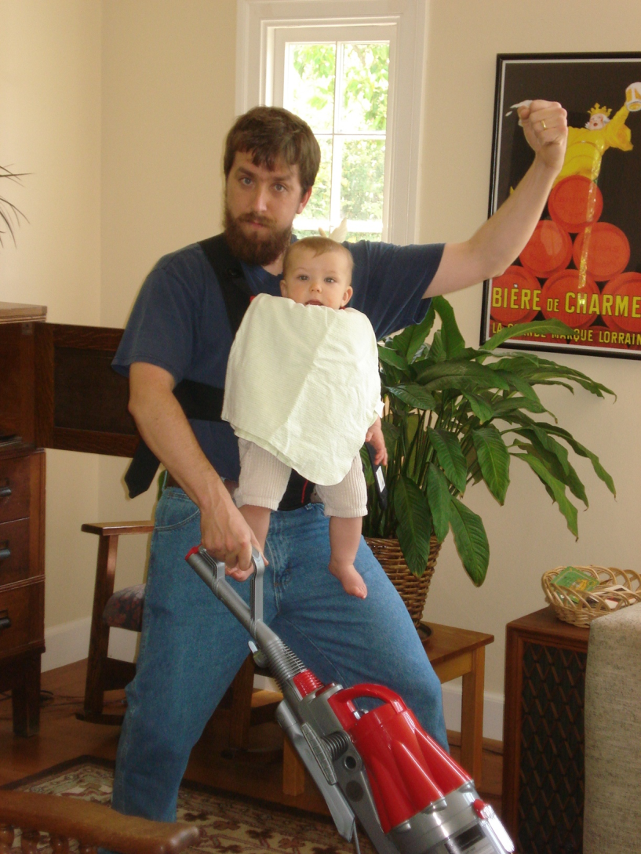
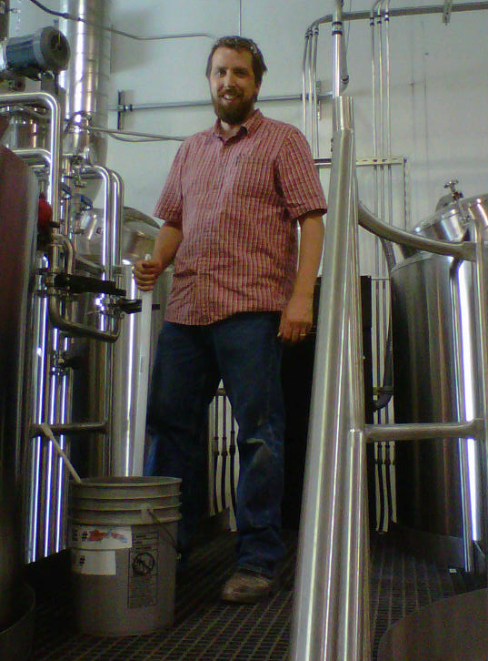
CWW’s Goal:
Value everyone’s work, measure everyone’s care
Producing market goods:
Producing non-market services:

Slide 10
What have we learned from CWW?
The size and importance of the care economy
  It is big
  Most of it is unpaid
  Most of the work is done by women
  Age patterns of care production differ from country to country
  Unpaid care work creates the future, it is the first building block of human capital
  Young children are care “expensive”, older people less so and many older persons are net care producers

Slide 11
It is big in terms of time
Distribution of total work hours
Source: Results from national time use surveys, compiled by Counting Women’s Work, www.countingwomenswork.org

Slide 12
It is big in terms of money

Slide 13
Most of it is unpaid
Paid care work – more credentialed (teachers, nurses, doctors, social workers)
Direct care economy by type
(distribution of aggregate hours of direct care):
Paid care work – less credentialed (home health aides, childcare workers)
Unpaid care work – direct care for adults, children, sick or disabled persons

Slide 14
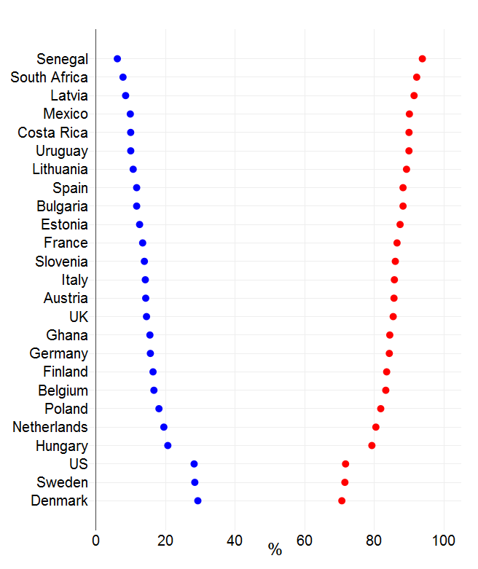
Most of it is done by women
Men
Share of men’s and women’s time in providing UCW:
Women

Slide 15
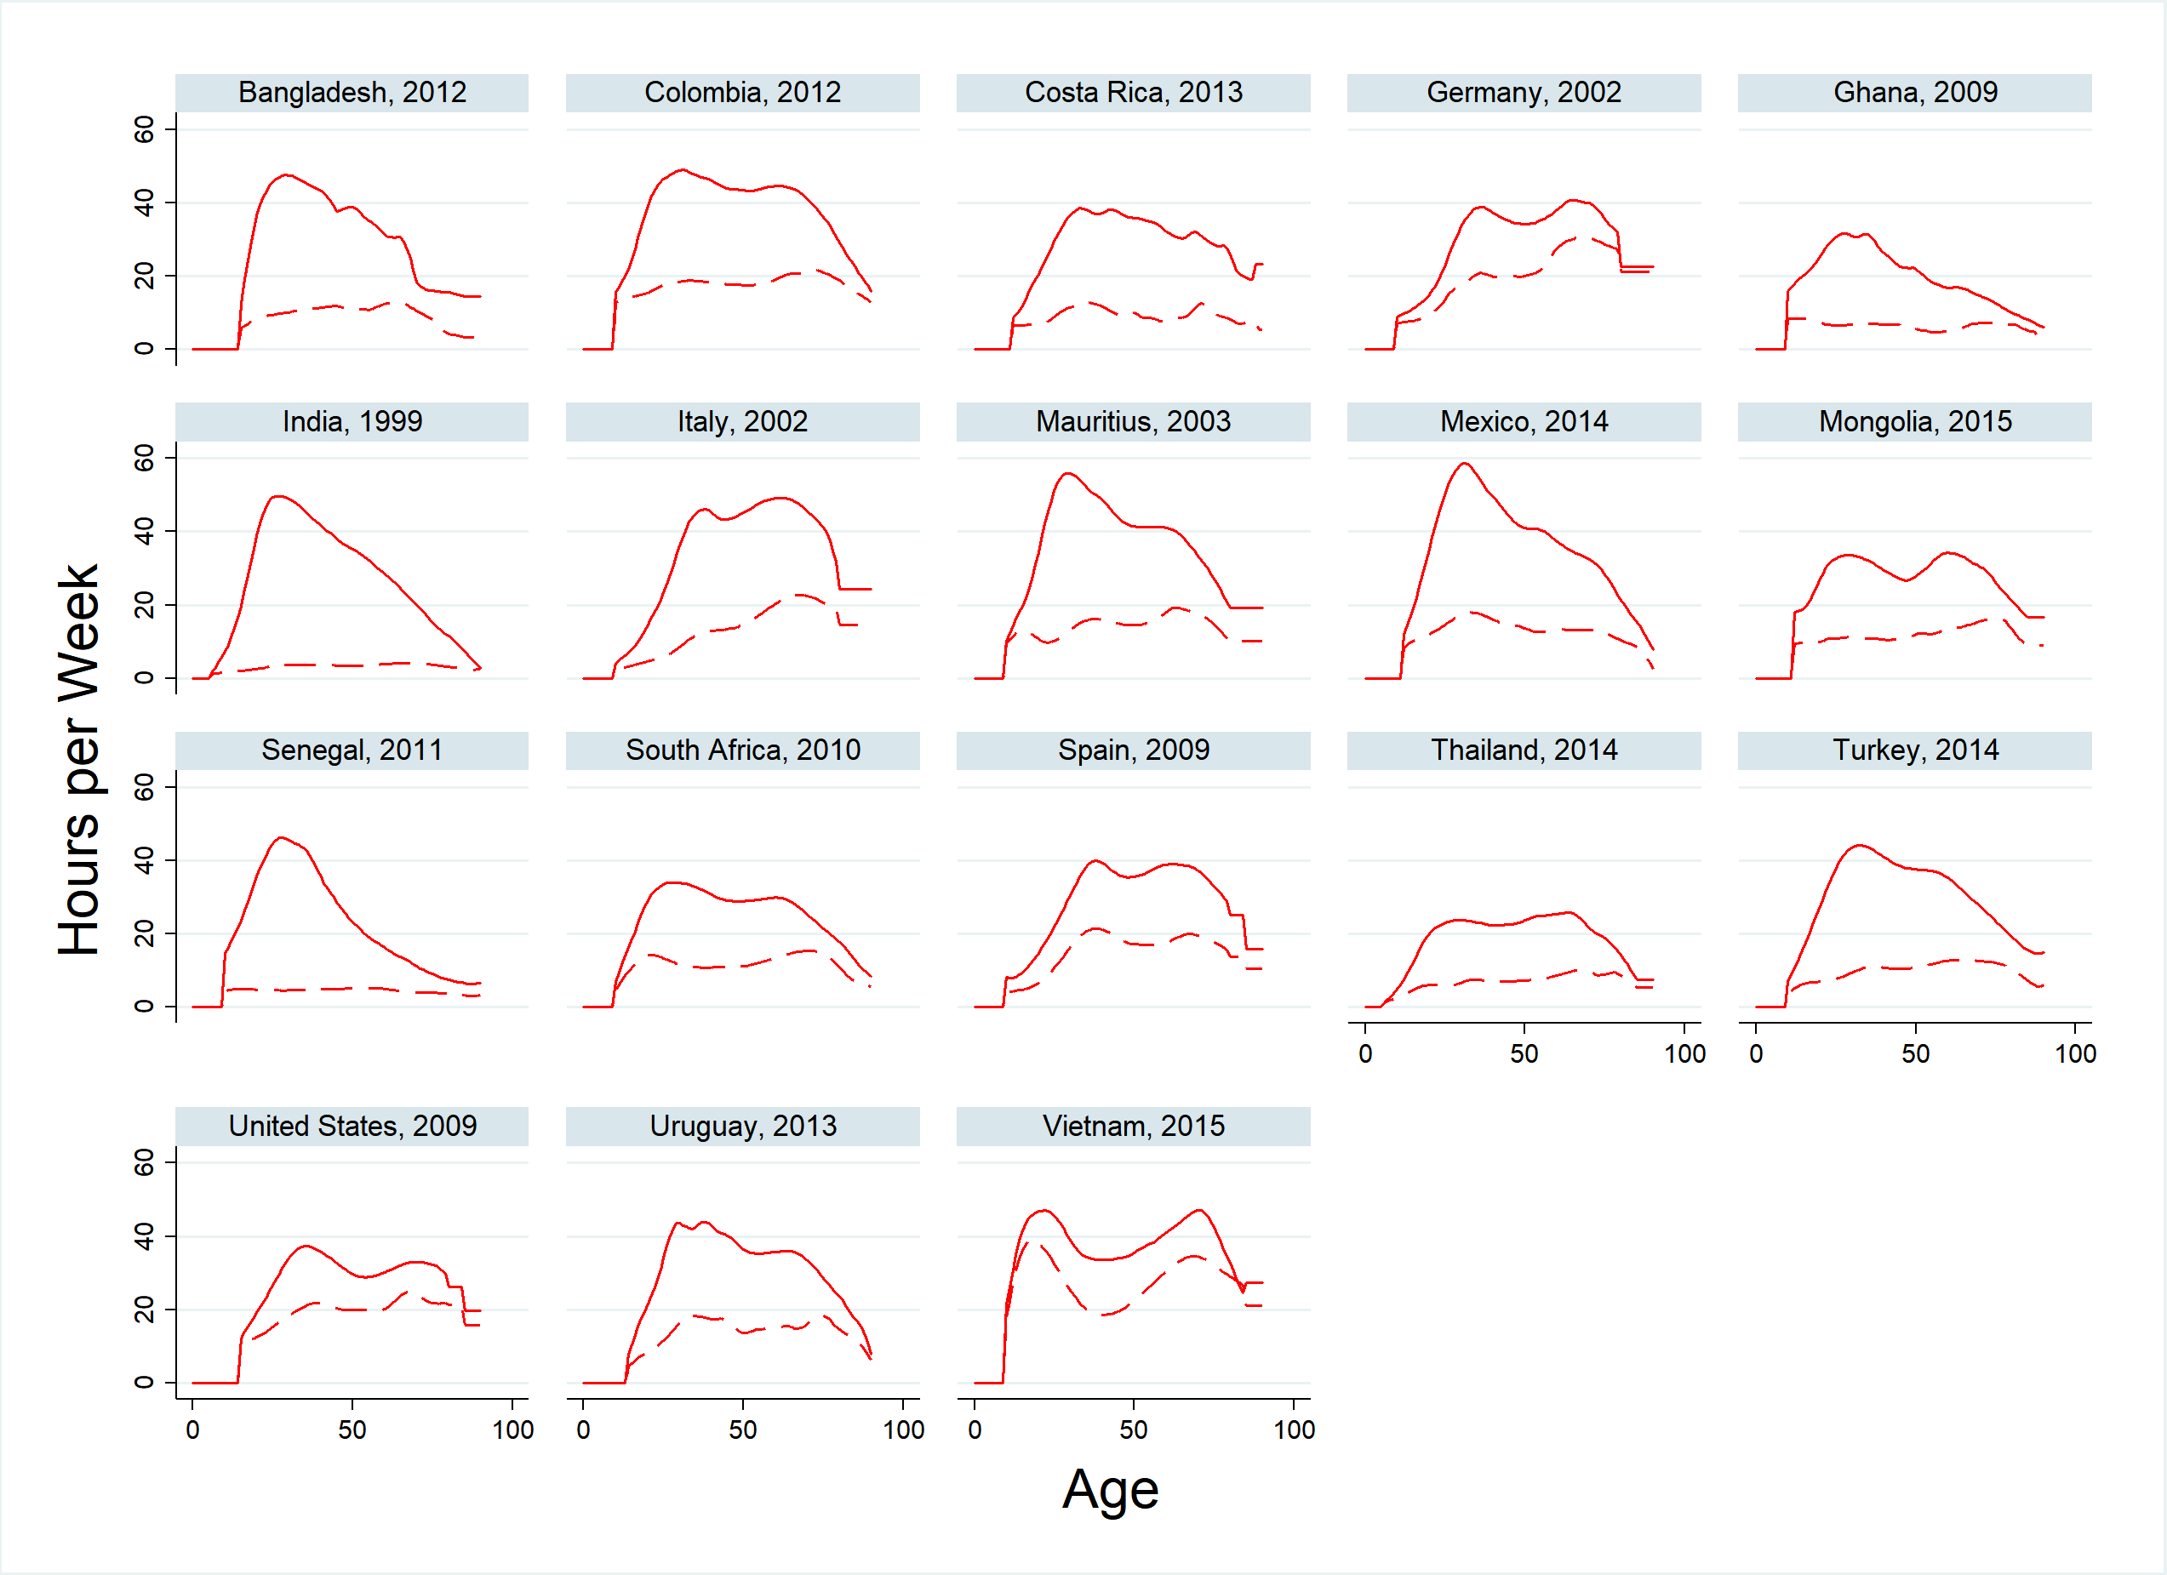
Variability in age patterns of care
Average unpaid care work, hours/week by age,
women (solid) and men (dashed)

Slide 16
Unpaid Care Work Creates Our Future
Data are monetary value of consumption during child’s first year, averaged over 17 countries participating in the Counting Women’s Work project. Unpaid care work valued at replacement cost of average childcare worker.
Notes:
For this chart, we look at consumption. For a child’s first year, 90% of what they consume is unpaid care.
And that’s even valuing the time spent in unpaid childcare at the very low wages generally earned by childcare workers or domestic help.

Slide 17
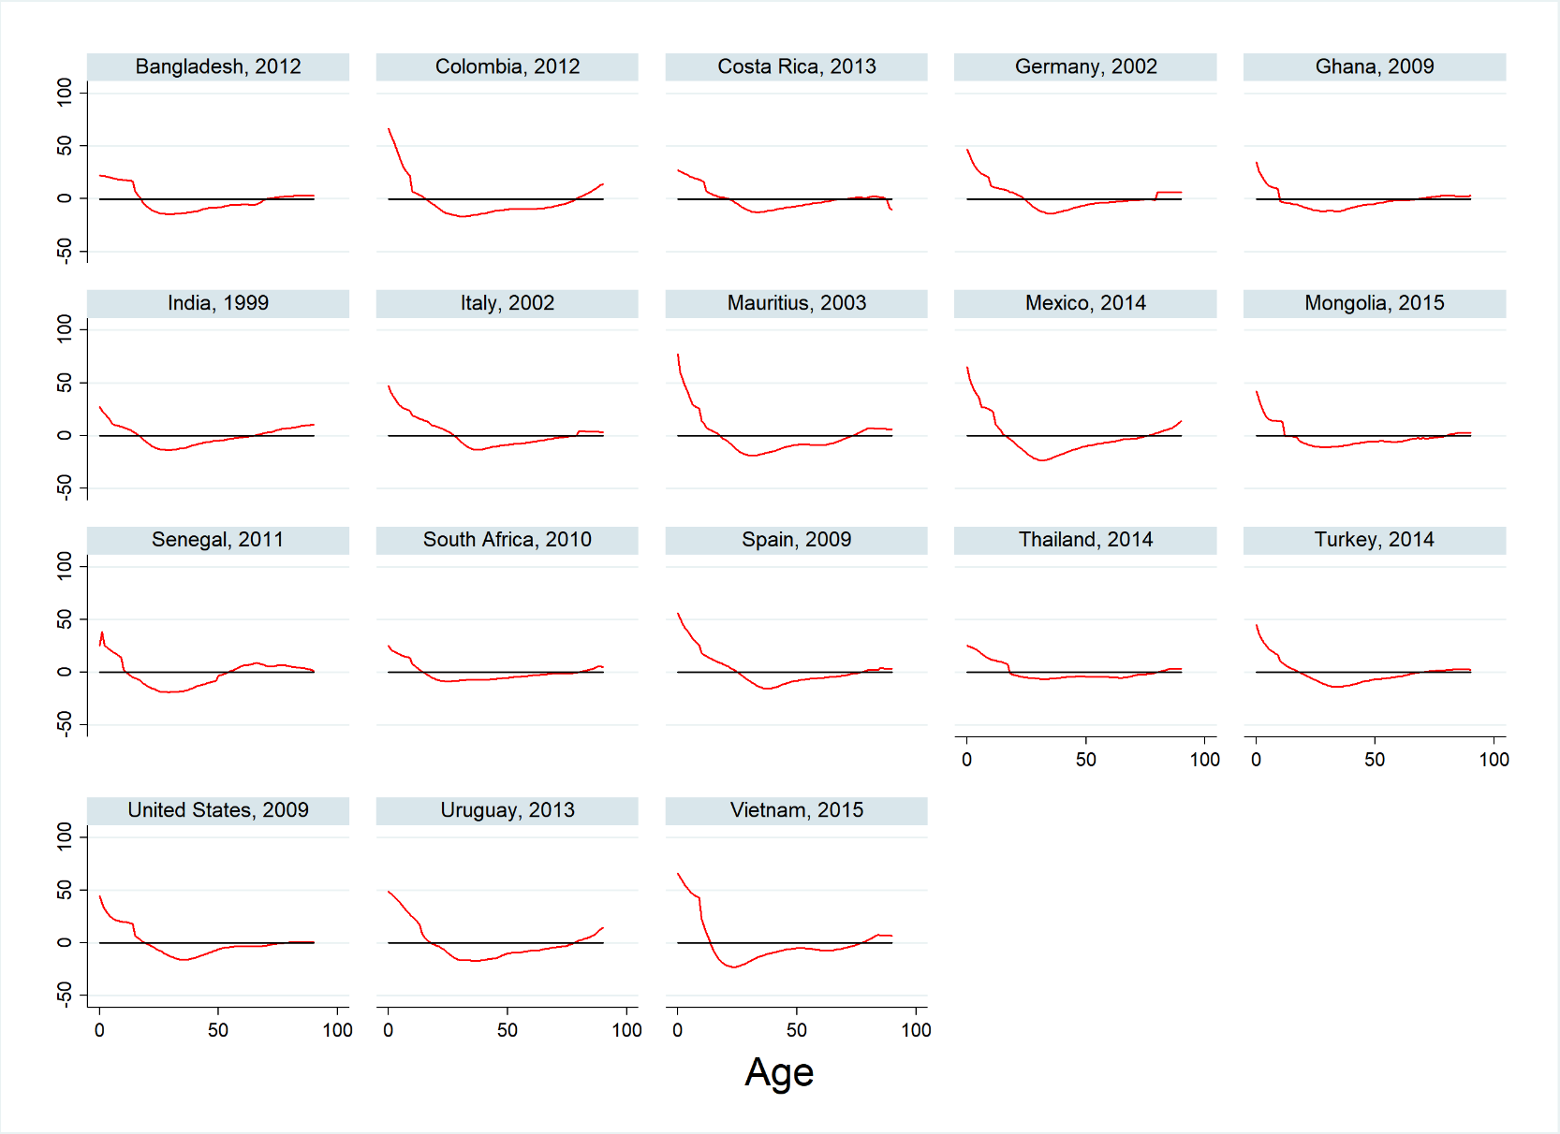
Who is care “expensive”?
Average hours/week in net UCW time consumed
(consumption less production)
Young children receive greatest net time transfers, many older persons make transfers until oldest ages
Notes:
What you see here is, for a group of 18 countries, the age specific consumption of unpaid care work in hours per week
For every country, infants are the biggest consumers of this work, there is just variability in the level.
There does not appear to be a large amount of care consumption by the elderly.
Indeed, many older persons are performing a great deal of unpaid care work themselves and are a vital resource

Slide 18
Why should we care about these empirical findings?
What do they mean for policy?

Slide 19

Unpaid Care Work and UN SDGs
5.4 Recognize and value unpaid care and domestic work through the provision of public services, infrastructure and social protection policies and the promotion of shared responsibility within the household and the family as nationally appropriate
Notes:
I’d like to focus now on two particular parts of the “Gender Equality” goal
Read them
These two are intimately linked. Understanding UCW, recognizing its value
I’m going to argue that doing this is the starting point toward giving women equal rights to economic resources

Slide 20
Implications of findings
and policy responses
Unpaid + feminized work = policy blindspots
  Example: we did not plan for pandemic impacts on the care economy; economic recovery slowed because care economy still impacted
  Example: potential under-investment in infrastructure
What to do?
  Support time use data collection, dissemination
  Support research on the care economy
  Embed care in policy documents, tools, plans

Slide 21
Implications of findings
and policy responses
Unpaid care work is a social good, not just a “burden” or “barrier” to WEE
  Relative size of inputs to young children stresses importance of care
  But want to share responsibilities more equitably so women are not disadvantaged
What to do?
  Subsidize unpaid care work
  Invest more in developing the paid care economy
  Structuring family policy to involve fathers more

Slide 22
The rest of the workshop
NTA by sex
NTTA by sex
  Production in Time Units
  NTTA: Consumption and Transfers in Time Units
  NTTA: Monetary Units

Slide 23
National Time Transfer Accounts
Workshop
Part 2: NTA by Sex
Gretchen Donehower
University of California, Berkley
Tim Miller
United Nations DESA
14th Global Meeting of the NTA Network
University of Paris - Dauphine, February 16, 2023
Notes:
Good morning, thanks for invitation and attention
Introduce self
Introduce NTA, explain that counting women’s work came out of NTA, familiar to EWC persons because of Andy Mason and Sang Hyop Lee, two senior fellows at EWC
NTA is about economic lives by age,
Sex is another characteristic that shapes economic lives so the methodology was expanded to show age profiles by sex.

Slide 24
Outline
Single-sex NTA review
How to split single-sex NTA into two profiles by gender
Adjustment for consistency with single-sex NTA

Slide 25
NTA Estimation Steps
Estimate single-sex NTA
Estimate separate M/F age profiles
  Follow basic NTA methodology again, with additional category
  For regression-based imputation, add sex to independent variables in regression equations
Adjust M/F profiles to macro controls by making them consistent with single-sex NTA
Sensitivity tests based on different methodology
  Change EAC weight allocations to regression
  Adjust assumption about headship

Slide 26
Data for NTA by Sex
National account data (for computing macro controls)
  Only computed for total population (no controls by sex)
Household survey
  Nationally representative
  Includes income and consumption (although some countries use different surveys for different profiles)
  Has household roster by age and sex (and other categories of interest)
Administrative or other supplementary age shape data (for flows not measured in surveys)
Population Data
  By age and sex

Slide 27
Review single-sex estimation strategy
In single sex NTA, we use different estimation strategies depending on data source, level of availability, and type of age profile:
  Data source: household surveys
    For individual-level data, compute age means directly
    For household-level data, allocate to household members
      Use “equivalent adult consumer” (EAC) weights for non-health, non-education private consumption
      Use regression method or iterative method for education and health care if utilization measures are available
      Allocate total amount to household head if assets are involved or for interhousehold transfers
  Data source: administrative data (government reports)
    Take age-means from government sources
  Profiles based on imputation/assumption

Slide 28
How to add sex as another category?
Data source: household surveys
  For individual-level data, compute age and sex means directly
  For household-level data, allocate to household members
    Use “equivalent adult consumer” (EAC) weights for non-health, non-education private consumption, using the same weights for males and females of the same age
    Use regression method or iterative method for education and health care if utilization measures are available, adding sex to the independent variables in the regression equations
    Allocate total amount to household head if assets are involved or for interhousehold transfers, treating male and female heads the same
Data source: administrative data (government reports)
  Take age- and sex-means from government sources
  Profiles based on imputation/assumption (use same imputation/assumption for both sexes)

Slide 29
Sex in Regression Allocation
“Kitchen sink” approach
  Where single-sex regression has a term for each age group, make a term for each age group for males and for females separately
  We are not concerned with statistical significance so okay to have terms in a regression equation that don’t add much fit
Alternative: using goodness of fit tests to get the most parsimonious model may be better for some research questions

Slide 30
Adjustment for consistency with single-sex NTA
Single-sex NTA is our best estimate
  Keeping sexes together means larger sample size
  Single-sex NTA profiles are adjusted to macro controls
Want gender-specific profiles to be consistent with single-sex
Adjust each age of gender-specific profiles for consistency
  Adjustment is different at each age, but the same for both sexes within an age group
  Adjust smoothed profiles to be consistent with smoothed profiles; unsmoothed with unsmoothed

Slide 31
Calculating adjustment factors
N(a): Population age a
N(a,g): Population, age a, sex g
: Single-sex profile, adjusted to control
x(a,g): Sex-specific profile
Age-Specific Adjustment Factors:
Adjusted Profiles :

Slide 32
Final notes on adjustment
Adjusting this way makes the gender profiles consistent with single sex profiles and macro controls in one step
Save the schedule of adjustment factors and plot them for review
  Adjustment factors should be similar size to the control adjustment factor for single-sex NTA
  If gender adjustment factors are very different, there may be a mistake in the calculations
  If factors have an age pattern, there may be a problem with the data not measuring the concept well

Slide 33
Sensitivity Tests
Change allocation of general consumption from EAC weights to regression
  Same EAC weights by gender may be bad assumption
  Run alternative estimates with regression-based estimates
  Best practice: estimate separate regression equations for different types of consumption, but this is very data intensive and time consuming
  Captures correlation between household composition by gender and consumption patterns, but still leaves a lot out
Change assumption about headship
  Does not affect consumption or labor income profiles, but for transfers and asset-based reallocations there is a big impact
  As much as possible, want to assign headship in the same way that legal control of assets is designated

Slide 34
Once you have profiles, what then?
For labor income, examine what determines the different levels to specify policy implications
  Labor force participation
  Full time vs. part time status
  Hours worked per week
  Occupational specialization
  Educational distribution
  Different wages for same work
For consumption, examine by sub-category to see which policies might be appropriate
Childcare and household responsibilities related to patterns of market labor?

Slide 35
Once you have profiles, what then?
For transfers, are there particular government programs or family transfer patterns that show gender disparities?
For all, could examine by type of household
  by SES
  by household type
  by region, etc.
Present an analysis of the potential for a “gender dividend”
  What would happen to the support ratio if women’s YL converged to that of men?
  BUT, then what would happen to the household production women were responsible for?
  More on this in the “applications” section

Slide 36
National Time Transfer Accounts
Workshop
Part 3: NTTA
Gretchen Donehower
University of California, Berkley
Tim Miller
United Nations DESA
14th Global Meeting of the NTA Network
University of Paris - Dauphine, February 16, 2023
Notes:
Good morning, thanks for invitation and attention
Introduce self
Introduce NTA, explain that counting women’s work came out of NTA, familiar to EWC persons because of Andy Mason and Sang Hyop Lee, two senior fellows at EWC
NTA is about economic lives by age,
Sex is another characteristic that shapes economic lives so the methodology was expanded to show age profiles by sex.

Slide 37
Outline
NTTA Production, in time units
NTTA Consumption, in time units
NTTA Transfers, in time units
NTTA in monetary units

Slide 38
NTTA
PRODUCTION
(time units)

Slide 39
Production Estimation Strategy
Learn your time use survey, data cleaning
Identify activity groups included in NTTA
Turn time use data into time spent in each activity group per time use respondent
Take age/sex means
Smooth and adjust at the aggregate level so that total consumption equals total production
  This can be a big adjustment if time use survey does not include all potential unpaid care work producers in a household

Slide 40
Know your time use survey
How is the data structured?
How are activities coded?
Whose time use data do you have in the household?
Do you need to merge different types of files (like activity files linked to demographic information files by a person ID number)
Are there sample weights? What are they adjusting for?
When were the surveys done? (Want to know what time of year because of seasonality)

Slide 41
Time use survey data cleaning
The usual data cleaning activities
  Variables are as described in the codebook?
  Duplicate observations?
  Unrealistic outliers?
  Invalid codes?
  Codes for missing data changed to missing or zeros as appropriate?

Slide 42
Time use survey data cleaning
Time-based diagnostics and checks on your use of the data
  Does total time sum to 24 hrs/day or all persons? (Or if you don’t have all activities accounted for, is sum of accounted activities reasonable?)
  If not, is error correlated with age and/or sex?
  Do you observe time patterns as expected
    more market work done on typical workdays
    childcare marked as an activity in households with very young children
    sleep is a reasonable amount on average by age

Slide 43
What to do if there are problems?
Total time not equal to 24 hours?
  Proportional adjustment for each individual if errors are not too large and your survey accounts for all possible activities
    Can delete some observations with far more than 24 hours accounted for, and adjust the rest
  OR look for specific outliers by individual or by type and see if problem can be isolated (eg observations from one province have large errors but others are fine)

Slide 44
Which activities are in NTTA?
Find time use survey’s coding scheme for activities, or list of activities with time variables in your survey
Identify NTTA productive activities in coding scheme
  Not already included in national accounts
    So market production is NOT included
    Unpaid family labor that generates market income is not included, even if the person who did the work did not get paid
    Collecting water/wood/fuel is often included even though it is conceptually already in national accounts
  Satisfies third party criterion
    You could pay someone else to do it for you
    Leisure, education, and many self-care activities do NOT satisfy this criterion
Group NTTA productive activities into categories, data permitting
  11 categories (plus gathering water/wood) in “manual” but you may have more or less depending on your time use data

Slide 45
Which activities are NOT in NTTA?
Ones whose value is already in national accounts and NTA
  Consumption of goods produced by household for own use are imputed in national accounts consumption measures
    (gathering wood/water is an exception in countries where in practice it is not included in national accounts)
  Returns to labor to produce these household-consumed and produced goods are imputed in mixed income

Slide 46
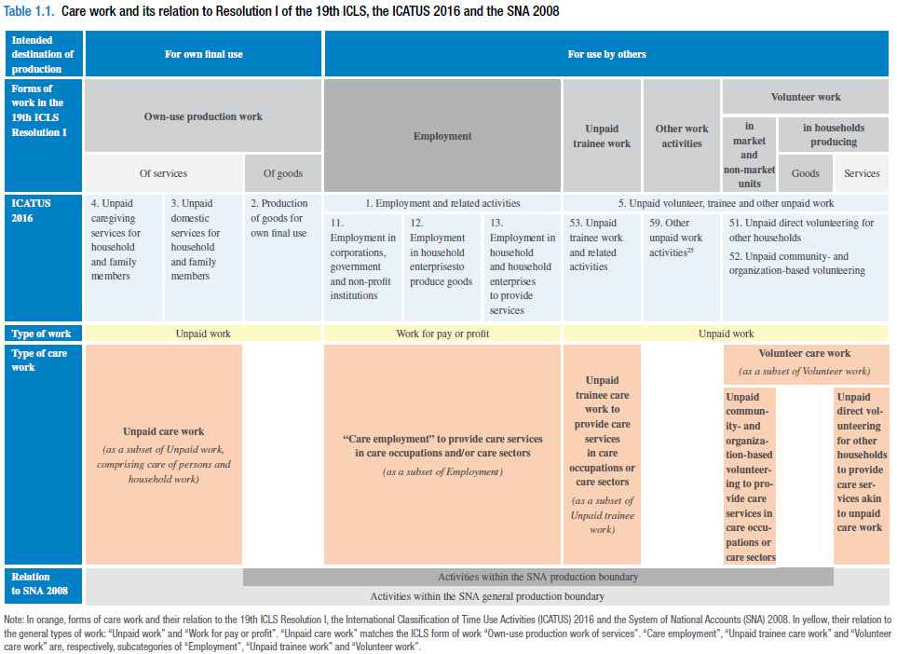
Care work and care jobs for the future of decent work / International Labour Office – Geneva: ILO, 2018.

Slide 47
Groups of NTTA Activities
Cleaning
Laundry (includes sewing and clothing repair)
Cooking (food and drink preparation)
Household maintenance and repair
Lawn and garden care
Household management (incl. finances, scheduling, coordinating, and related telephone calls)
Pet care (not veterinary care)
Purchasing goods and services
Childcare **
Eldercare and care outside the home (includes volunteering) **
Travel (related to care activities and purchasing goods and services)
(Fetching wood or water: included in NTTA if it is NOT imputed into national accounts in your country, even though conceptually it is goods produced for own use)
** Needs to be divided into variables for care in household versus outside household

Slide 48
Time use survey file preparation
Need to create a file with one observation per household member and variables for time average daily time spent in each household production activity
  Includes all household members, with unique household id for each household
  Time respondents will have time values in those variables, non-respondents will have missing data code (“.” in Stata)
  Non-time respondents are not necessary for production but are for consumption

Slide 49
File prep for diary surveys
Given time diary file and household roster file:

Slide 51
File prep for activity questions

Slide 52
Unsmoothed Age Means
Collapse file by age/sex, using survey weights, keeping number of observations:
gen obs=1
collapse (mean) cook clean chcare… (rawsum)
obs [w=wgt], by(age sex)
(need “obs” for smoothing routine)
Keep care categories separated by location (in household vs. outside household) if possible, for use in consumption calculation
Use survey weights

Slide 53
Smoothing
Strategy
  Examine smoothed profiles by looking at each one
  Adjust spans so as not to “smooth over” a real pattern
    care variables will often need smaller spans than other household activities or need to be smoothed in sections
Method
  See NTA Manual
  Current prefered method: Friedman’s super smoother
    Available in R as “supsmu”, available in Stata as an add-on “ado” file.
  Alternative: Stata’s “lpoly”
    Discussed in manual because at that time no Friedman’s smoother available in Stata

Slide 54
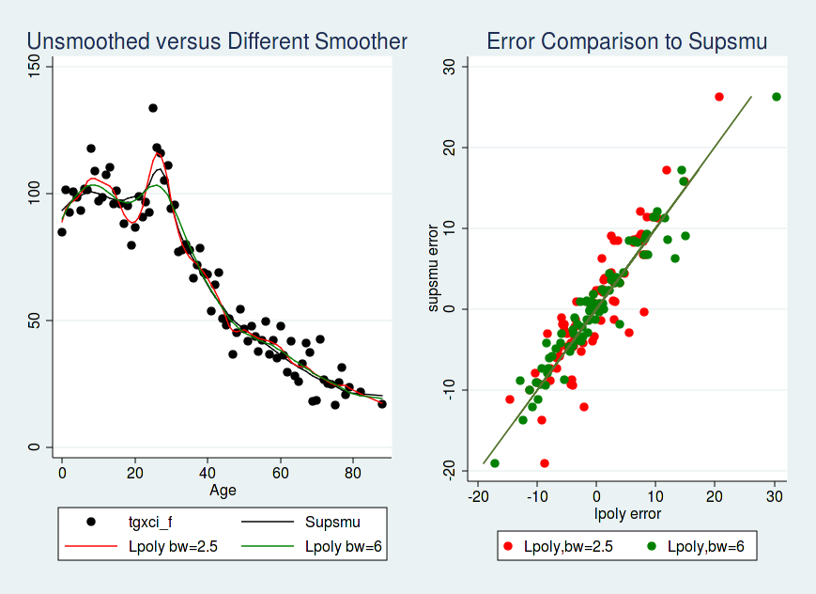
Comparing Smoothers
Example (welfare payments to families with young children):

Slide 55
Sensitivity Tests
Change methodology to evaluate how different results would be if you made different assumptions
Most important one for production account in time units is including secondary activities
  Preserve 24 hours in a day (i.e. no multitasking miracle)
  Divide the time unit in half between the two activities

Slide 56
Understanding the results
Can further cross-cutting reveal how overall patterns emerge?
  Regional variation
  SES
  Different household structures
  If you have more than one time use survey, are patterns stable over repeated cross-sections?
Examine time use and gender differences across different countries

Slide 57
NTTA
CONSUMPION
(time units)

Slide 58
Consumption Estimation Strategy
Impute consumption to individuals in households
Take age/sex means as you did for producers
Smooth and adjust at the aggregate level so that total consumption equals total production
  Why? Surveys are designed to get representative producer, not consumer
  This can be a big adjustment if time use survey does not include all potential unpaid care work producers in a household

Slide 59
Consumption Imputation Assumptions
For care activities
  If care is for household members, implement regression method using household members in target age range
    Example: for care of household children aged 0-18, estimate regression equation using number by age and sex for household members age 0-18
  If care is for non-household members:
    If age-targeted (children, elders), distribute proportionally to household members in that age group.
    If not age targeted (general volunteering) divide time equally across total population

Slide 60
Consumption Imputation Assumptions
Care allocation ALTERNATIVES
  For household childcare: instead of regression, calculate time spent on children by age and sex for households with only one child; use those as weights
  For non-household childcare or eldercare: per capita in child or elder age range
  If you only have a general “care” variables instead of child/elder care separately
    Leave producer ages out of the regression
    If care is for sick/disabled but you have no indicator of sick/disabled in the household, can use external measures of disability by age/sex
    Other?

Slide 61
Consumption Imputation Assumptions
For general household activities
  Divide equally among all household members
  Easy!

Slide 62
Finalizing profiles
Smooth and adjust smoothed and unsmoothed means so that consumption equals production
Why do we need to adjust?
  Smoothing throws off the balance slightly
  Differential sampling can throw off the balance A LOT

Slide 63
Simplified Spreadsheet Examples
Available on the wiki
  www.ntacounts.org
    Projects > Working Groups > Gender, time use
  Versions for simplified and complex methods

Slide 64
Simplified examples
Two age groups, children (1) and adults (2)
Two groups of NTTA activities, “hha” is general household activities, “care” is care for children
One sex
Two cases
  Simple case of one time use respondent per housheold
  More complex case of multiple time use respondents per household

Slide 65
Each household has only one time respondent:

Slide 66
Households A and E have more than one time respondent:

Slide 67
Sensitivity tests
Change consumption allocation to estimate differences between males and females
  In contexts with heavy “son preference,” equal allocations between males and females may be a bad assumption
  Regression-based allocation to get a data-driven estimate (will only partially address the issue, but it’s a start)
  Do some sensitivity tests
    One child method, but may miss discrimination that is only applied when time is scarce, so could look at difference by type of household structure (by age and sex distribution of children)
    Trying an allocation of childcare or other activities to girls of x% of boys

Slide 68
NTTA
TRANSFERS
(time units)

Slide 69
NTTA Transfers Defined
Transfer outflows are the time produced but not consumed by the producer
  All care time produced is a transfer outflow
  General household activity time produced MINUS that portion consumed by the producer is a transfer outflow
Transfer inflows are the time consumed but not produced by the consumer
  All care time consumed is a transfer inflow
  General household activity time consumed MINUS that portion produced by the consumer is a transfer outflow
Code examples to do this are available on the NTA wiki
  http://www.ntaccounts.org/web/nta/show/Gender%2c%20Time%20use

Slide 70
NTTA
(monetary units)

Slide 71
Understanding your wage data
What type of wage data is available?
What is the coding scheme for different jobs or occupations?
Is the data pre-tax or post-tax?
Do the wages include fringe benefits or employer-paid taxes?

Slide 72
Methods for Imputing Wages
Different methods for different types of research questions
  Replacement method: what would you have to pay to buy the service in the market?
    Can replace with generalist or specialist wages
  Opportunity cost method: what could you earn with your time in the market if you worked for pay instead of doing the household activity?
  Cost of output method: values time by the cost of the service produced in that time, not just the cost of the labor
NTTA uses specialist replacement
  Although in some countries, generalist may be more appropriate

Slide 73
Why use specialist replacement?
NTA is mostly concerned with accounting type questions, not behavioral models or individual incentives
Opportunity cost analyses sometimes come up with values of household production that are so large that no one pays attention
  Reveals the limitations of the behavioral model and measurement issues with opportunity cost method
Output method is very challenging to implement consistently across our many NTA countries

Slide 74
Which wages to use?
Country teams must decide what is appropriate in their context
Wage data may need to be transformed to reflect a flow per consistent unit time
Can use single occupation or average of different occupations
  Use employment-weighted averages to reflect the distribution of occupation types in the market

Slide 75
Other aspects of wages
Want pre-tax wages, so gross wages paid to employee, plus employer-paid taxes
Potential change down the road: Add an age-productivity adjustment, but have not settled on one method yet
Adjustments we used to make that we have dropped:
  Quality adjustment factors for some activities
  Inclusion of imputed fringe benefits in wages

Slide 76
Sensitivity Tests
Change methodology to evaluate how different results would be if you made different assumptions
Changing wage imputation
  Specialist to generalist
  Mean to median?

