Slide 1
The Direction of Intergenerational Transfers and Demographic Transition:
Findings from Lee & Mason
Robert J. Willis
University of Michigan

Slide 2
From Willis Blurb for Lee & Mason

Slide 3
Goals of my talk
Present major finding of NTA project on the relationship between direction of intergenerational transfers, fertility and economic development
Explain how this finding is connected with Samuelson’s overlapping generations model using realistic demography
Discuss a few implications

Slide 4
The Caldwell Hypothesis
Caldwell (1976) persuaded many that the transition from high to low fertility was accompanied (or even caused) by a change in the direction of intergenerational transfers.
  In primitive societies, the older generation is motivated to have many children by the prospect of receiving support in old age
  Modernization and economic development undermine the incentives of children to support the elderly
  With the “props” for high fertility removed, fertility declines with social and economic development

Slide 5
Lee & Mason’s Findings from NTA
Their data show the exact opposite of the Caldwell hypothesis
  In all societies, except for the most advanced ones, the direction of intergenerational transfers is downward, from the older to the younger generation
  In the next slide, this is shown in a diagram format invented by Lee & Mason using “Big Arrows”
  I then show how L&M derive these arrows

Slide 6
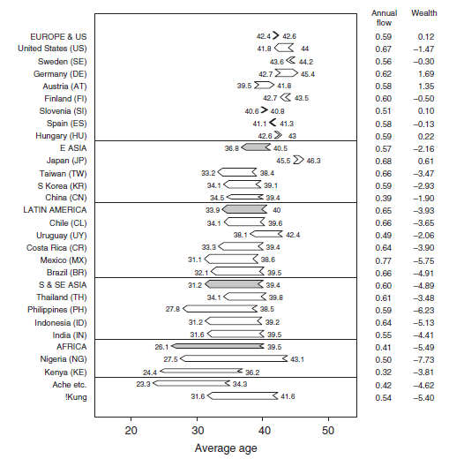
Direction of Intergenerational Transfers
(point left = upward, point left=downward)
Upward transfers in
Europe (but not US)
Arrows point to right
Downward transfers in
rest of world (except Japan),
especially in lowest income
countries
Arrows point to left

Slide 7
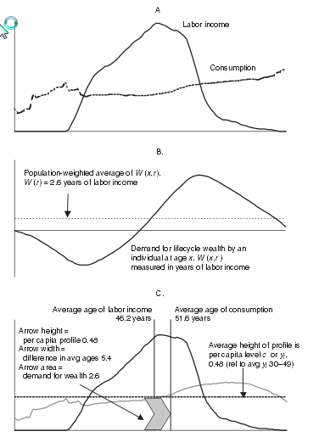
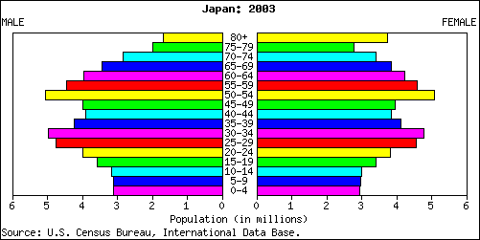
Derivation of the Big Arrows
(The Case of Japan, shown in Fig. 2-1 of L&M)
consumption
includes education
and health
expenditure
Aggregate Consumption=
Aggregate Labor Earnings
Children and elderly have
virtually no earnings
All production from middle age
group of workers
Aggregates = Sum of age-specific values
of c and y weighted by fraction of
of people at each age
Equation holds with 2003 age distribution
age

Slide 8
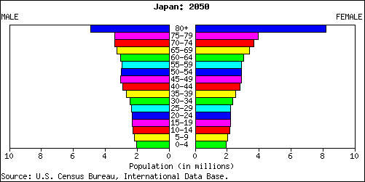
Life Cycle Income, Consumption, Wealth and the Direction of Intergenerational Transfers
(The Case of Japan)
Aggregate Consumption=
Aggregate Labor Earnings
Equation will not hold with 2050
age distribution
Consumption profile must be
lowered at some or all ages to
satisfy aggregate budget constraint
age

Slide 9
Derivation of “Big Arrows”
Imagine Japan with no families and no government, ONLY BANKS!!!
(i.e., Samuelson’s Consumption-Loan Economy)
Newborns take
loans from bank
to finance
consumption flow
Aggregate Credit Balance
= c(Ac-Ay)
Ac>Ay in figure
c = per capita consumption
Ac= avg. age of consuming
Ay= avg. age of producing
When enter labor market,
individual has accumulated
debt equal to cost of
childhood consumption
Aggregate Credit Balance
credit of old
greater than
borrowing of young
Surplus could be used to
finance investment in
physical capital
Workers pay off debt and
begin saving for retirement
Arrow measures Aggregate
Credit Balance & Direction of
Transfers
length = Ac-Ay
width = c
area = total transfer
point right = upward
point left = downward
Retirees finance
consumption by drawing
down wealth
age

Slide 10
When Ac>AY, net transfers are from young to old, arrows point to right, and the economy is inefficient
Possible to reallocate resources so as to increase the welfare of some members of current and future generations without harming others. E.g.,
  Increase rate of population growth, causing younger age distribution
  Increase investment in human capital of young
  Increase investment in physical capital

Slide 11
When Ac<AY, net transfers are from old to young, arrows point to left, and the economy is efficient in sense of Pareto optimality
Reallocation of resources of resources involves trade-offs in which members of some generations gain at the expense of members of other generations. E.g.,
  Number of Children vs Investment in Human Capital
  Retirement income vs investment in children

Slide 12
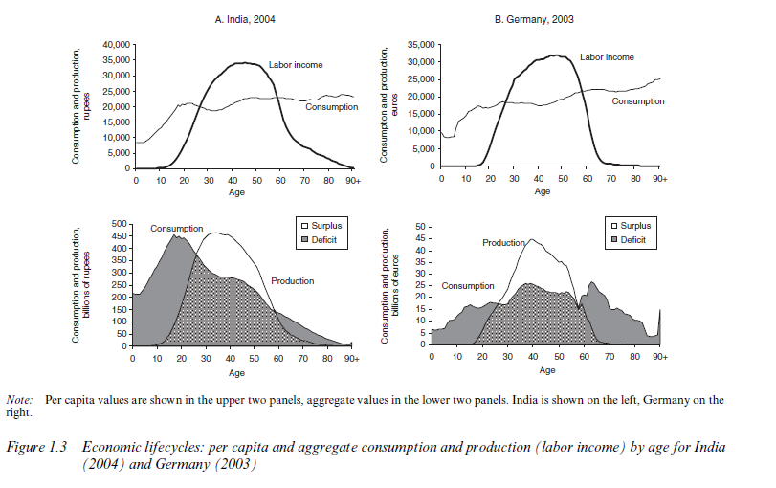
Comparison of India (Ac<Ay) and Germany (Ac>Ay)
India cannot raise consumption
profile without fertility decline
Germany could increase consumption
at each age with increase in fertility
Individual
life cycles
Aggregate
spending by
age
(note: c and y normalized by dividing each by per capita income)
Note that c and y are normalized by dividing by per capita income
In each country

Slide 13
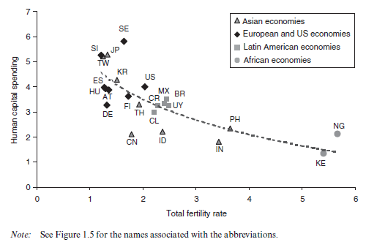
Trade-off between quality and quantity of children
Human
Capital
Spending
Total Fertility
Rate

Slide 14
Family & State
The same logic can be applied to upward and downward transfers through the family and the state
The net direction of transfers depends on the difference between the mean ages of those who give and receive transfers

Slide 15
The Family-1
Parents pay cost of children & also pay for own retirement
Person enters labor force with
zero assets instead of debt
First task is pay costs of rearing
own children
Only begins saving for retirement
after (most) children’s costs have
been paid
Life cycle wealth now follows
The dark blue path.
Because downward transfers
within families reduce borrowing by
the young, the supply of lending
(area under blue curve) is increased.
Thus, more investment in
physical capital could take place

Slide 16
The Family-2
Children may also provide old age support for parents
(Avg age of transfers given< Avg. age of transfers received)
Upward transfers within families
reduce retirement saving by working age
people and the supply of lending (area
under blue curve) is decreased.
Thus, as an accounting identity,
increases old age transfers from children
cause decrease a decrease investment in
physical capital, holding life cycle
consumption and income constant
Likewise, increases in parental transfers
to children increase aggregate savings
and, therefore, increase investment

Slide 17
The State
Tax workers in order to transfer downward to finance education & upward to finance retirees
Difference in Avg age of taxpayers
Average age of transfer recipients
determines effect of transfers on
supply of saving, hold lifecycle
consumption and labor earnings
Constant
A shift of a dollar of transfers
from retirees to childhood education
increases saving; the opposite shift
reduces savings

Slide 18
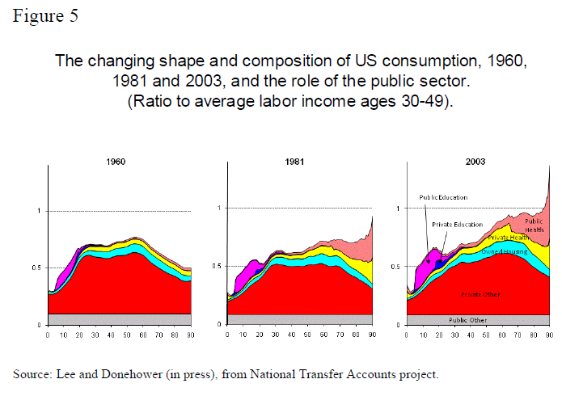
Growth in Public Sector Intergenerational
Transfers from Young to Old in Advanced Countries

Slide 19
Conclusion
Growth of public transfers from young to old in advanced countries reduces resources for investment in human and physical capital
Role of political economy
  age distribution of voters shifting in favor of elderly at the same time they are becoming more expensive to support
“Reproductive Shirking” (Willis, 1980)
  Upward transfers through public sector creates wedge between private and social benefits of child bearing
Lee & Mason have given us a marvelous analytic framework and body of comparative data that will help us understand how to cope with the implications of demographic and economic change

